Slide 1
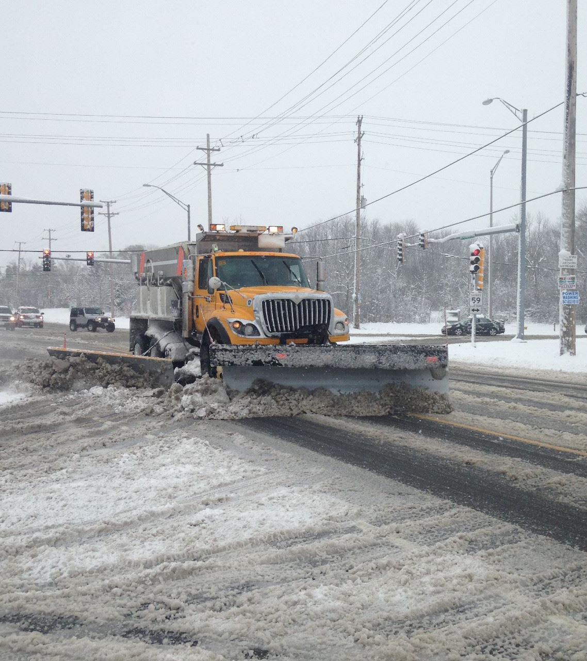
Lake county dot snow and ice operations

Slide 2
LCDOT winter maintenance by the numbers:​
• 61 maintenance staff​
• 7 temporary employees or snowbirds​
• 26 plow routes
• 3 spare plow trucks​
• 847 Lane Miles​

Slide 3
Planning
Annual snow and ice plan
Routes and assignments
Equipment
Callout procedures
Operational guidelines
Adding a route or route adjustments
Additional lane miles
Construction zones
Replace equipment
Plow truck life cycle 13-15 years

Slide 4
facilities
Salt domes
Blending building
Truck Barn
Heavy Duty Shop
Truck wash

Slide 5
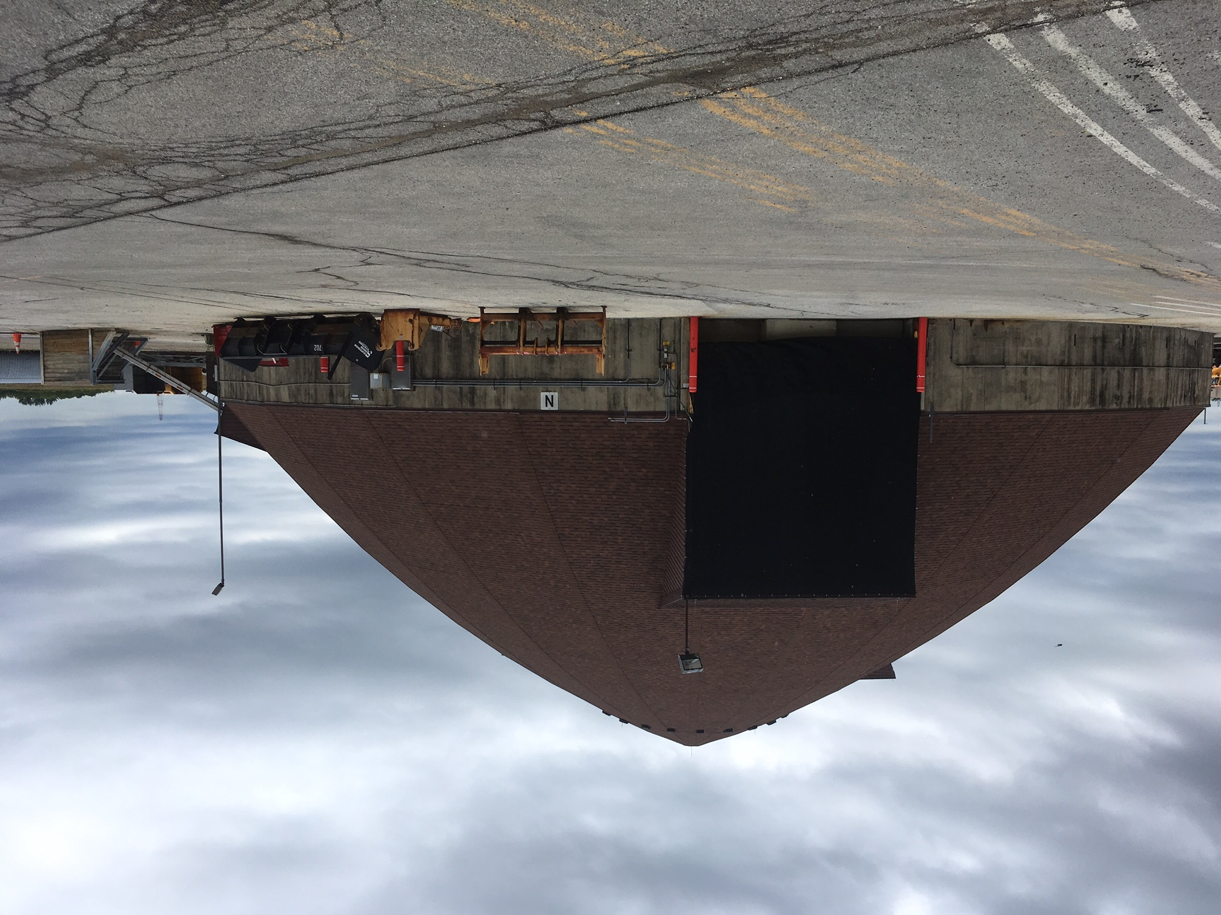
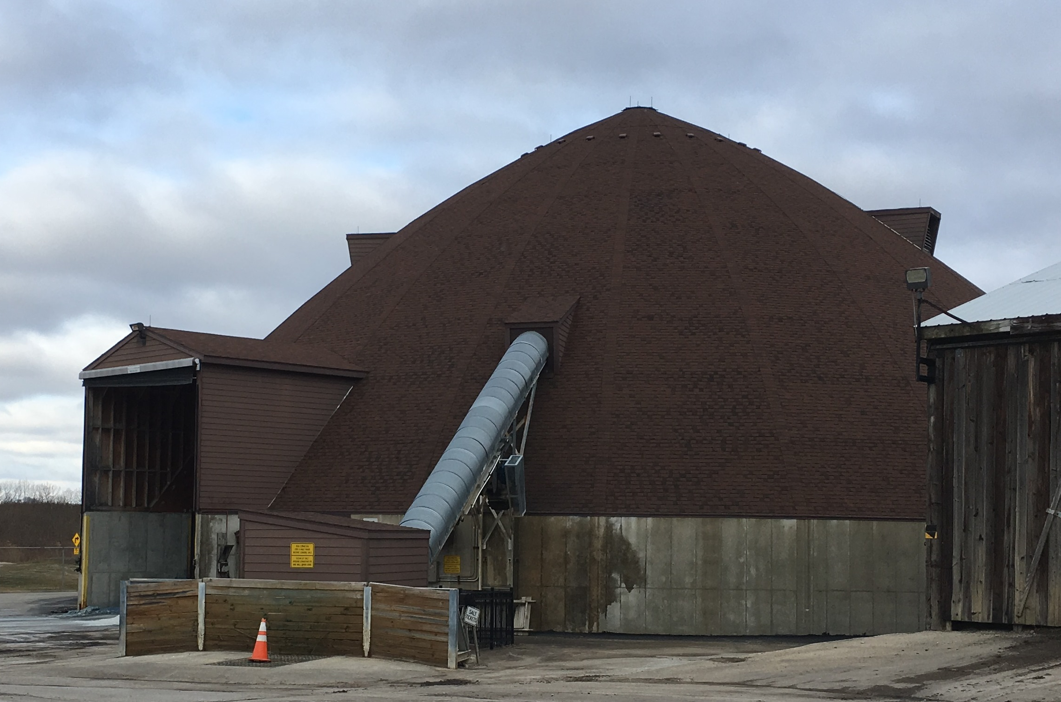
East Salt Dome
Capacity 9,000 tons
West Salt Dome
Capacity 11,000 tons

Slide 6
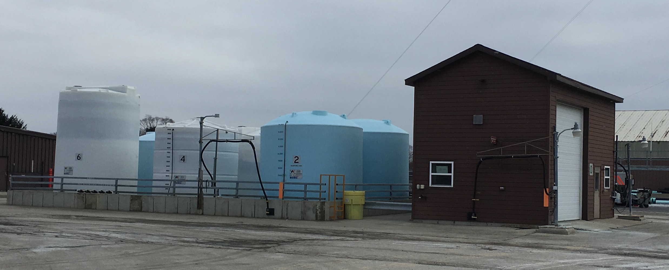
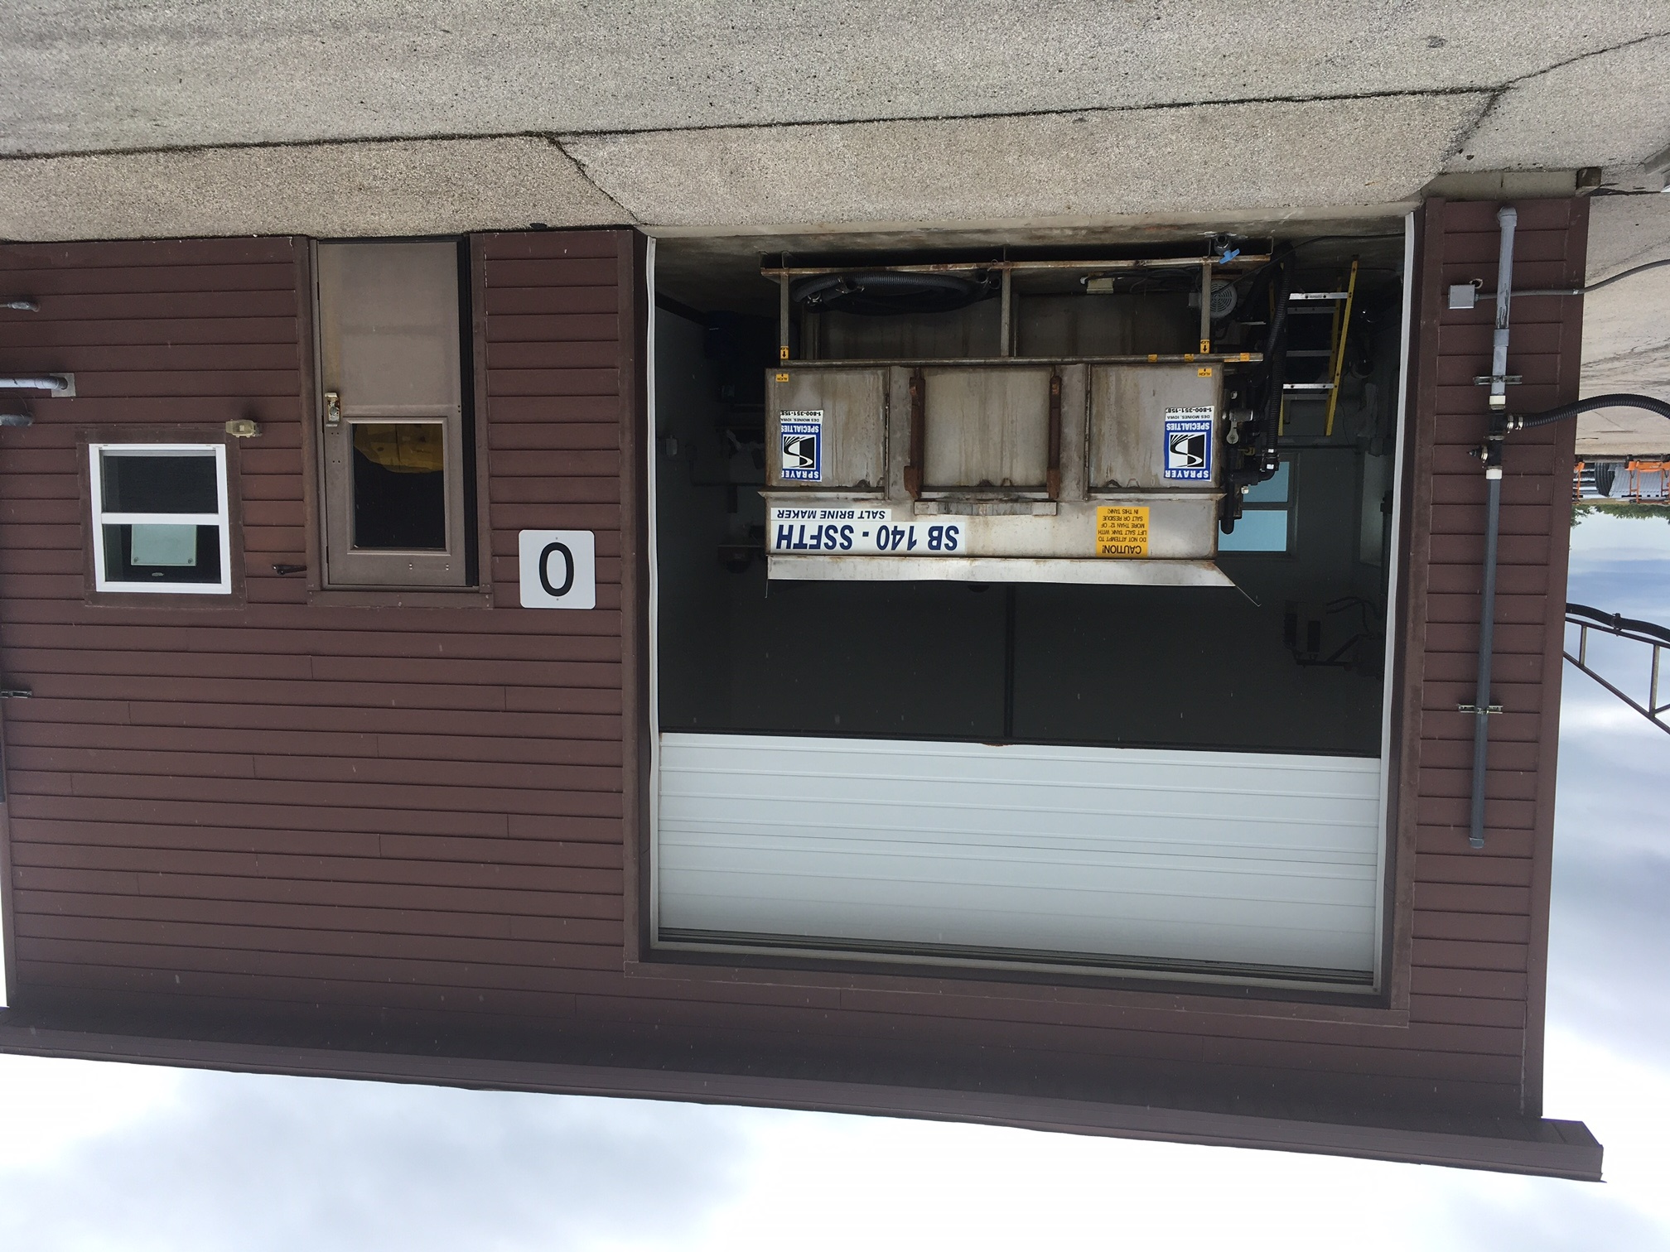
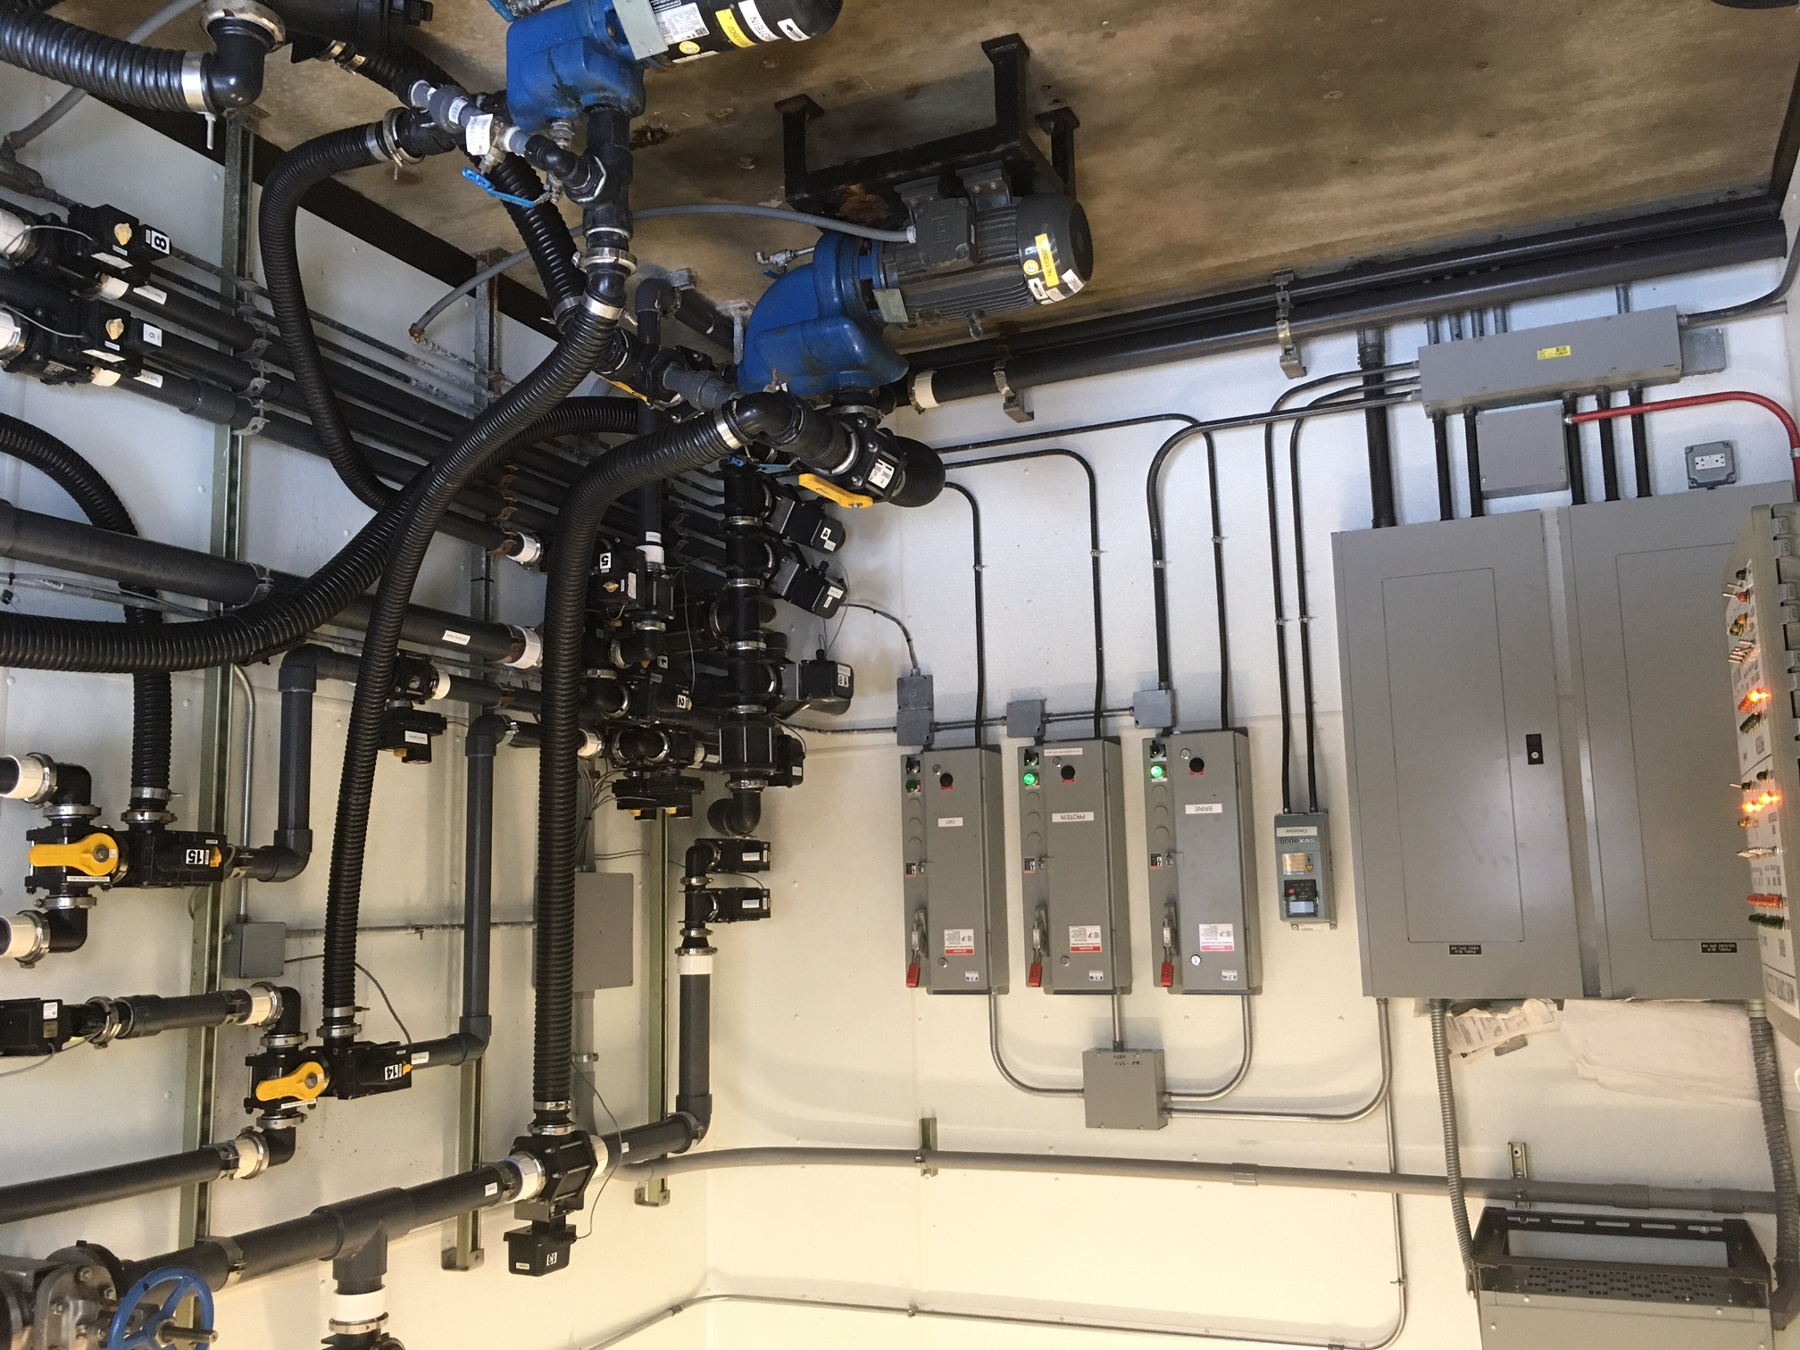
6 tanks
4 fill stations
Building – brine maker and pumps

Slide 7
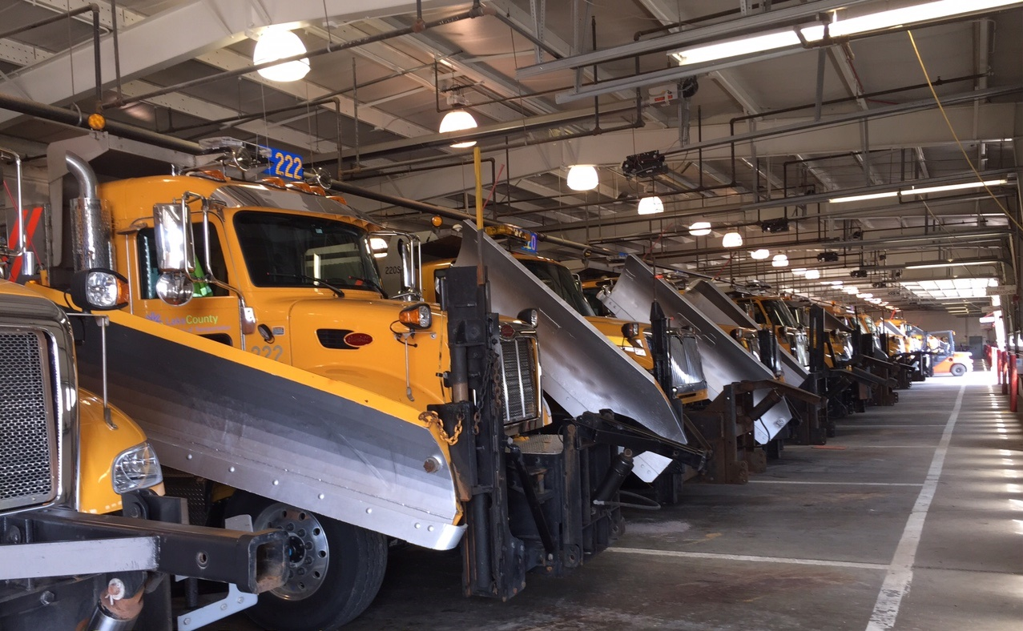
Truck Barn

Slide 8
Heavy Duty Shop

Slide 9
Truck Wash

Slide 10
Trucks and equipment
Plow Trucks
Tank Sprayer
Loaders

Slide 11
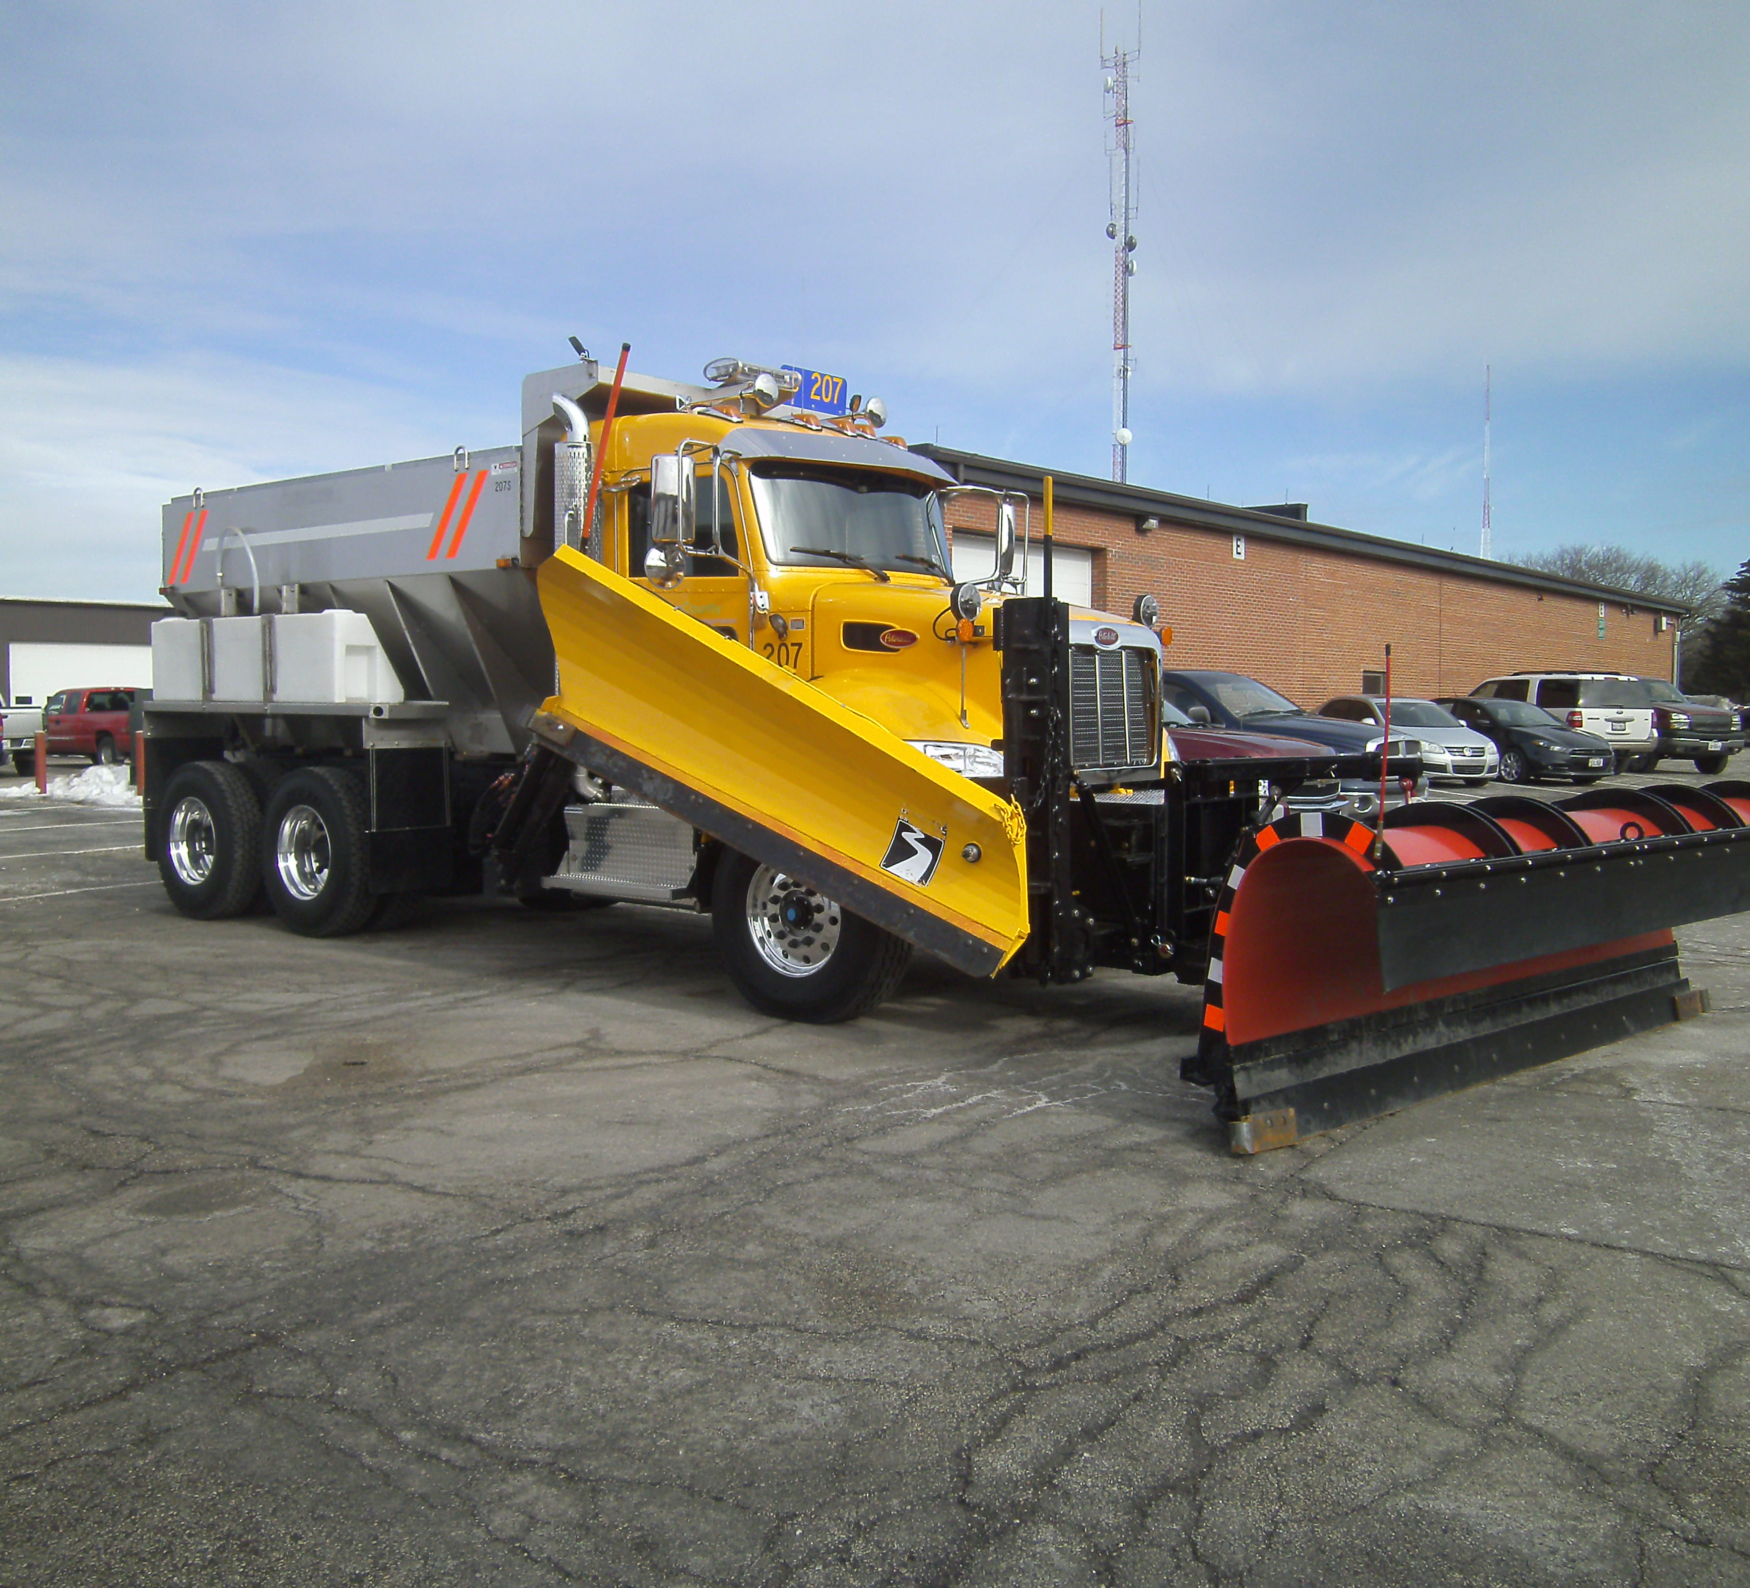
Plow Truck

Slide 12
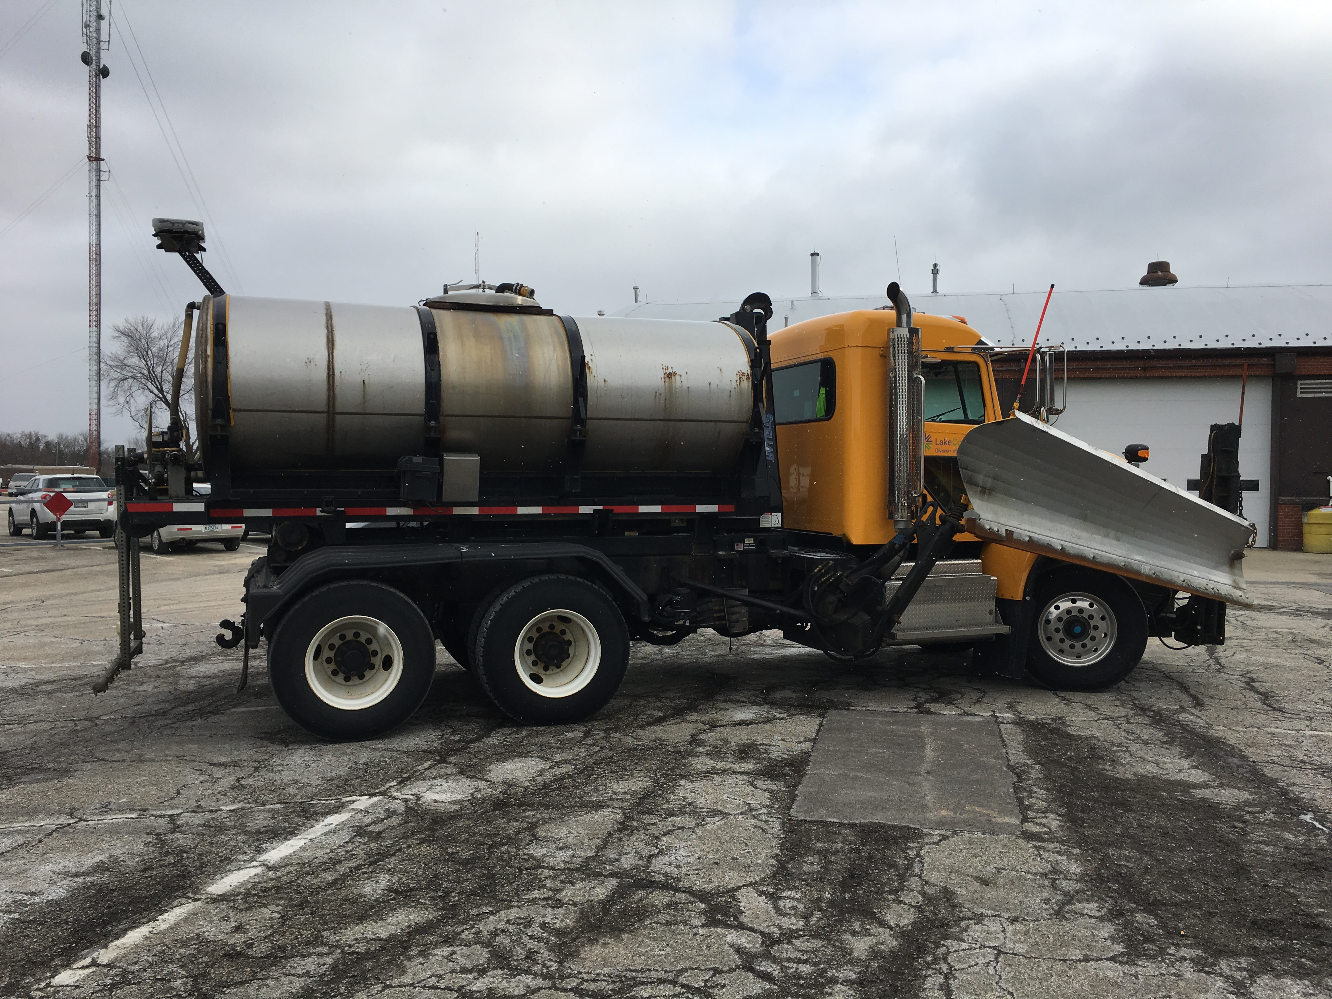
Tank
Sprayer

Slide 13
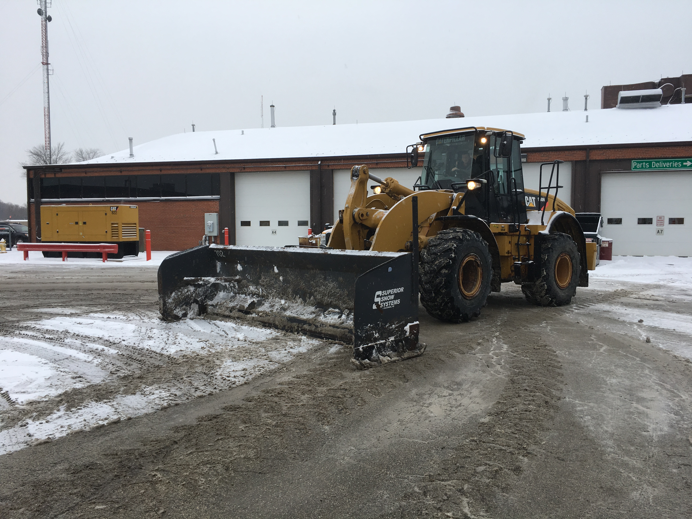
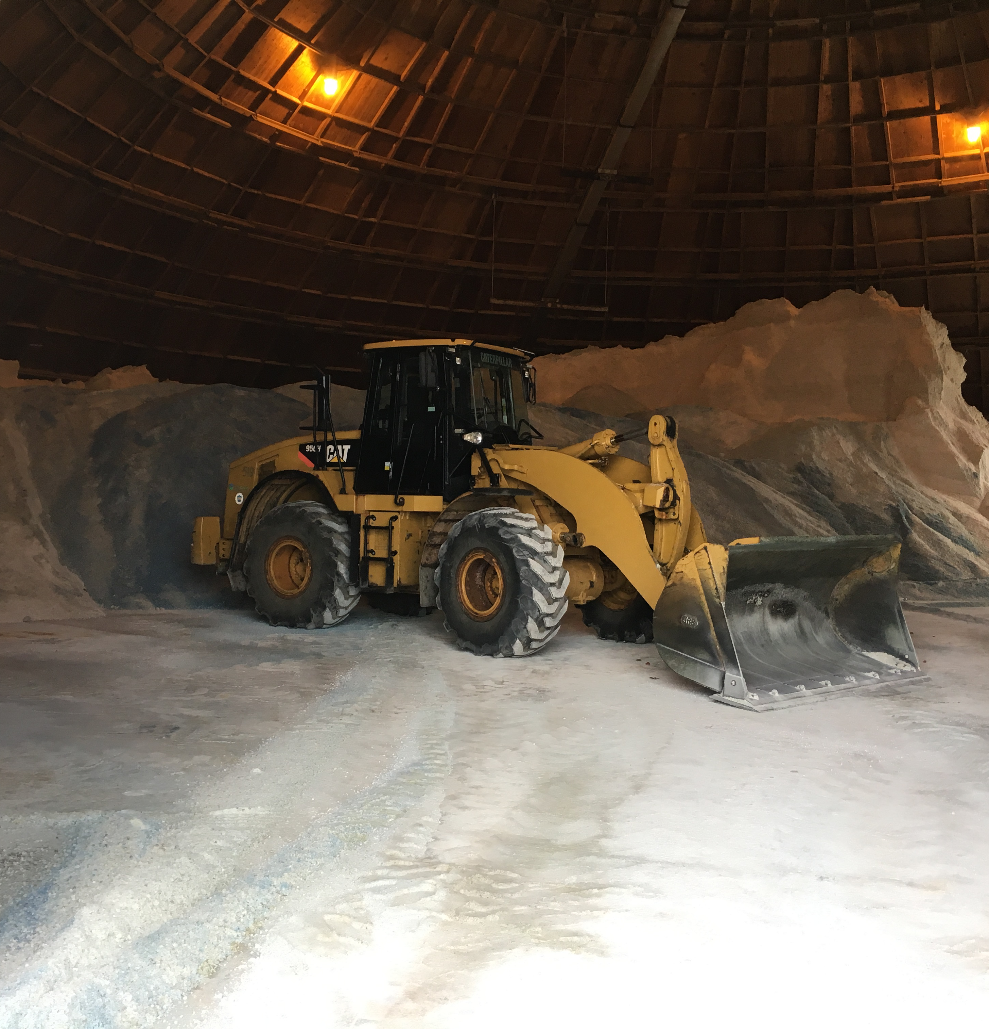
Loader

Slide 14
technology
Trucks
Computer controls
AVL/GPS
Weather service
RWIS
GIS
PASSAGE

Slide 15
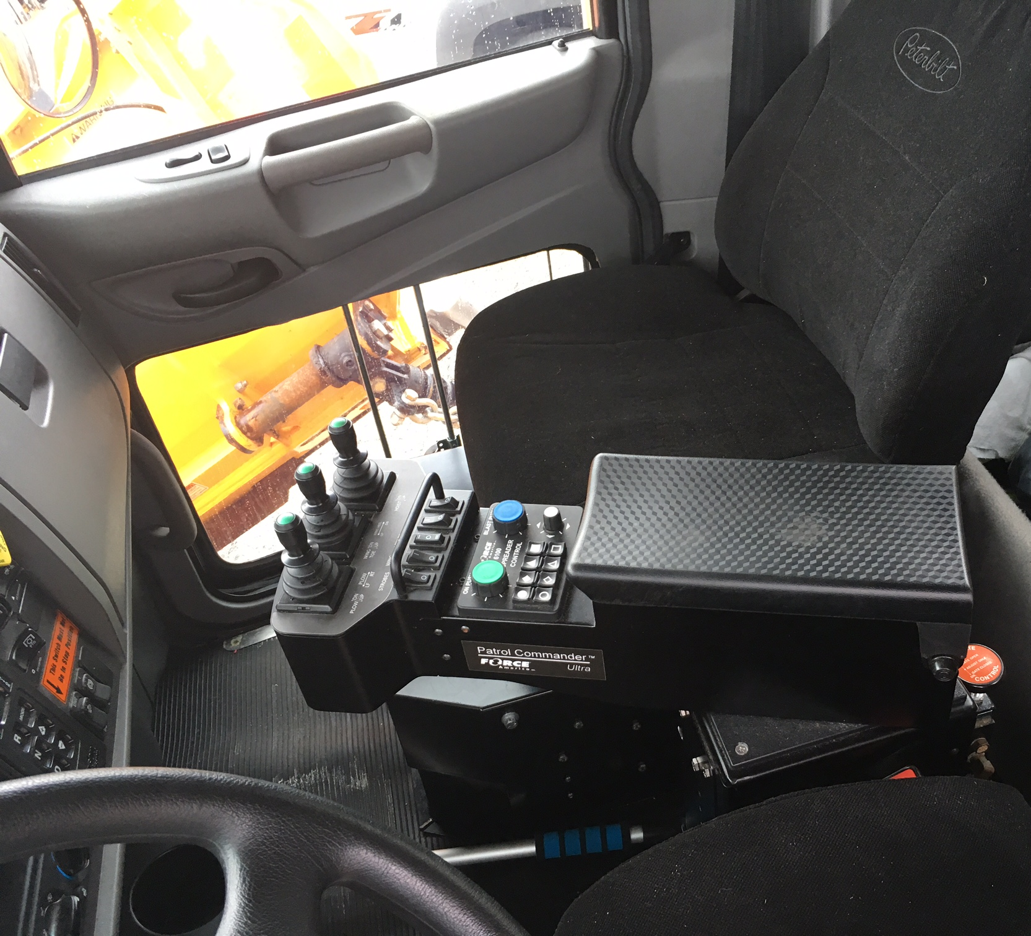
Spreader and liquid controls

Slide 16
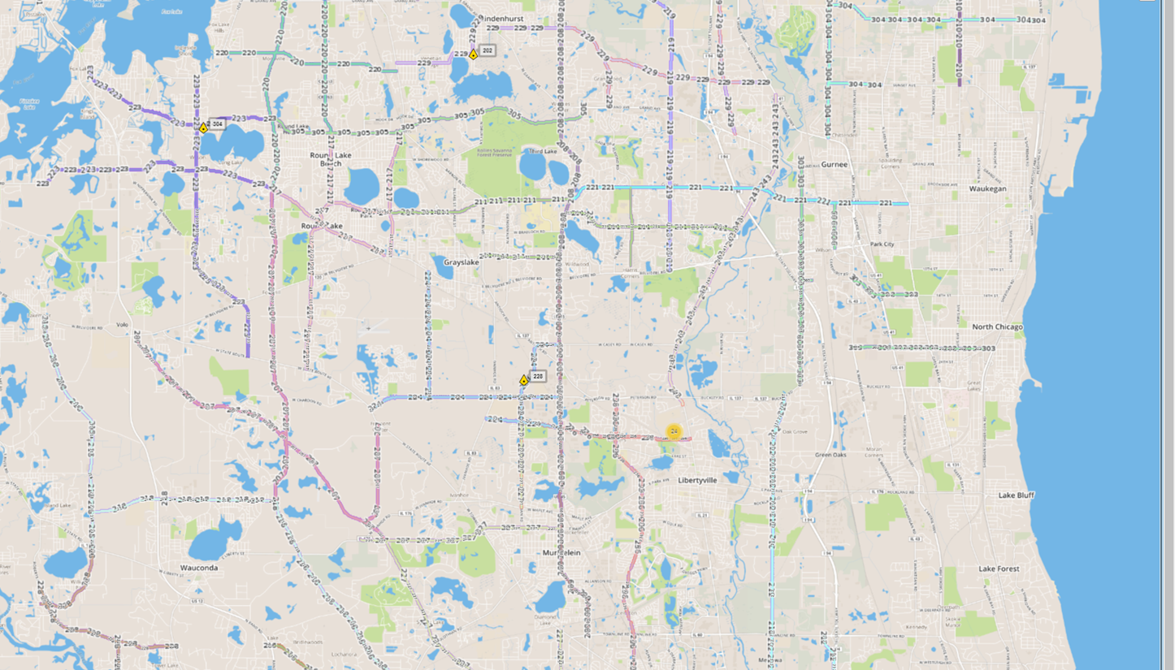
AVL Map

Slide 17
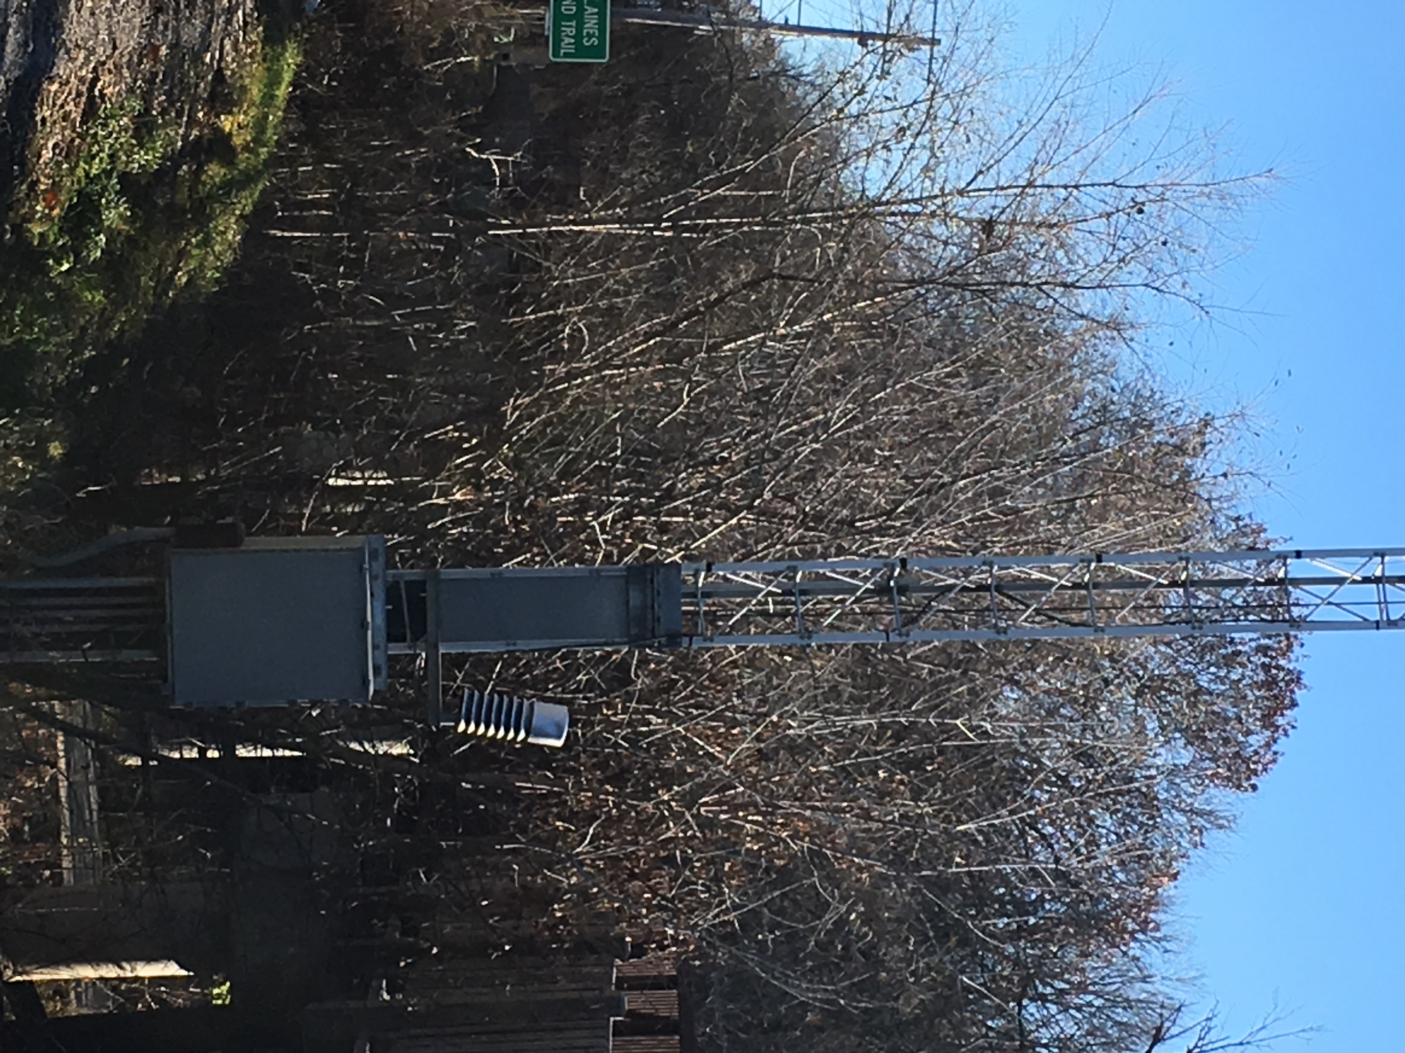
rwis
4 locations one in each corner of the county
Air and surface temp
Wind speed
Surface condition – wet, dry, snow, or ice

Slide 18
gis

Slide 19
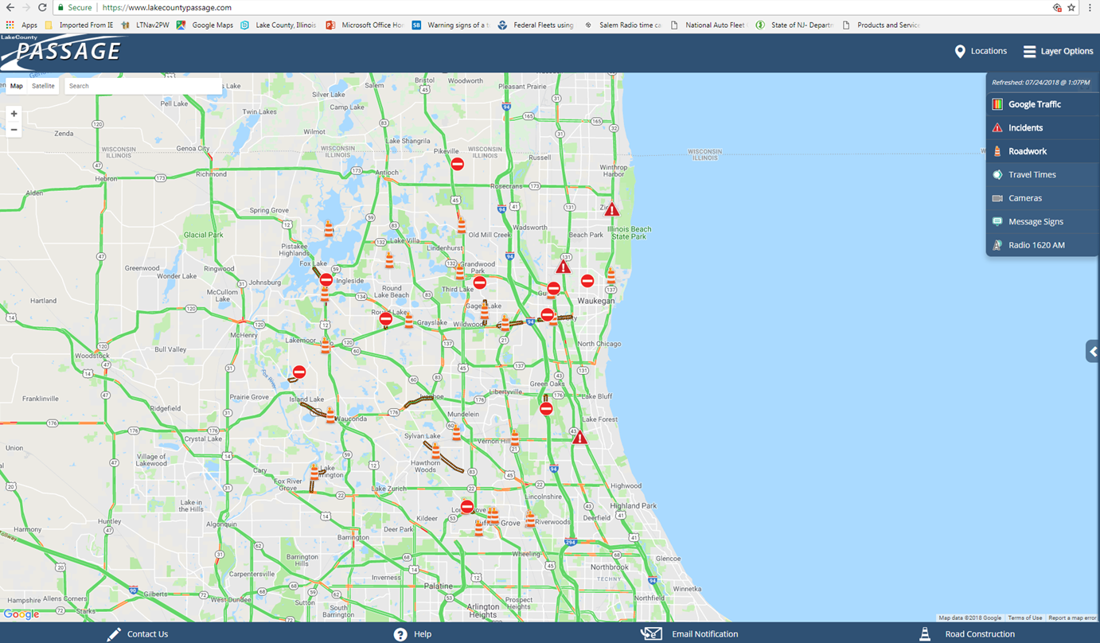
PassAge
www.lakecountypassage.com
Active 6 AM- 7PM M-F

Slide 20
Environment
Salt
Increase in Chloride levels in lakes
Liquids
Keeping salt on the roads
Snow Fence
Traditional snow fence
Living snow fence
Corn
Bushes or trees
Facilities
Sweep residual salt after deliveries
Filtration basin
Monitoring
Health department has been monitoring chlorides leaving the DOT facility since 2014

Slide 21
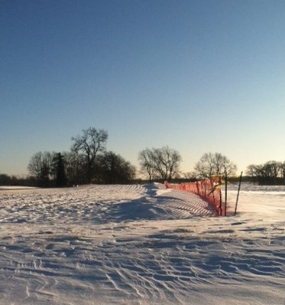
Snow fence and living snow fence is used to reduce drifting on the roads. This results is less plowing and salt usage.

Slide 22
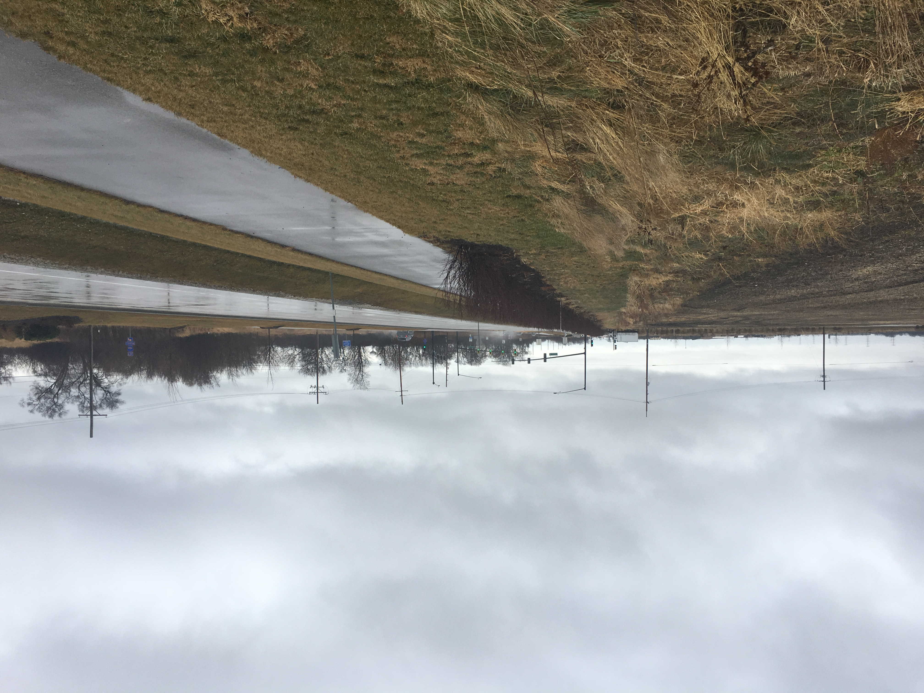
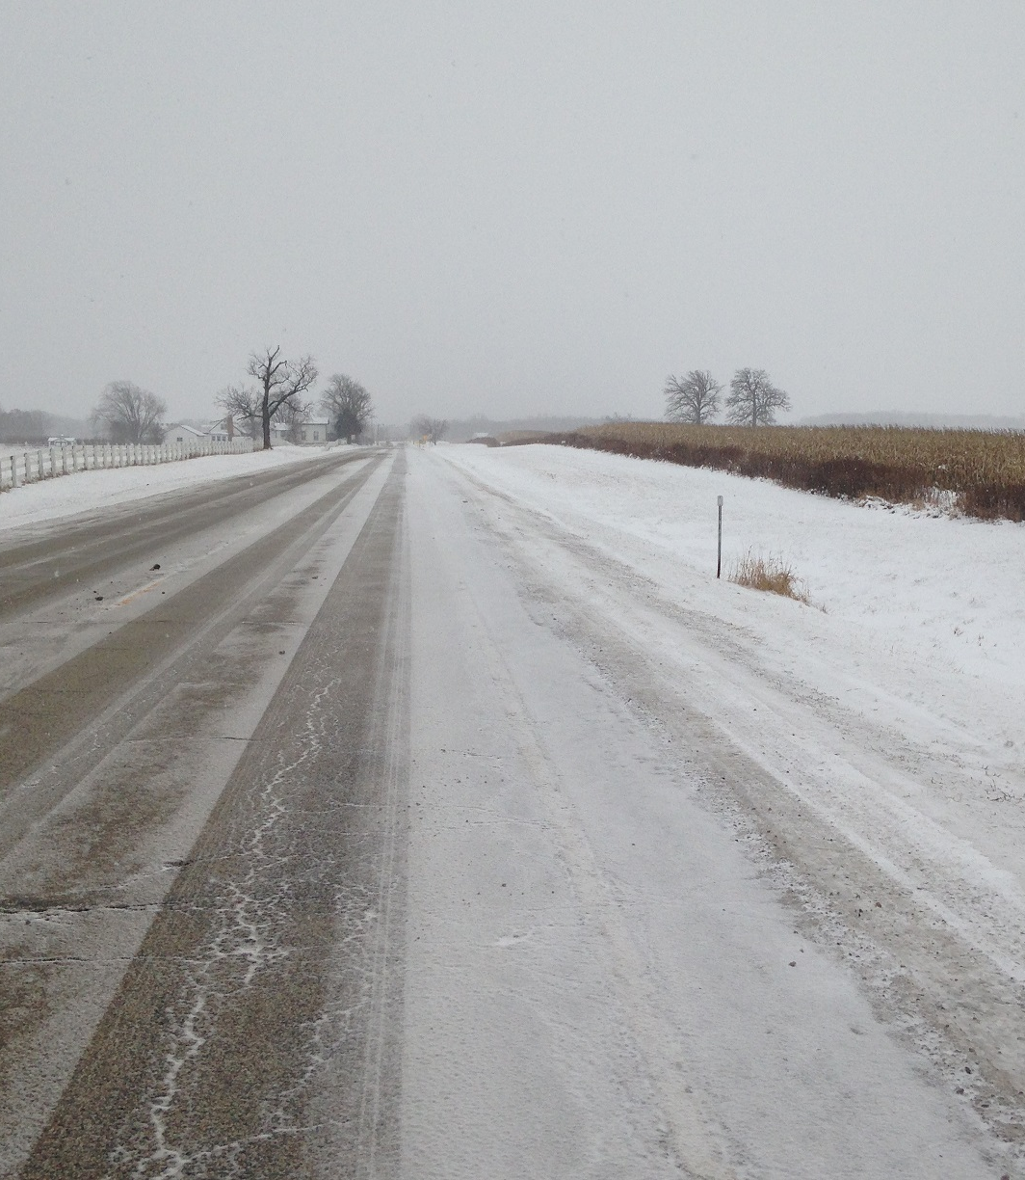
Row of bushes incorporated as part of a construction project
Living snow fence
12 rows of corn 4,300 ft.
2014 and 2016

Slide 23
Filtration basin
The basin was constructed by a DOT labor crew using an engineered soil made up of sand, topsoil, compost, and gypsum. The water flows through the ditch and the chlorides are attracted to the soil.

Slide 24
Chloride Monitoring
Lake County Health Department
Continuous monitoring of chloride levels
Regular meeting with DOT to discuss results
Filtration basin and revising good housekeeping practices were outcomes of those meetings

Slide 25
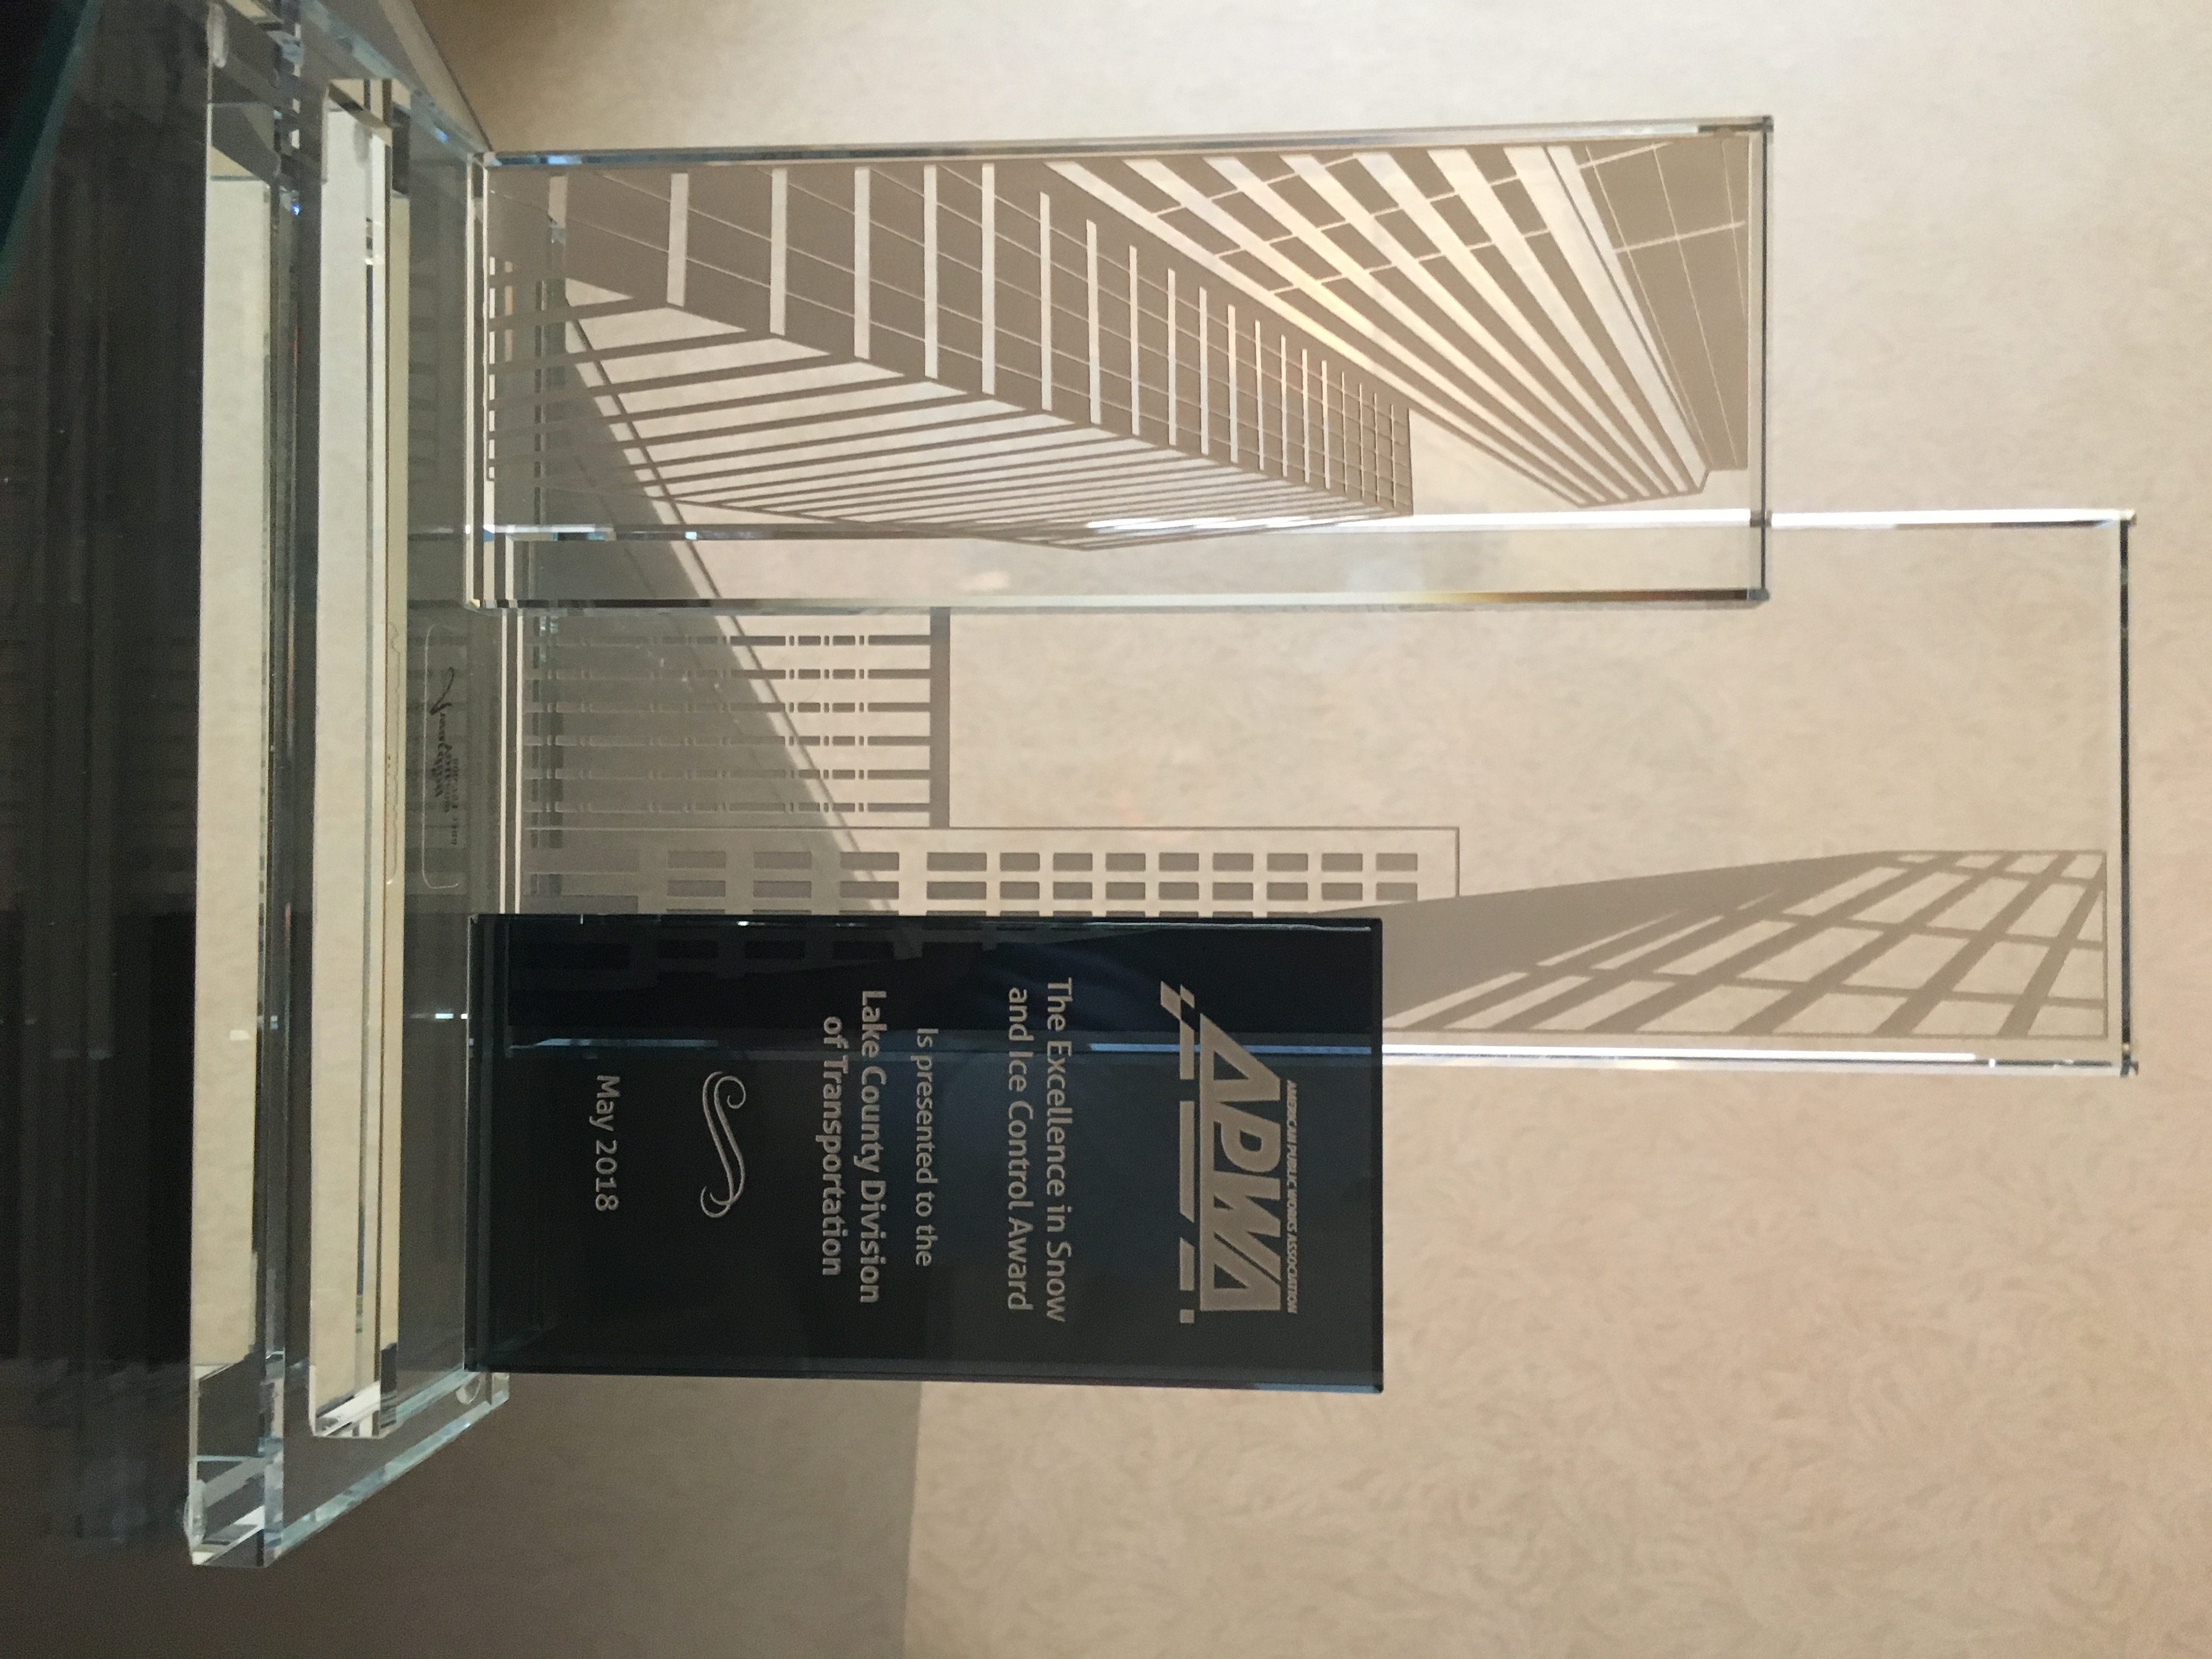
APWa excellence in snow and ice

