Slide 1

Drww
Winter Chloride Monitoring Update
August 16, 2018
Mike Adam
Lakes committee chair
Monitoring Committee
Executive board

Slide 2


Chloride by the numbers
Illinois General Use Standard = 500 mg/L
USEPA Drinking Water Standard = 250 mg/L, however, chronic environmental standard is 230 mg/L
MBI DuPage/Salt Creek = 141 mg/L
1 tsp in 5 gallons water = 280 mg/L Chloride

Slide 3
Chloride Monitoring
LAKES: Cl as high as 2,700 mg/L (ave = 191 mg/L)
Streams:
  Winter 2014-2015 (LCHD/SMC): Cl as high as 33,000 mg/L
    Not flow weighted
  DRWW data: Cl identified as one of the primary issues
    Data collected mostly in May-Oct

Slide 4
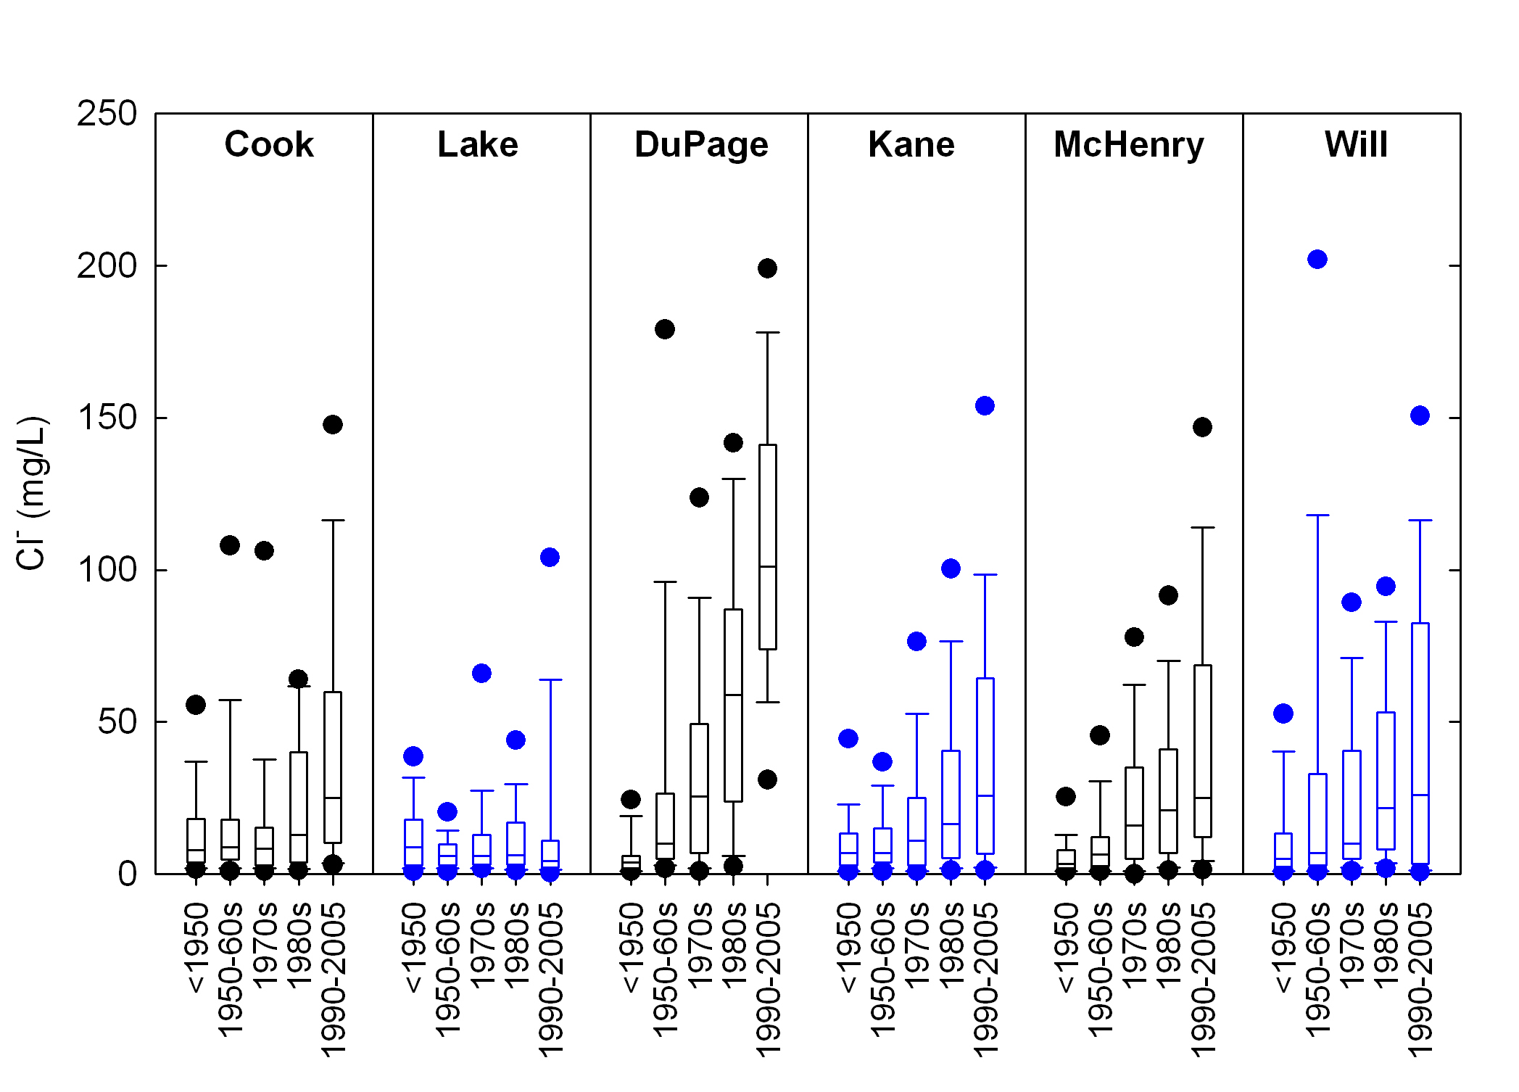
Chloride by County

Slide 5
Historic Chloride Data

Slide 7
Conductivity vs Chloride
500 mg/L = ~ 2.0 mS/cm

Slide 8
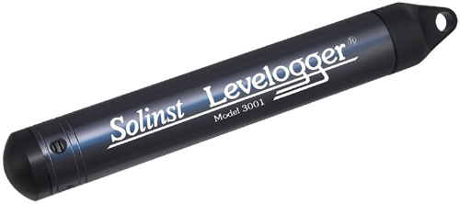
DRWW Winter Chloride Monitoring
December 2017 to current
  Sondes (North Shore) - continuous 24/7 (winter only)
  Conductivity loggers – continuous 24/7
    Converted to chloride concentrations
  Level loggers measure flow
    Flow X Concentration = Load

Slide 9
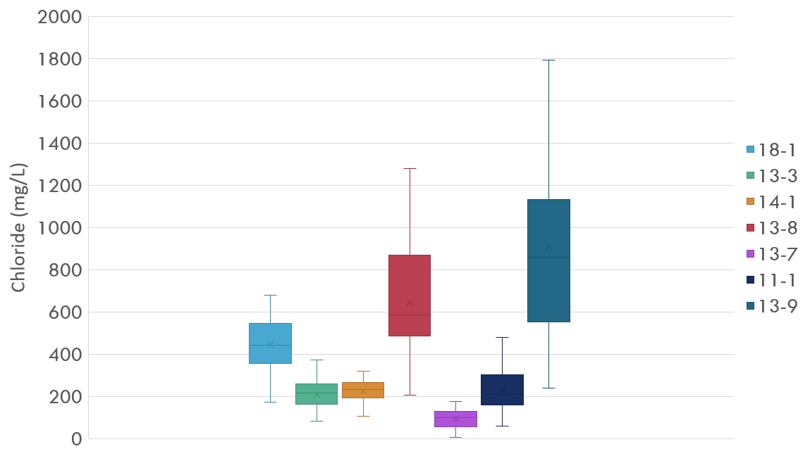
DRWW Winter Chloride Monitoring – Dec ‘17 to March ‘18
IEPA
USEPA
MBI

Slide 11
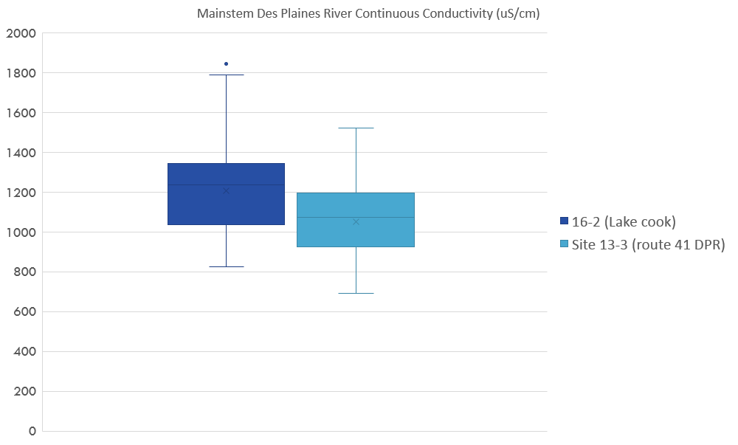
IEPA
USEPA
MBI

Slide 12
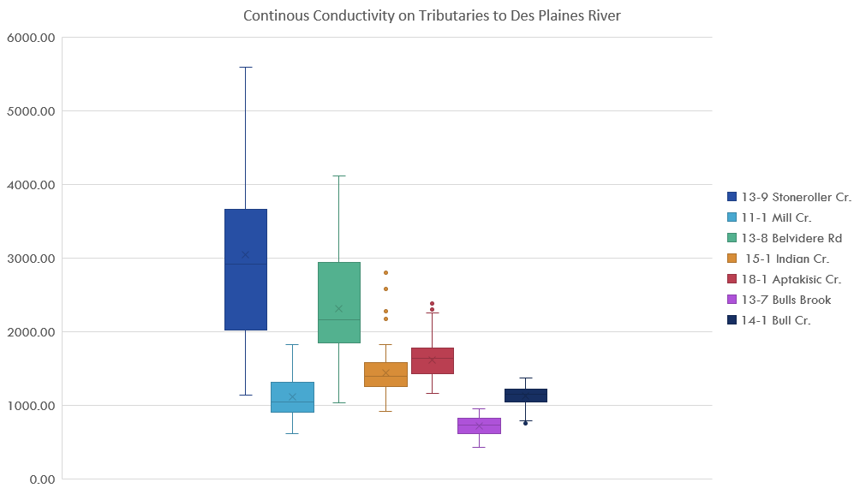
DRWW Winter Chloride Monitoring – Dec ‘17 to March ‘18
IEPA
USEPA
MBI

Slide 14
DRWW Winter Chloride Monitoring

Slide 15
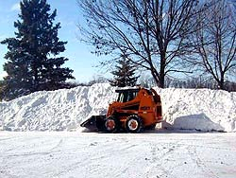
De-icing workshops
Lake and other Counties
  Lake County Agencies
    Stormwater Management Commission
    Health Department
    Division of Transportation
    Public Works
  2009 – 2017
    >1,000 participants
    231 different entities
  October 1, 2, & 3, 2018

Slide 16
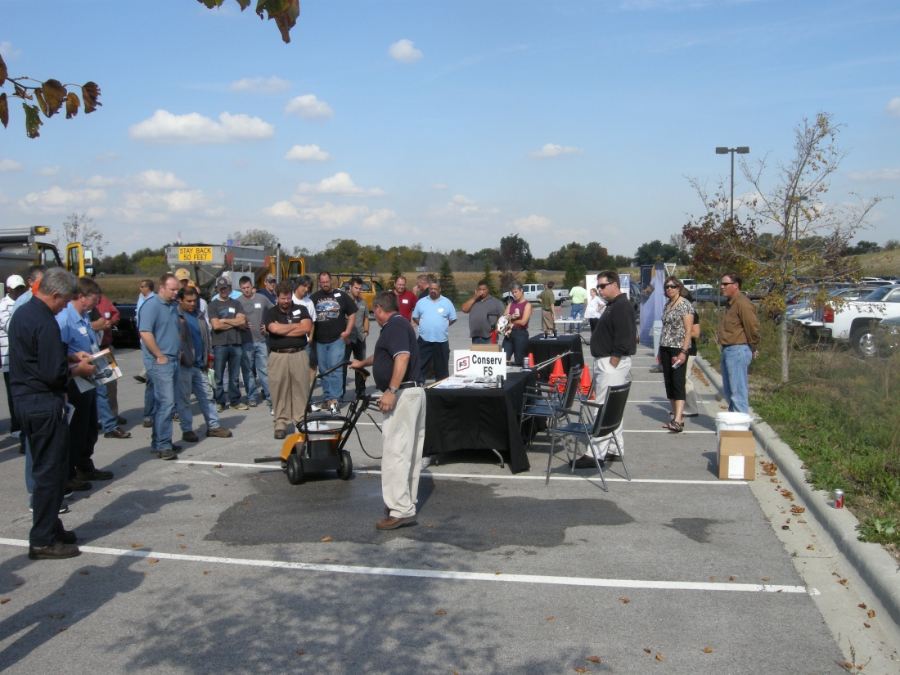
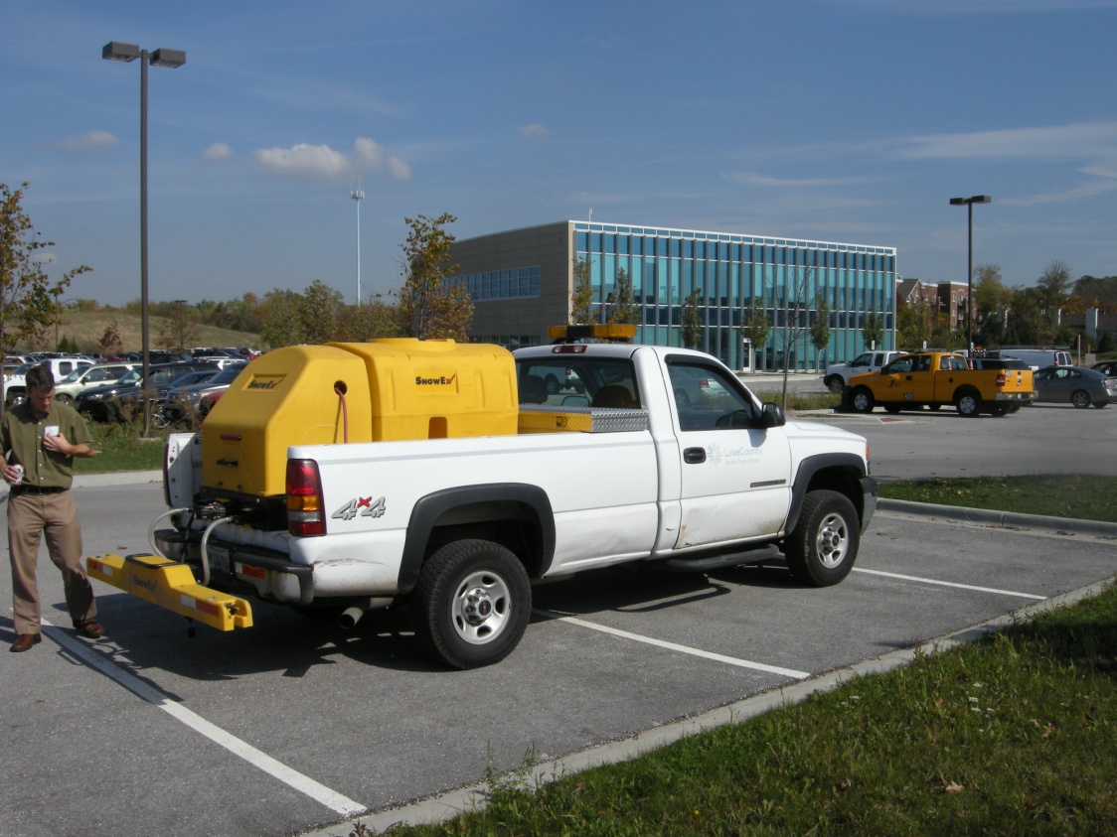
De-icing workshops

