Slide 1
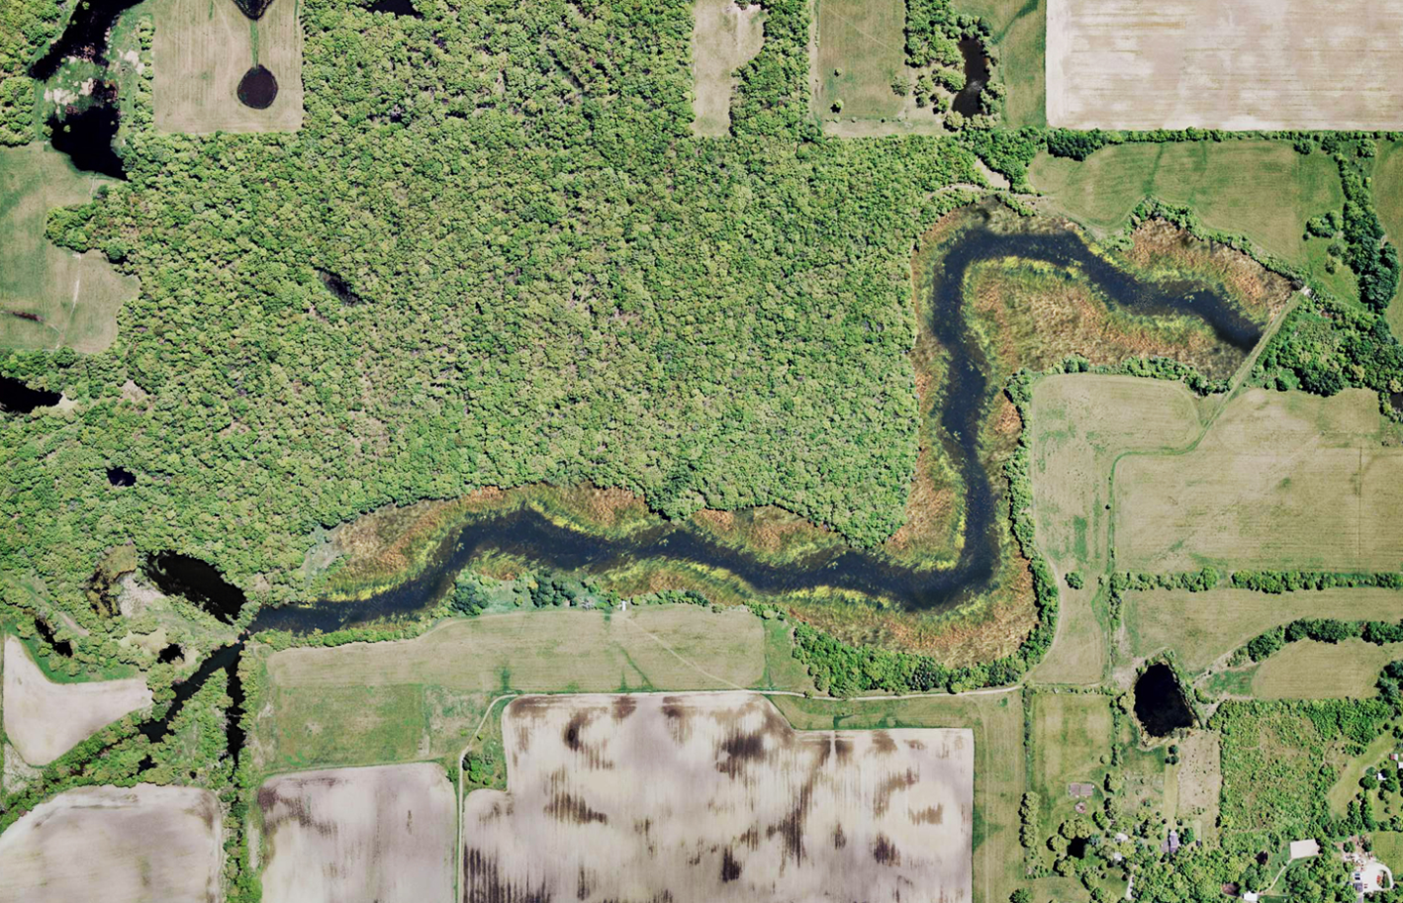
North Mill Creek Restoration

Slide 2
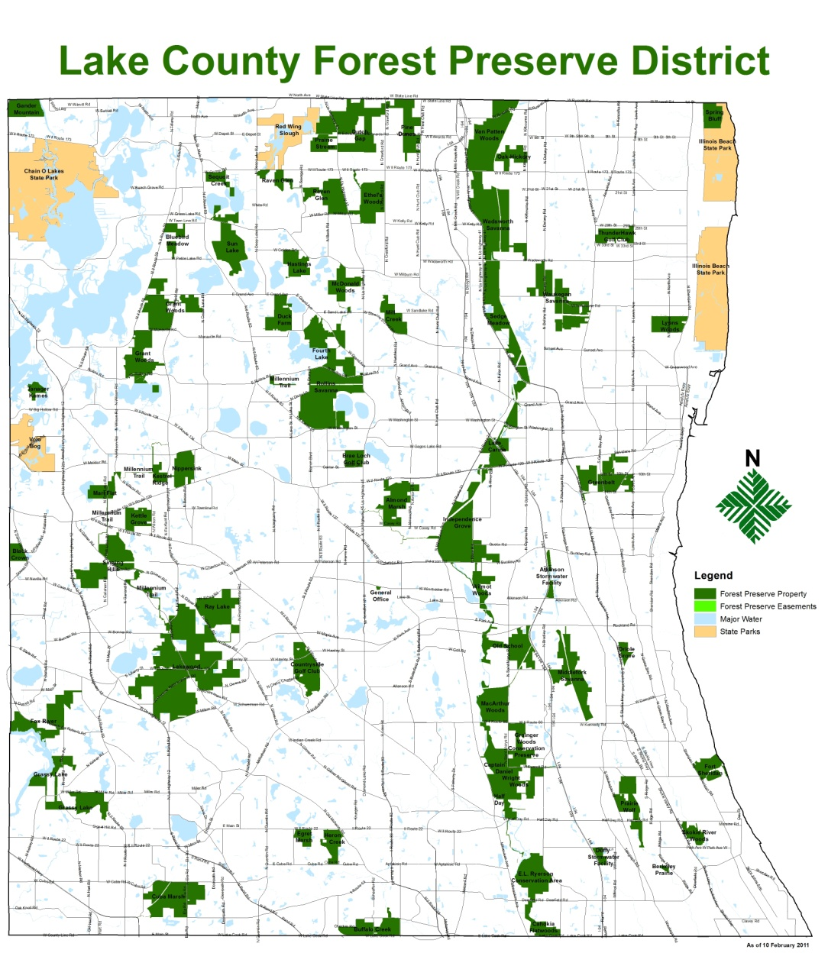
Project Location: Ethel’s Woods Forest Preserve

Slide 3
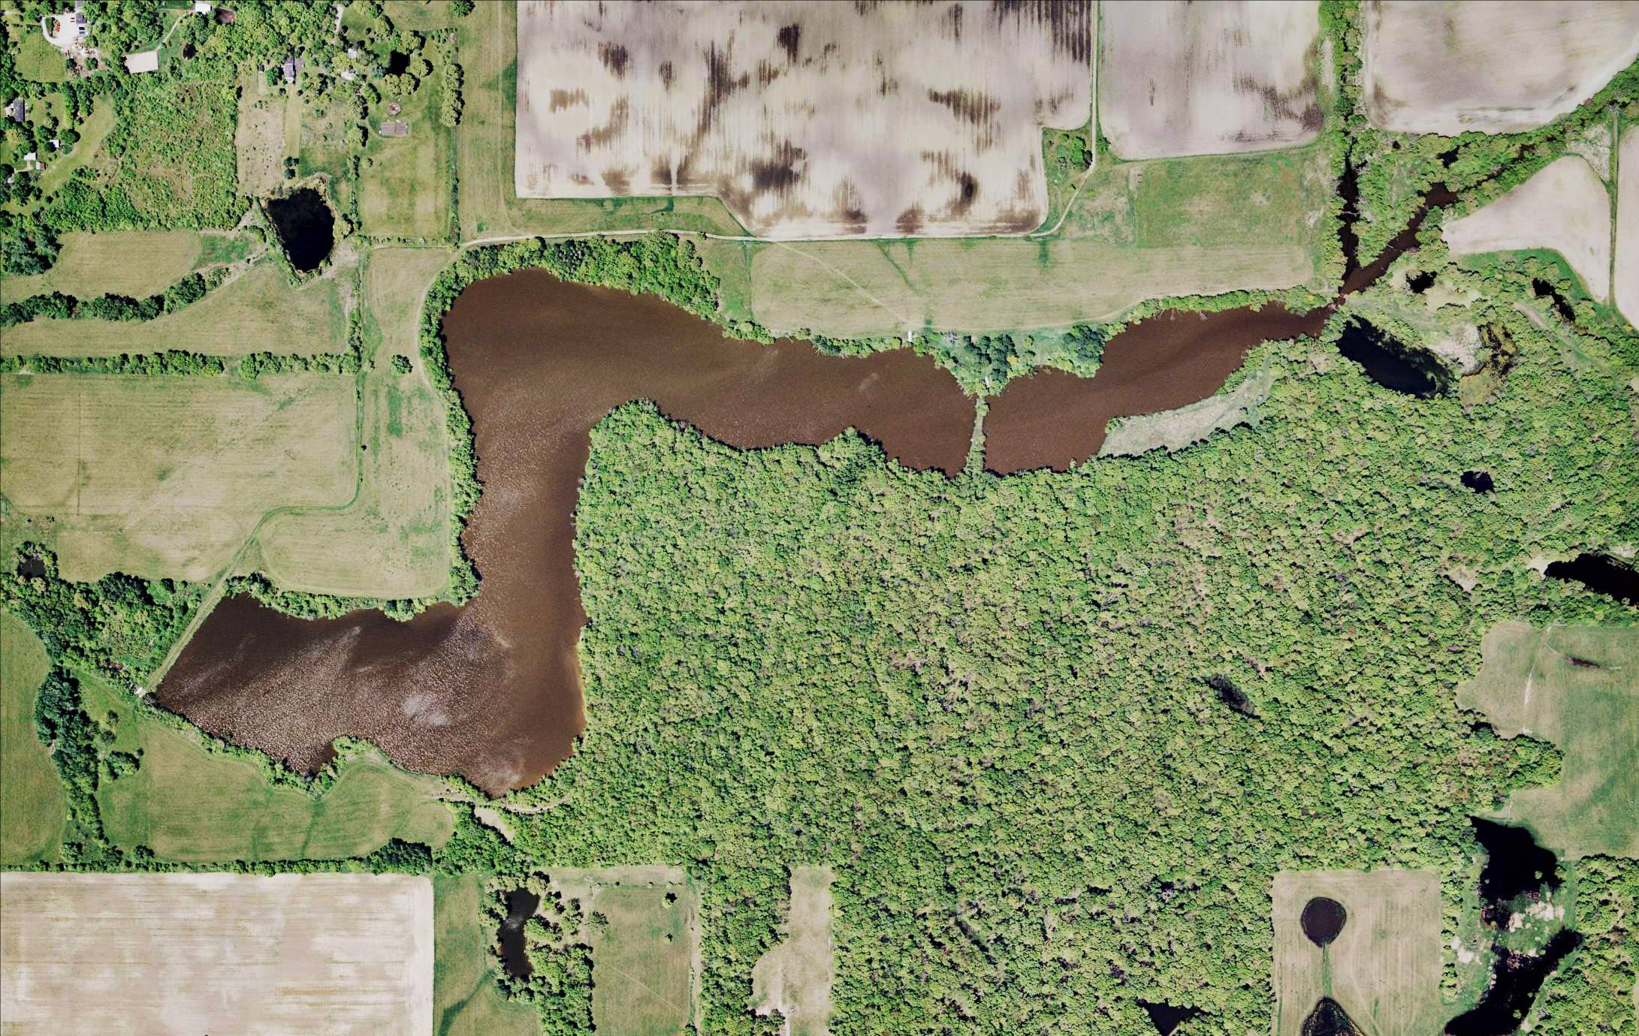
Rasmussen Lake

Slide 4
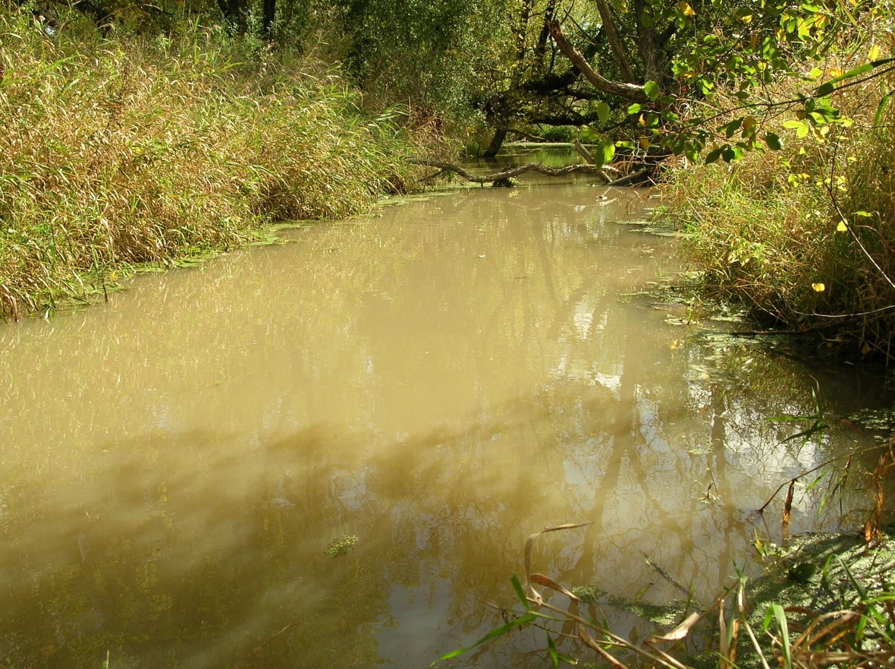
Rasmussen Lake – Existing Conditions
IEPA non-support for aquatic life, swimming and recreation
Clean Water Act classification 303(d) as Impaired Lake
LCHD ranked 161 of 162 lakes for water quality
Phosphorus levels are 10 times higher than median of all lakes in county
Alkalinity are highest recorded in county

Slide 5
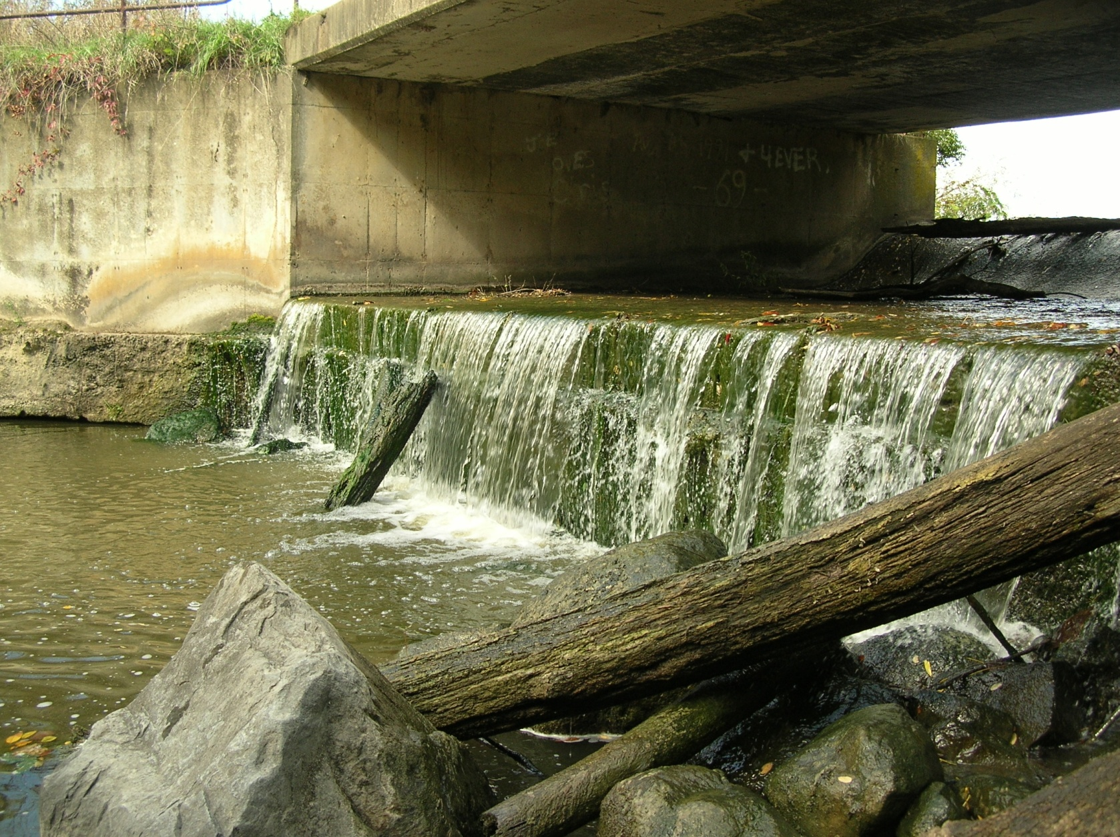
Rasmussen Lake – Existing Conditions
Severely eroding shoreline with slopes 5’ or greater
Dam, spillway and overflow outlet are in poor condition
Engineering models show earthen dam is overtopped in 100-year event and very close to overtopping in 10-year event

Slide 6
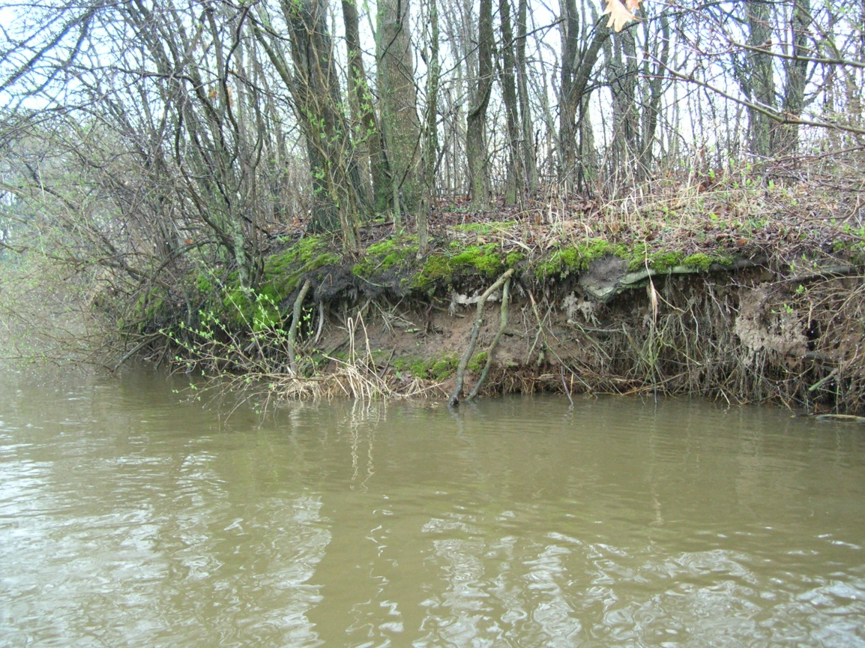
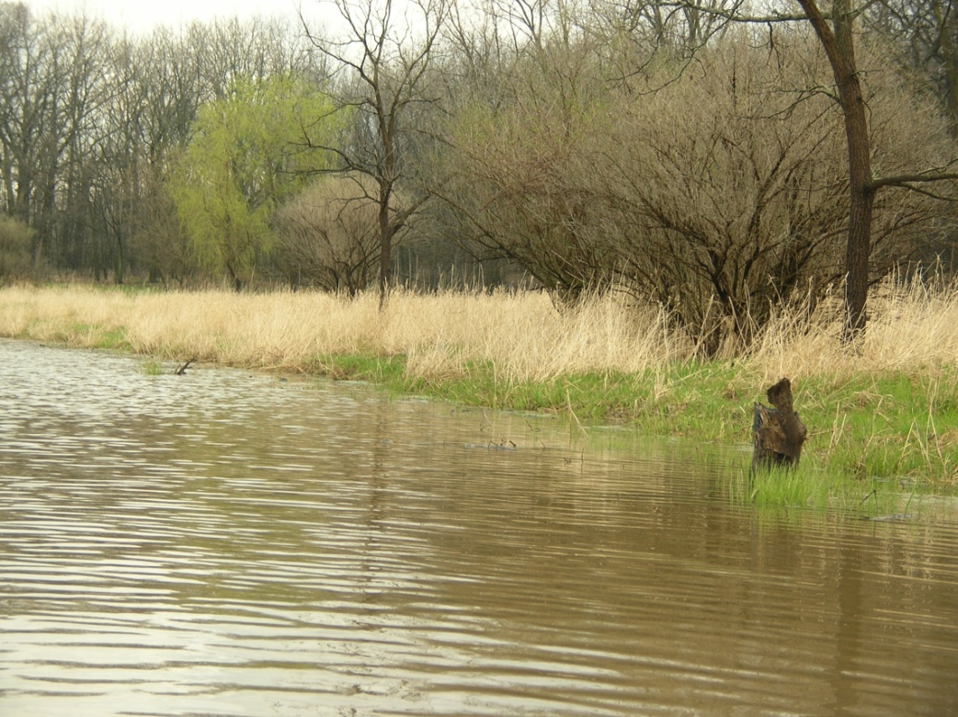
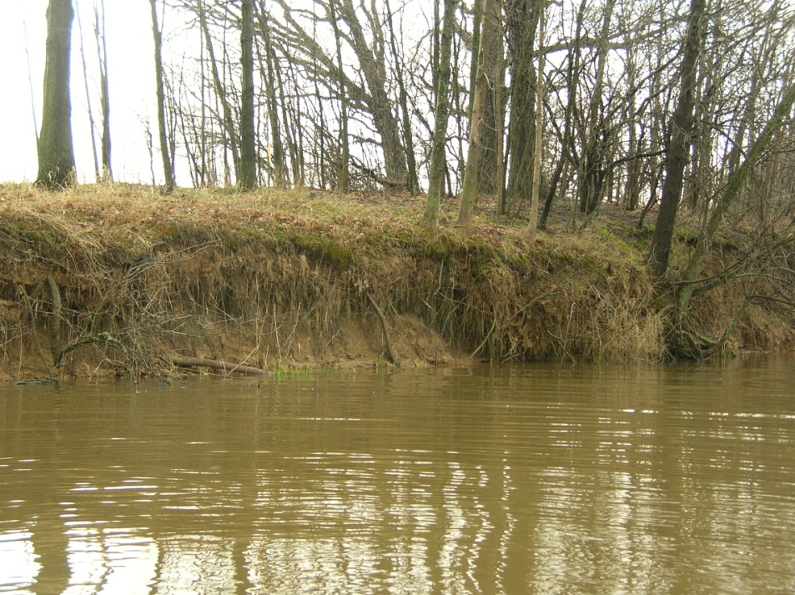
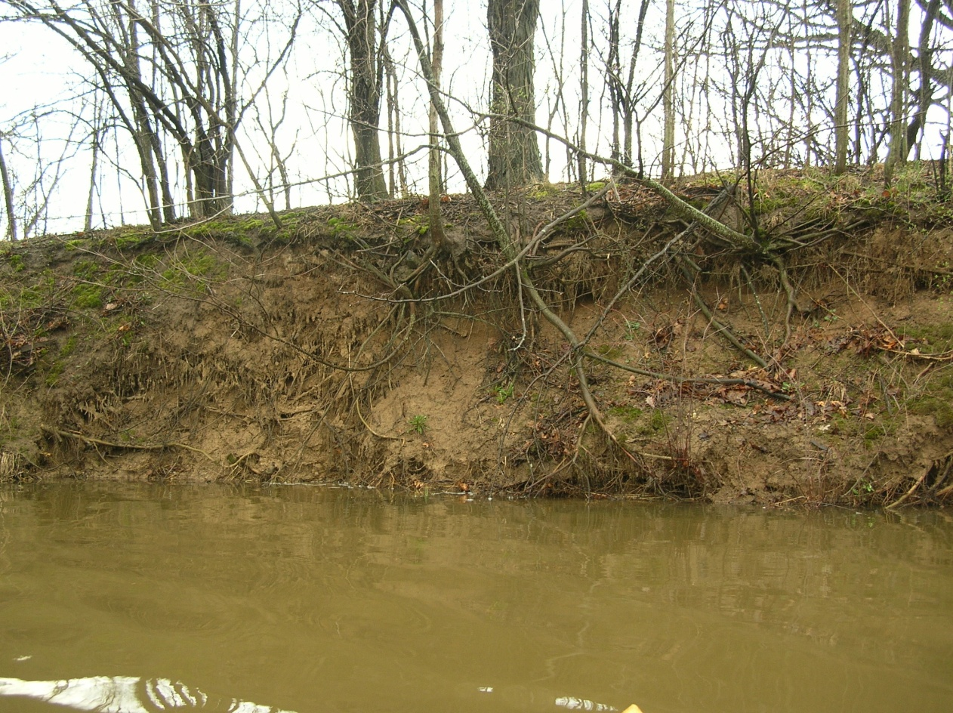
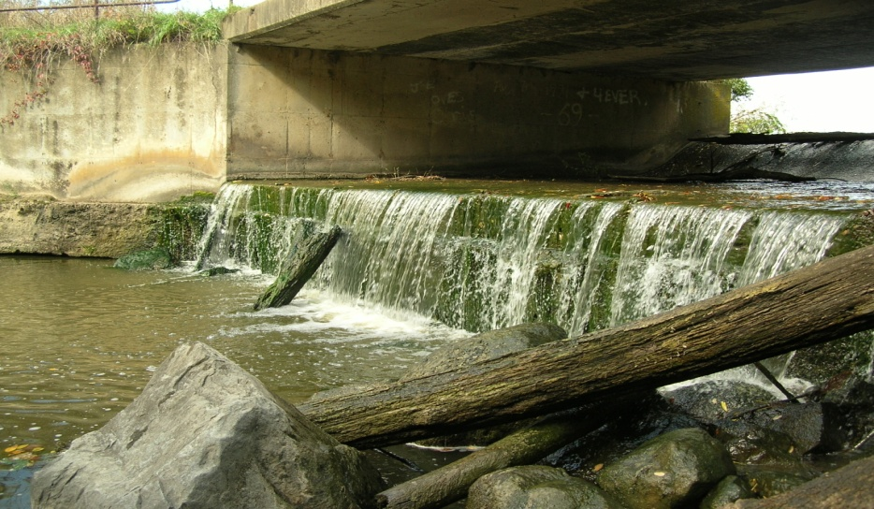
2006 Conceptual Alternatives
Take No Action
Improve Lake
Restore Stream

Slide 7
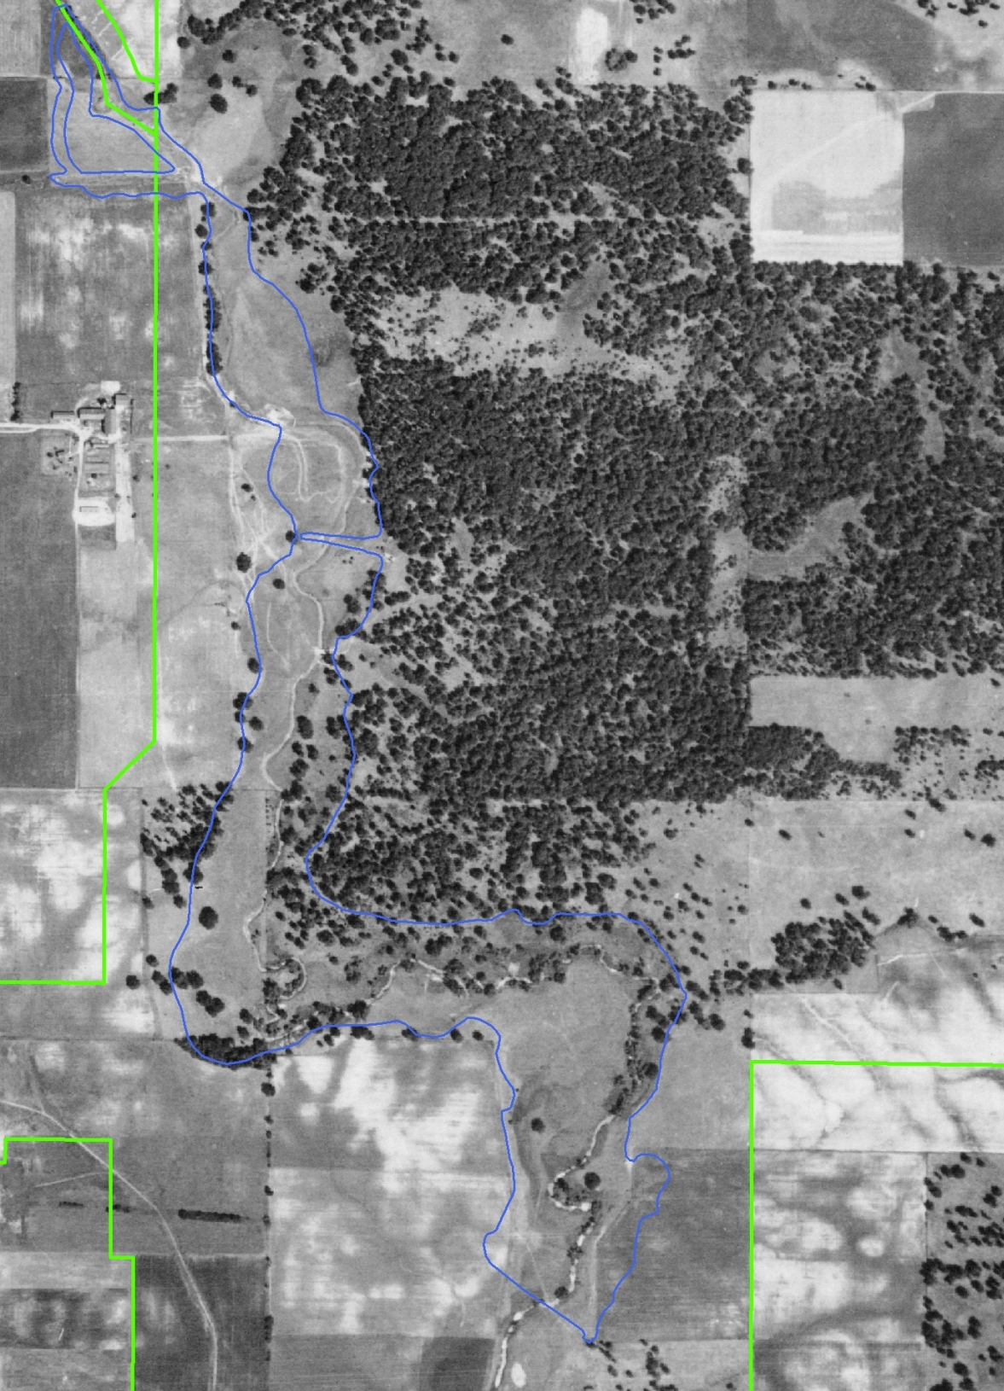
North Mill Creek Restoration
1939

Slide 8
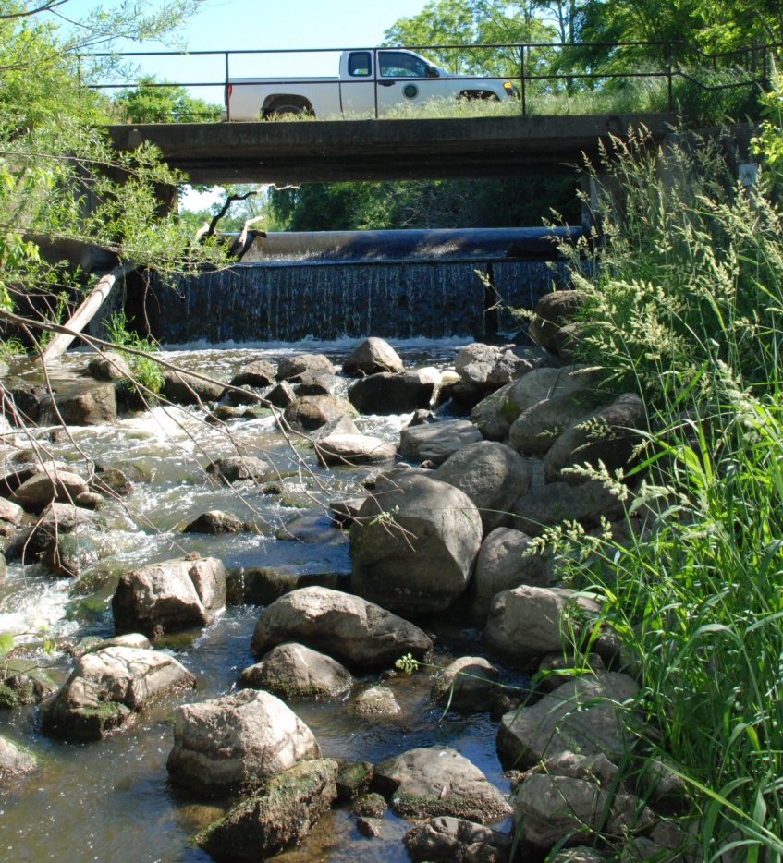
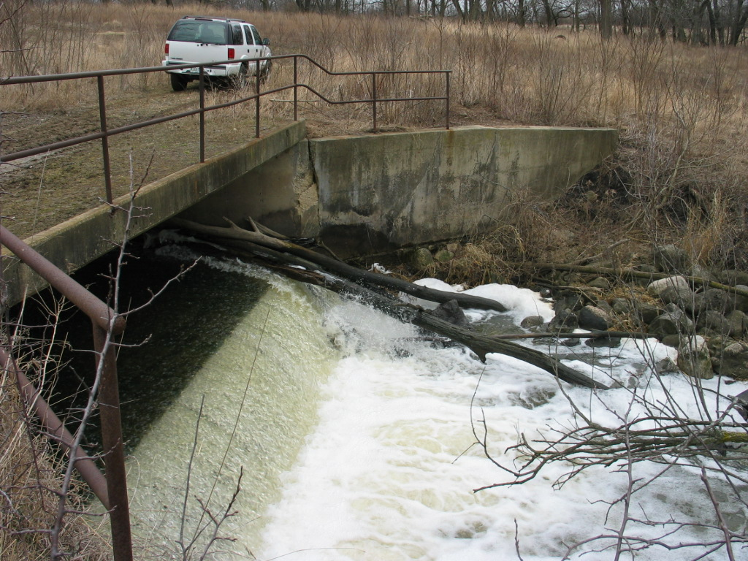
February 2007 Board approved moving forward with planning for dam modification and stream restoration.
In 2008 Board funded the North Mill Creek Channel Restoration Project at $4M.

Slide 9
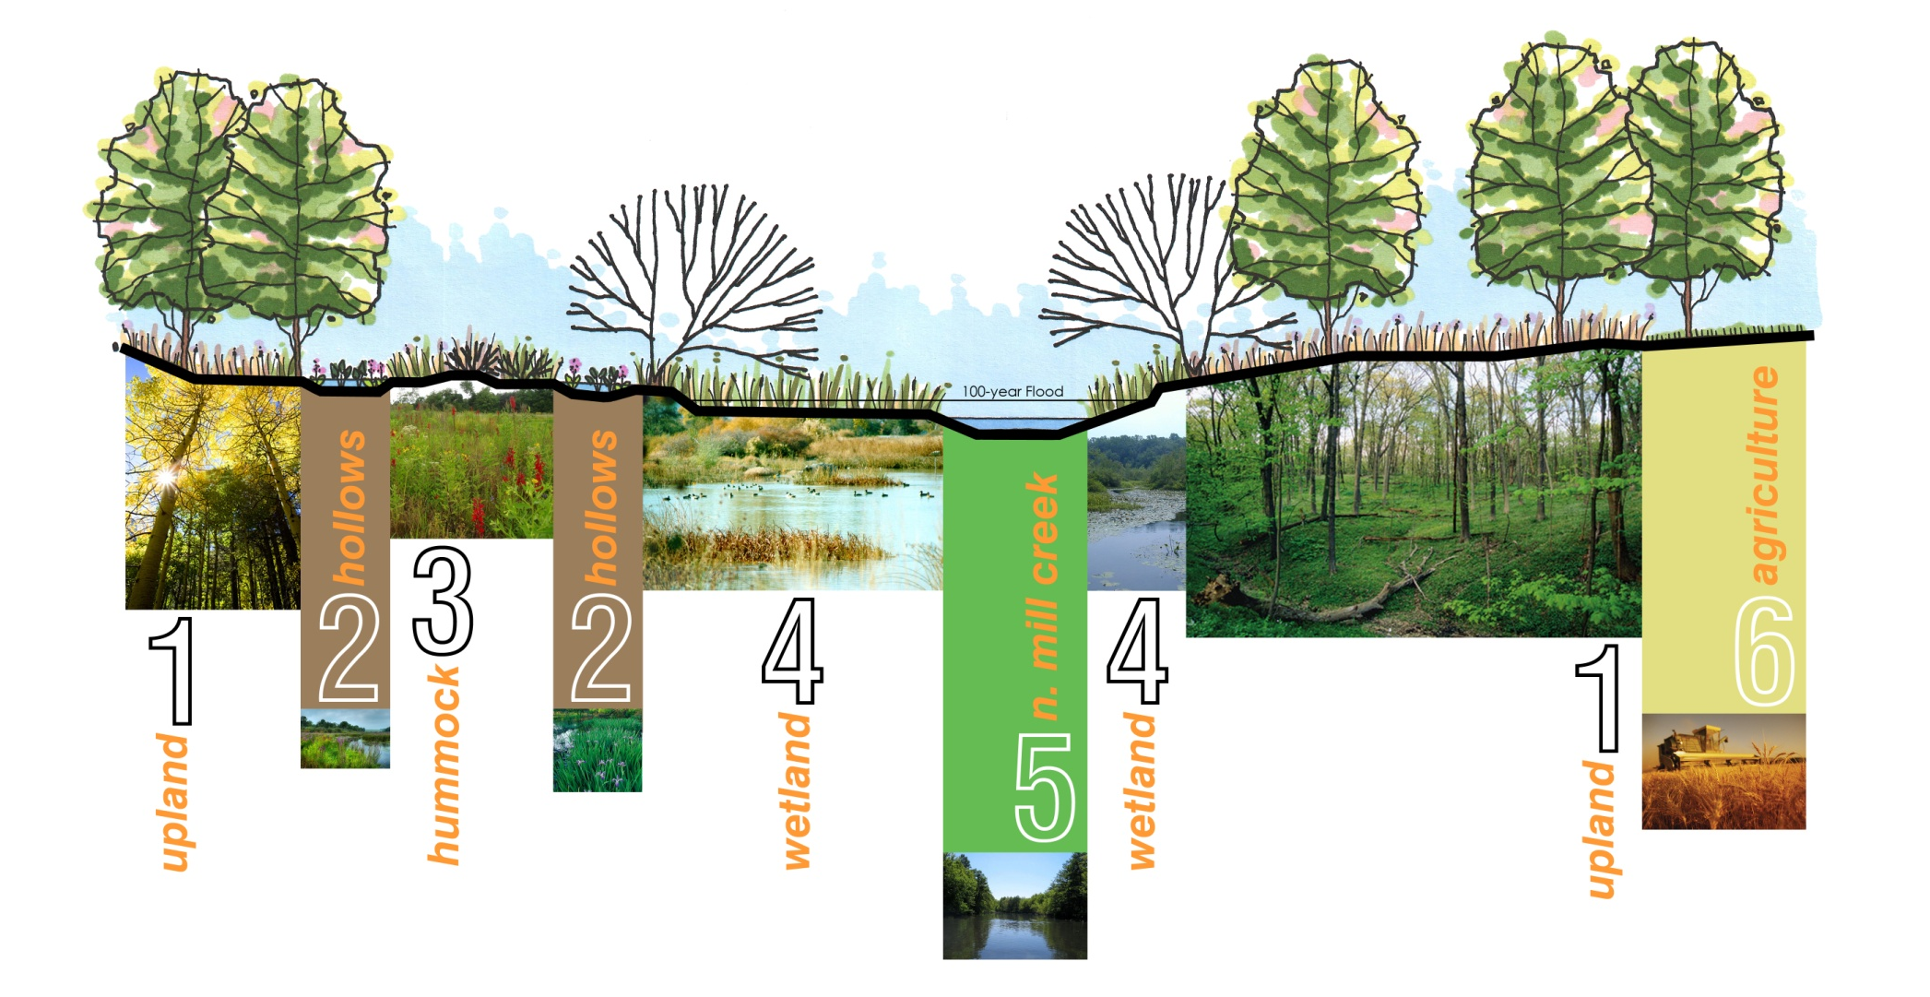

Slide 10
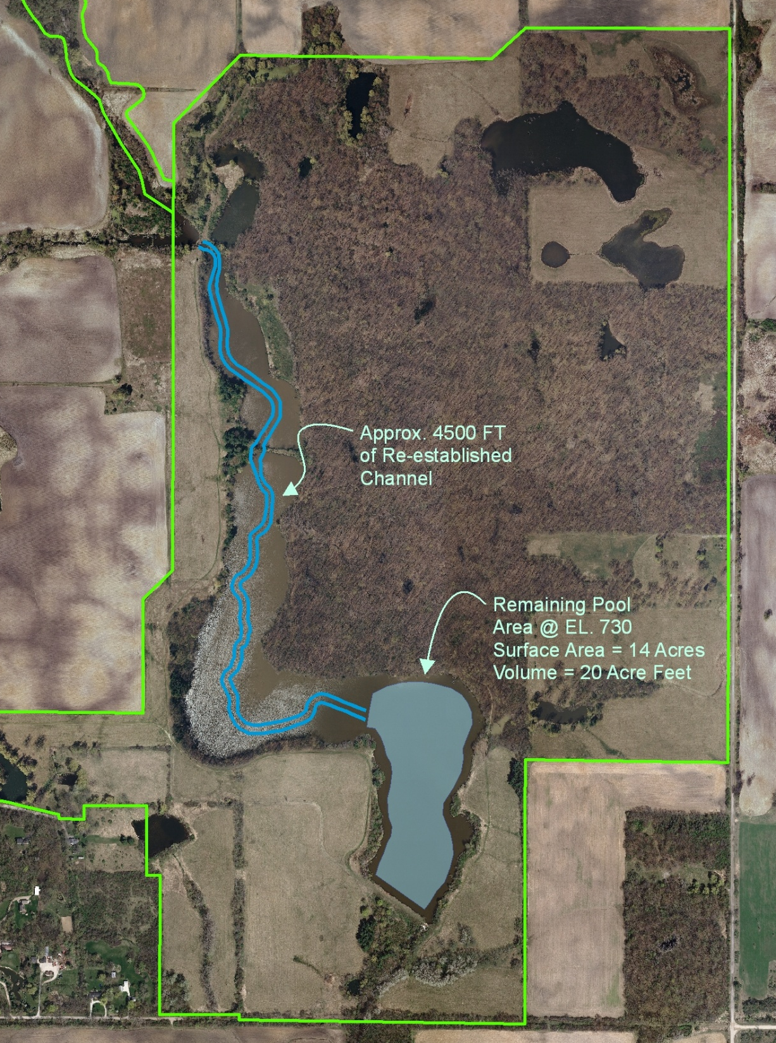
Phase I
Partial lake draining
Coffer dam to control lake elevation
4500 Ft of Channel
14- acre lake to catch sediment
Seeding of new floodplain

Slide 11
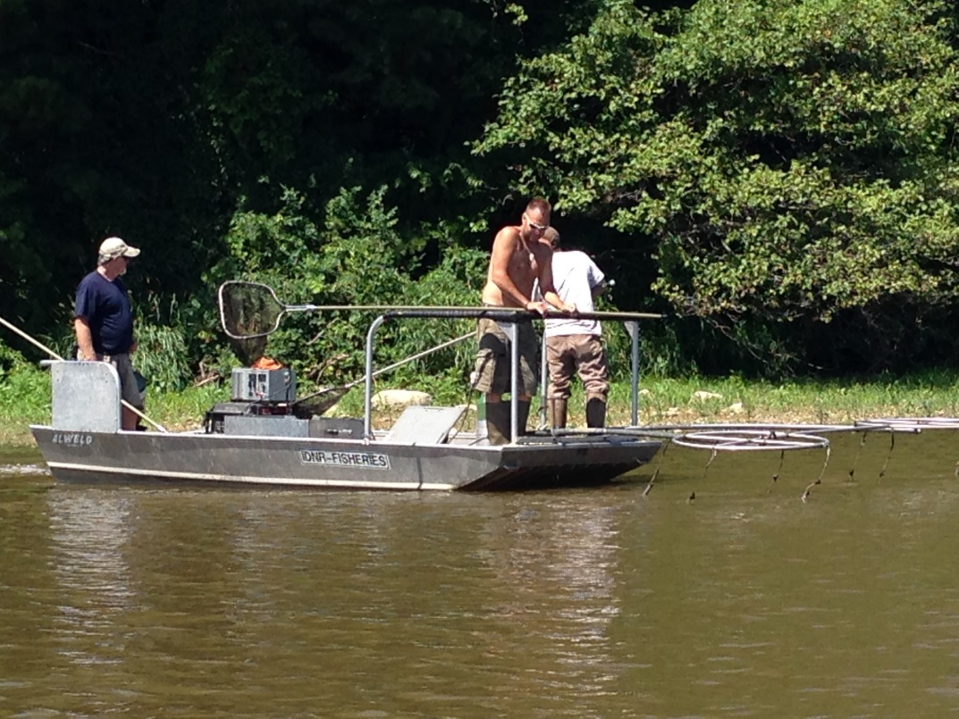
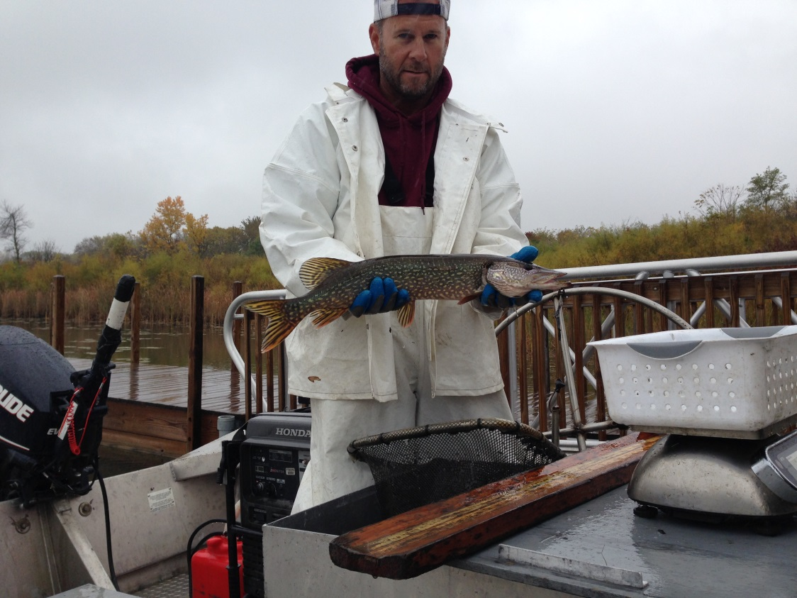
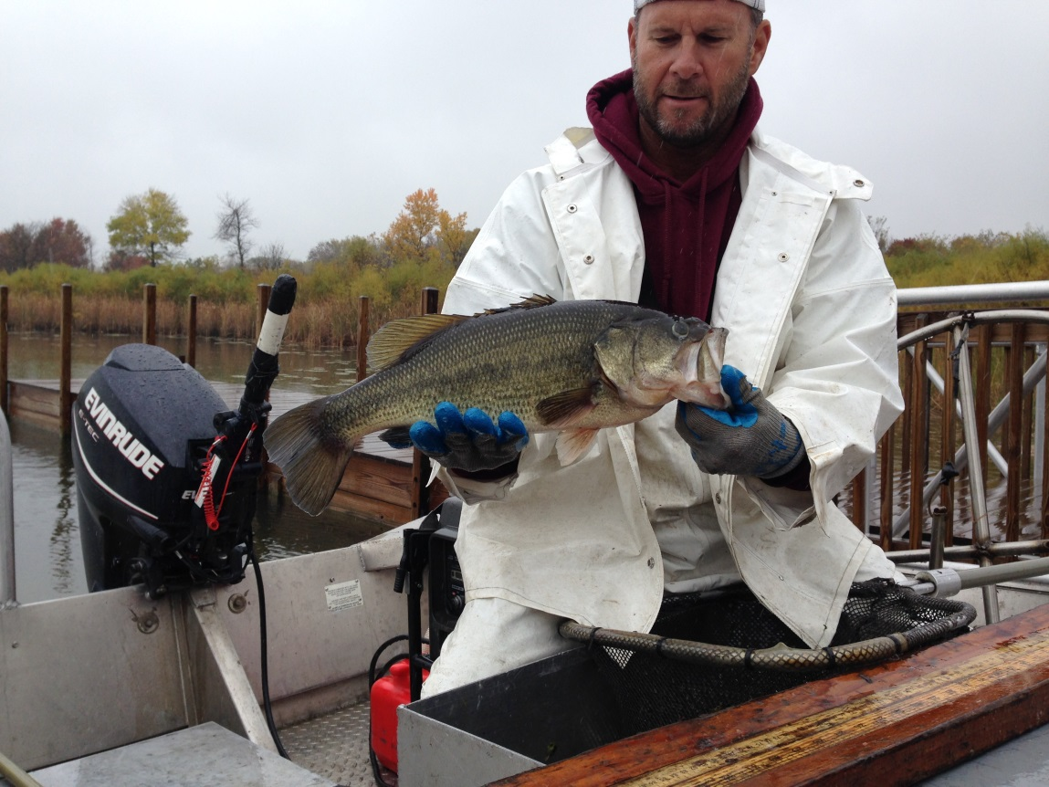
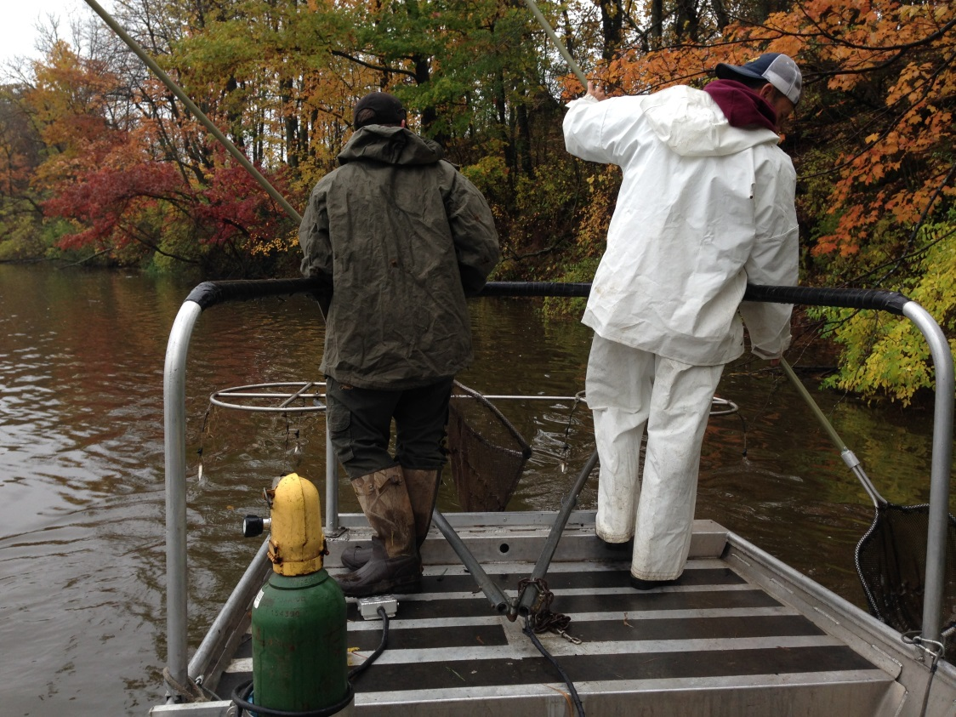

Slide 12
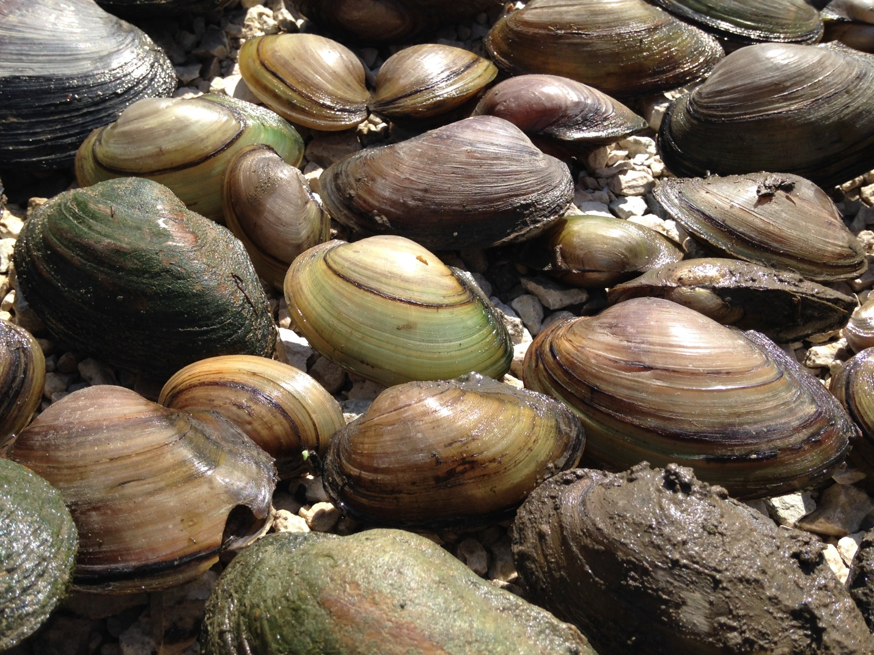
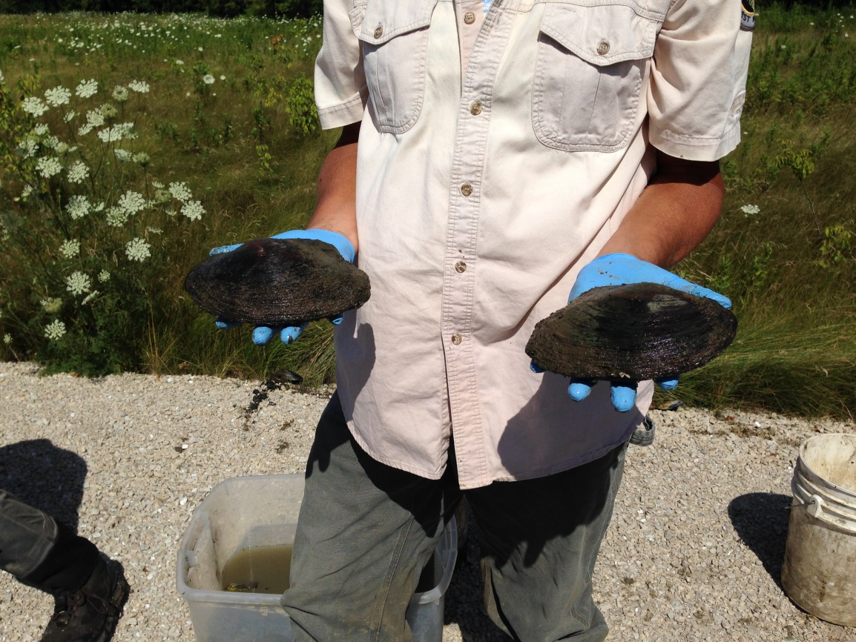
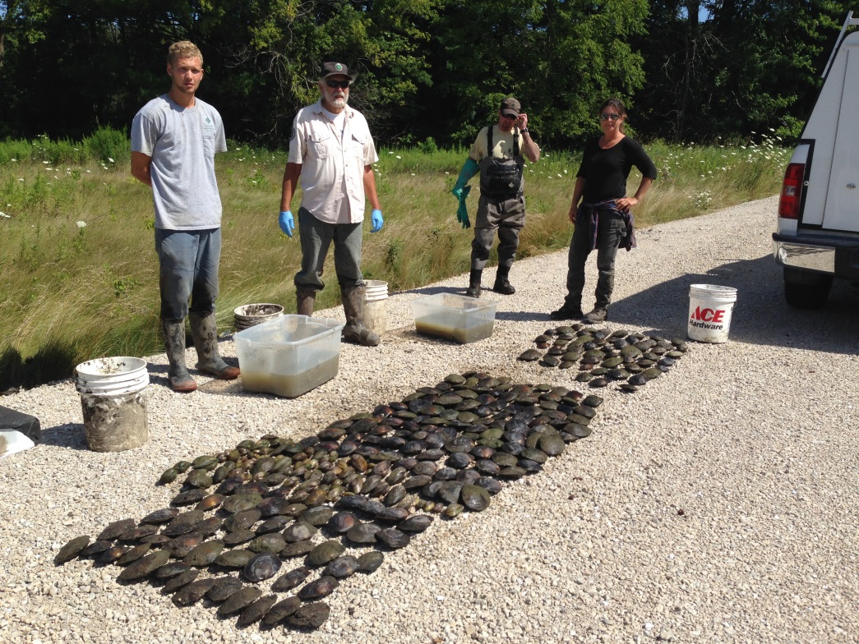

Slide 13
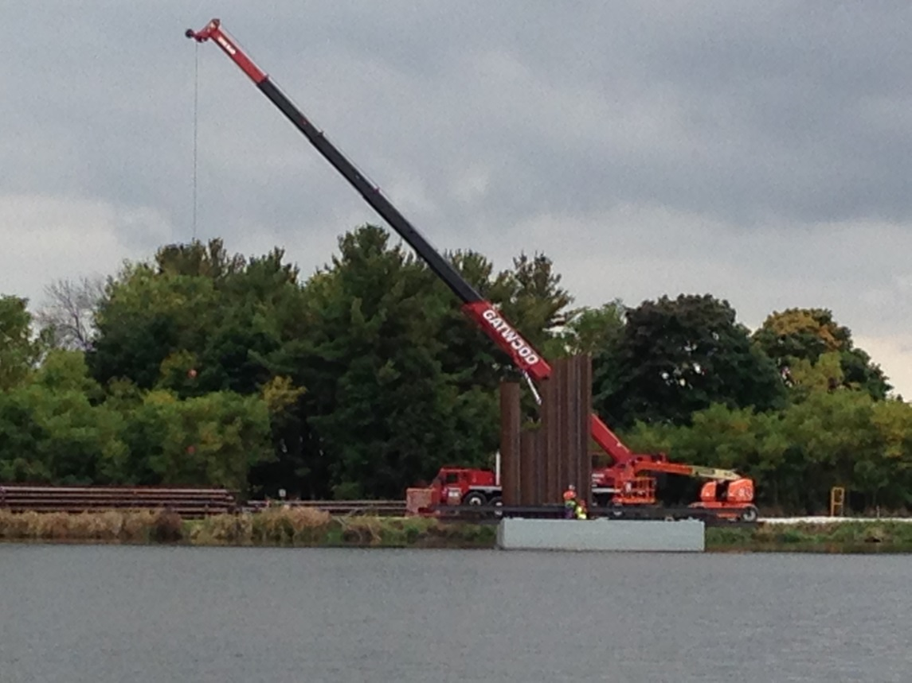
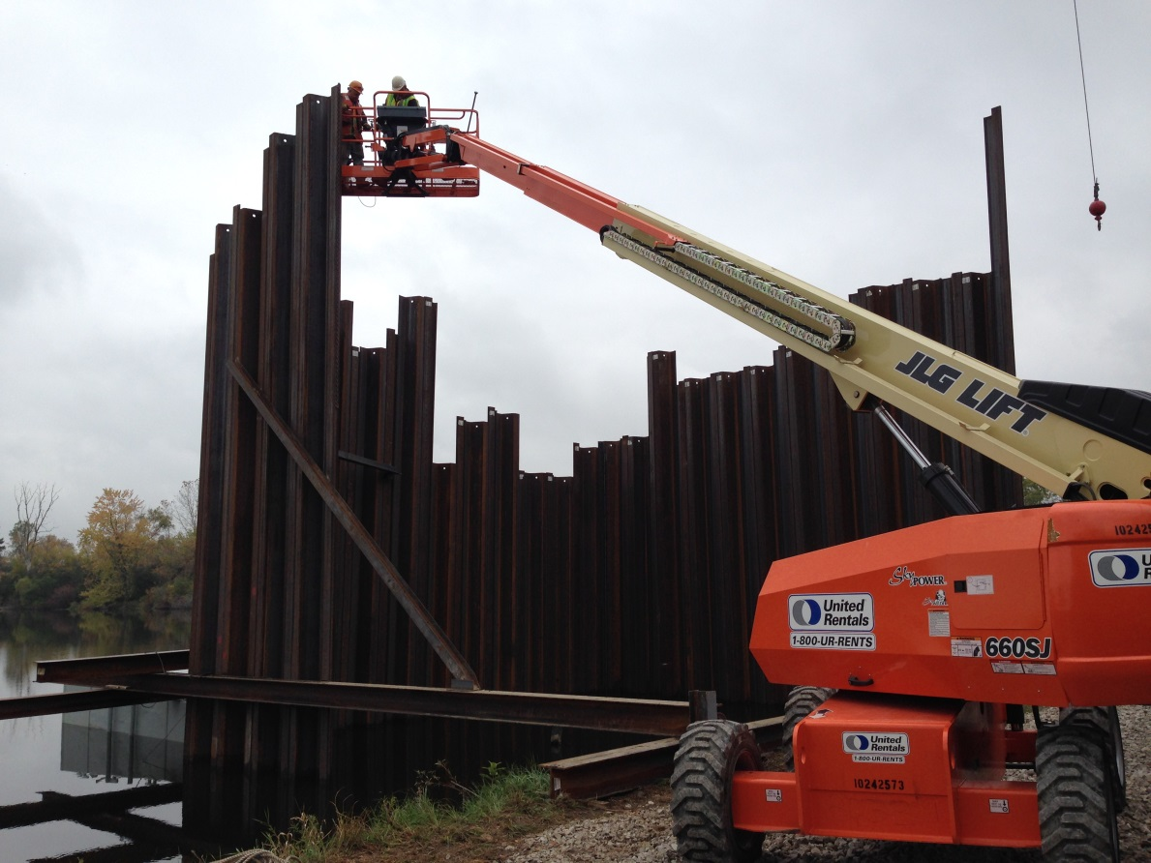
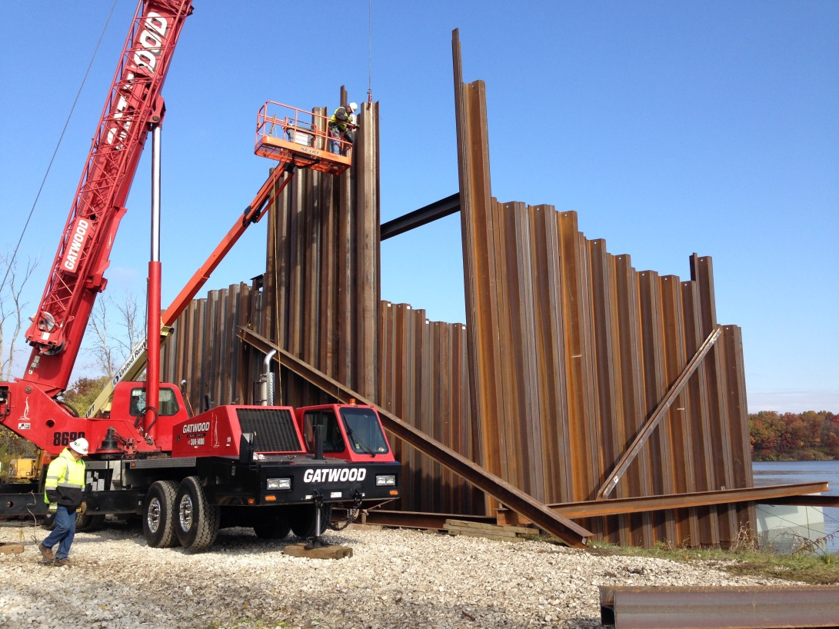
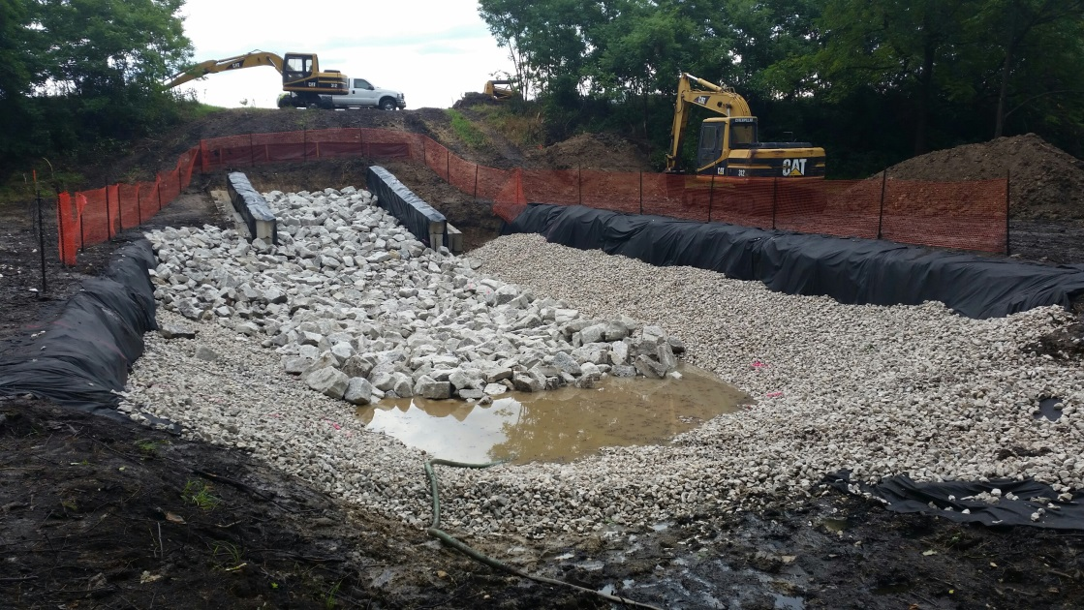

Slide 14
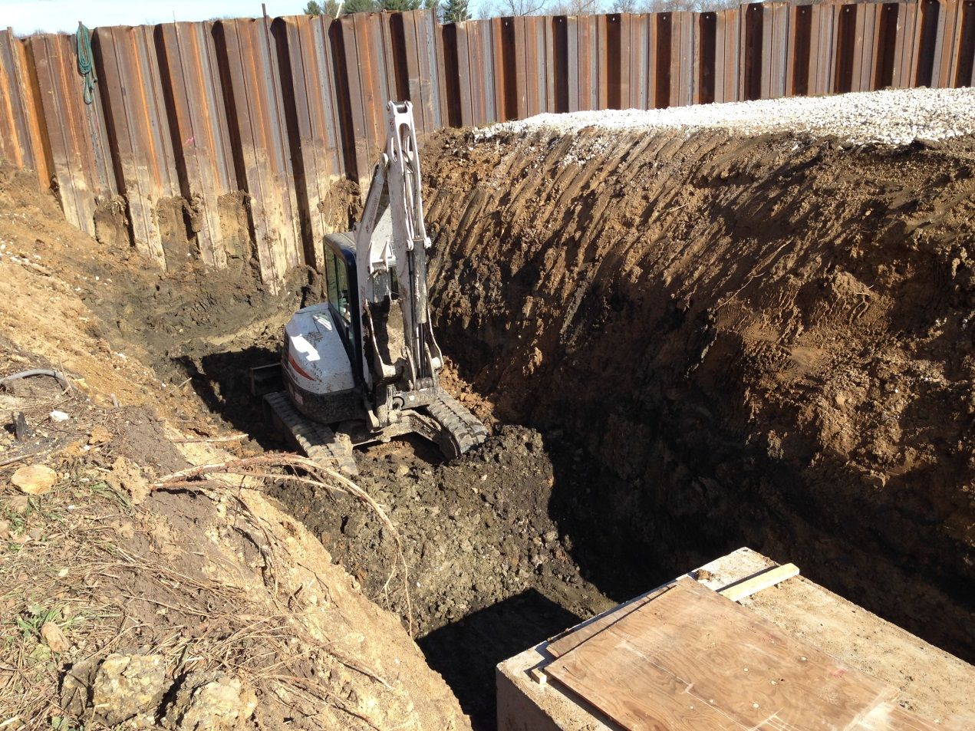
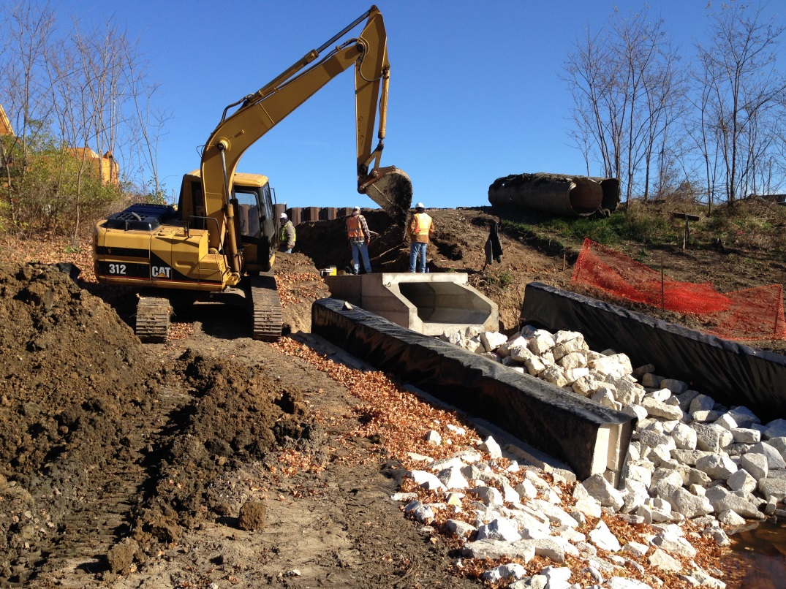
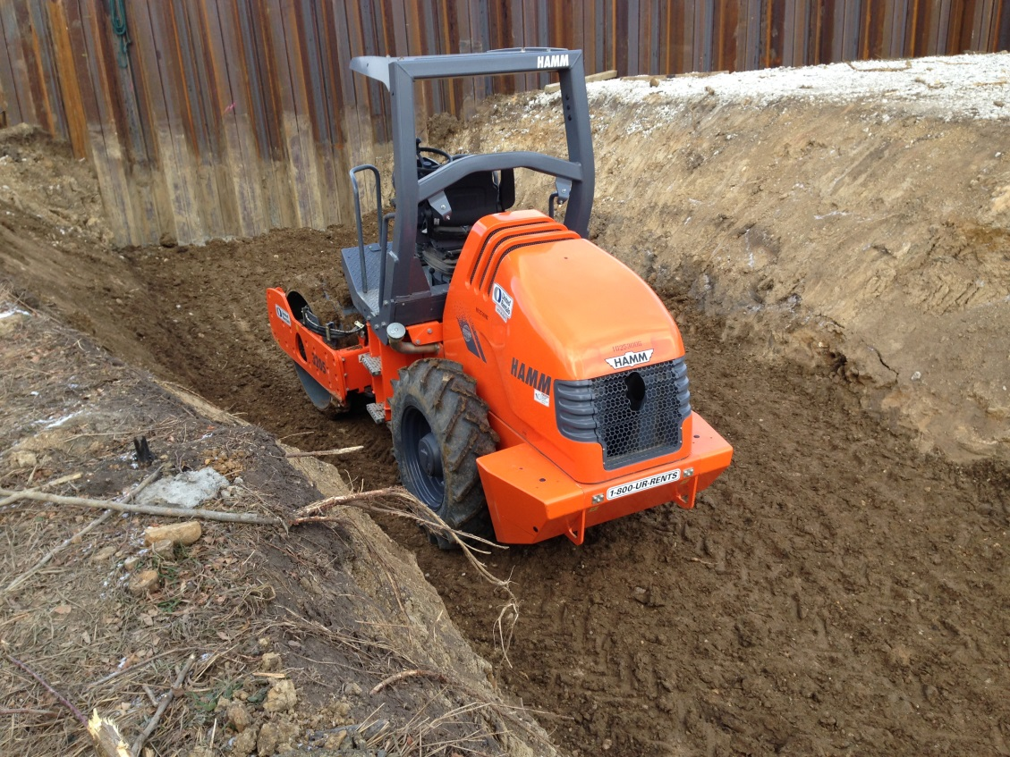
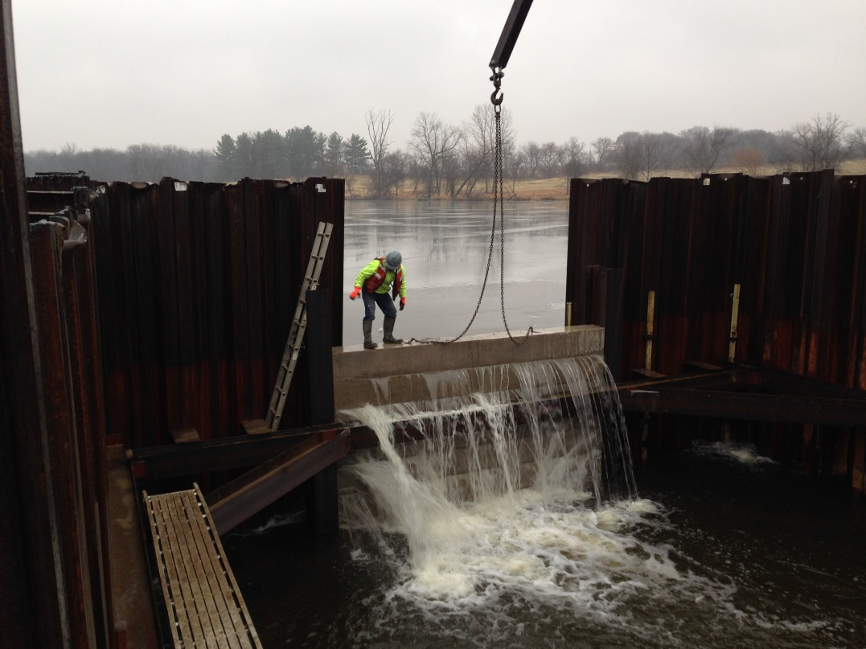

Slide 15
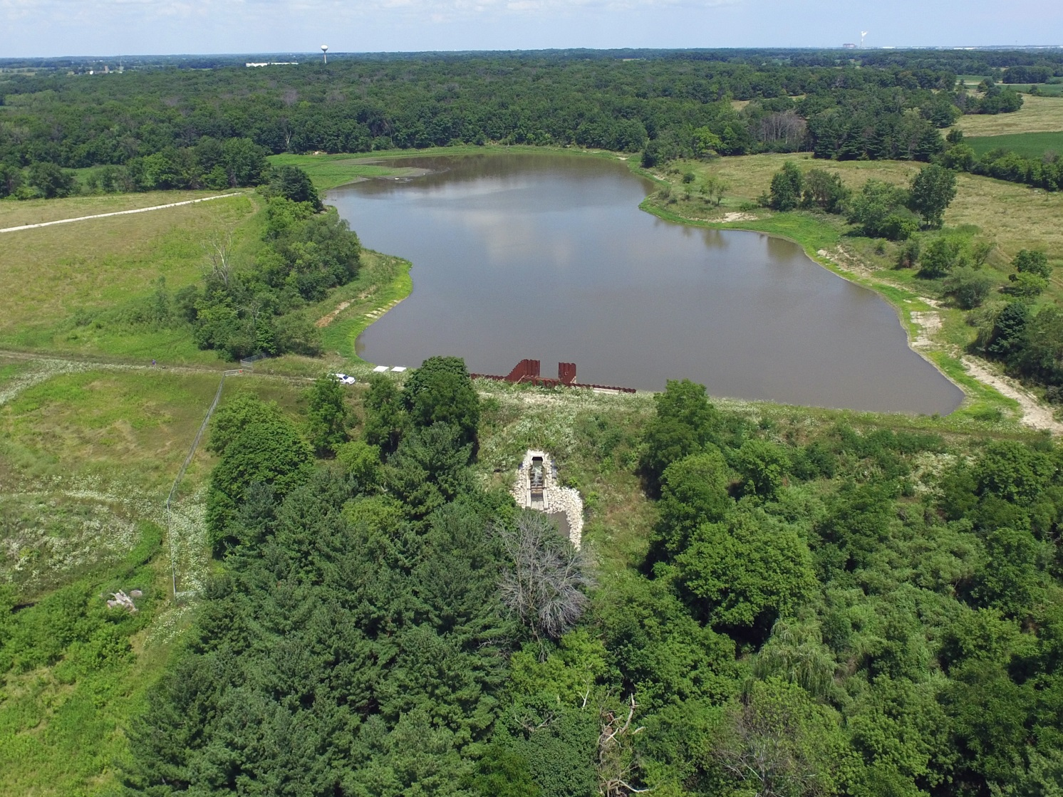
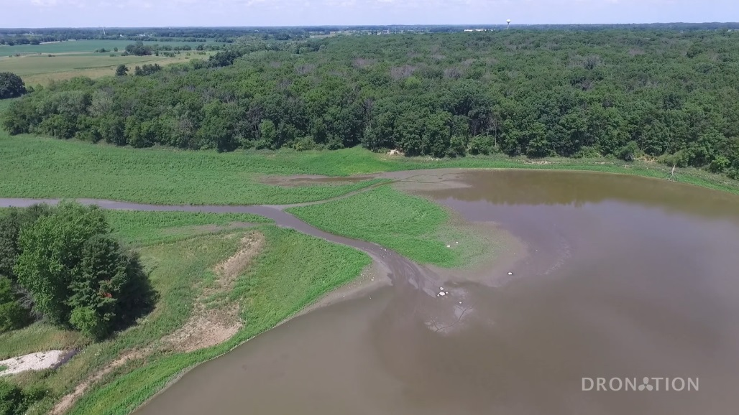
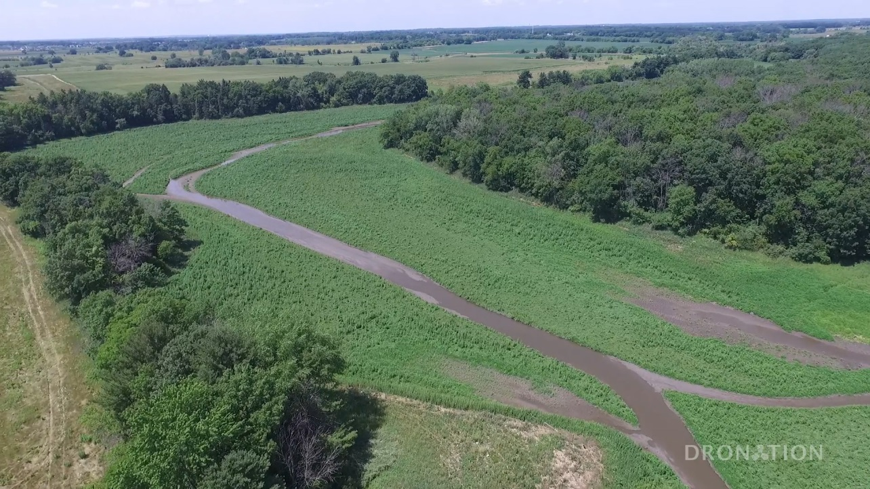

Slide 16
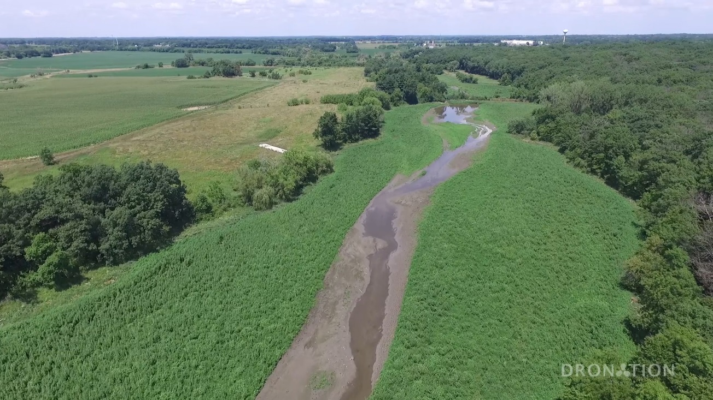
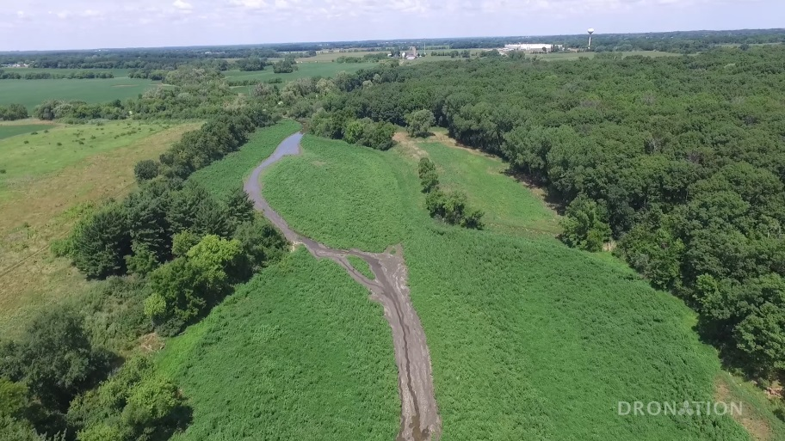
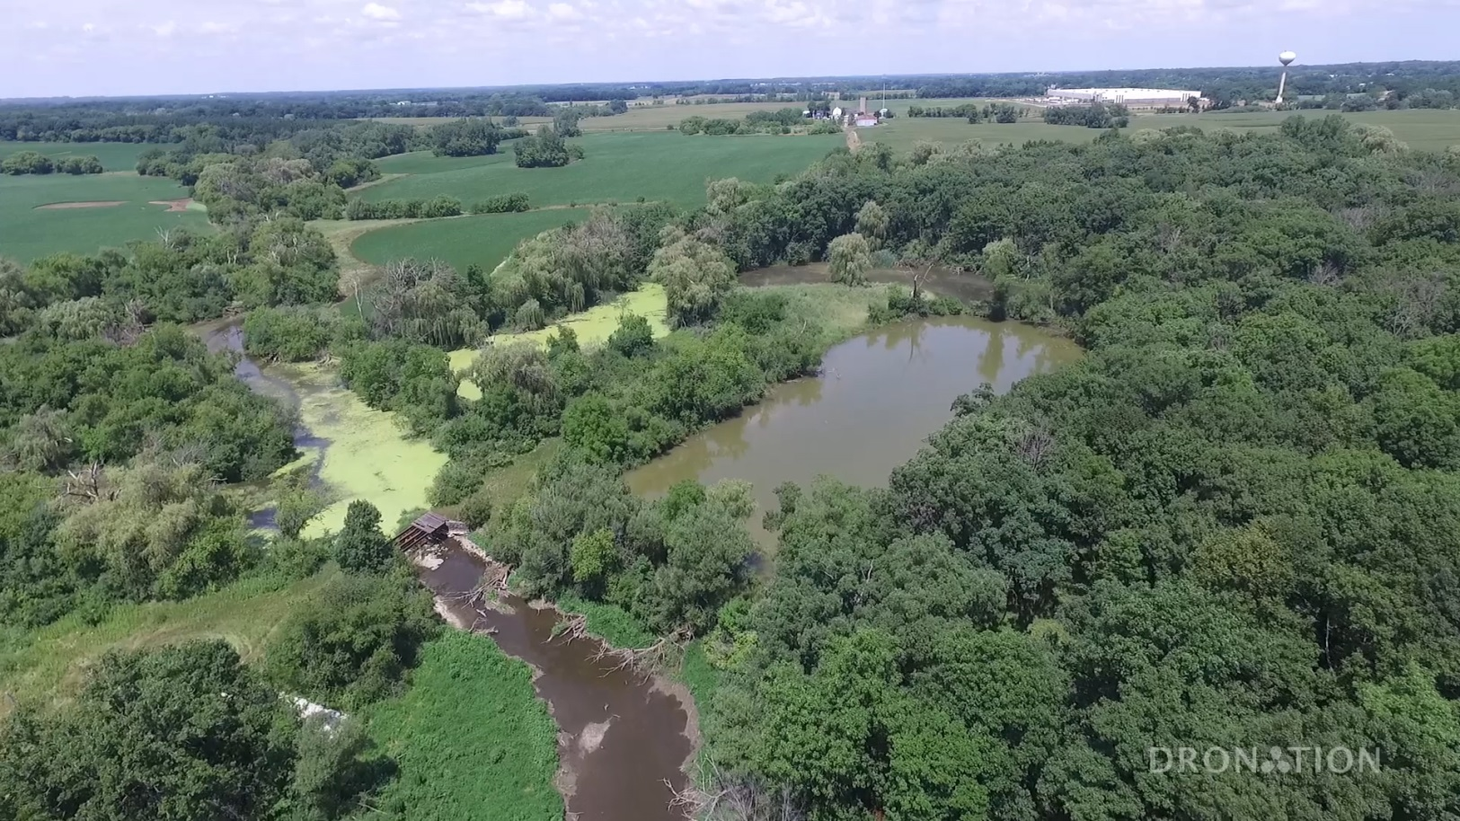

Slide 17
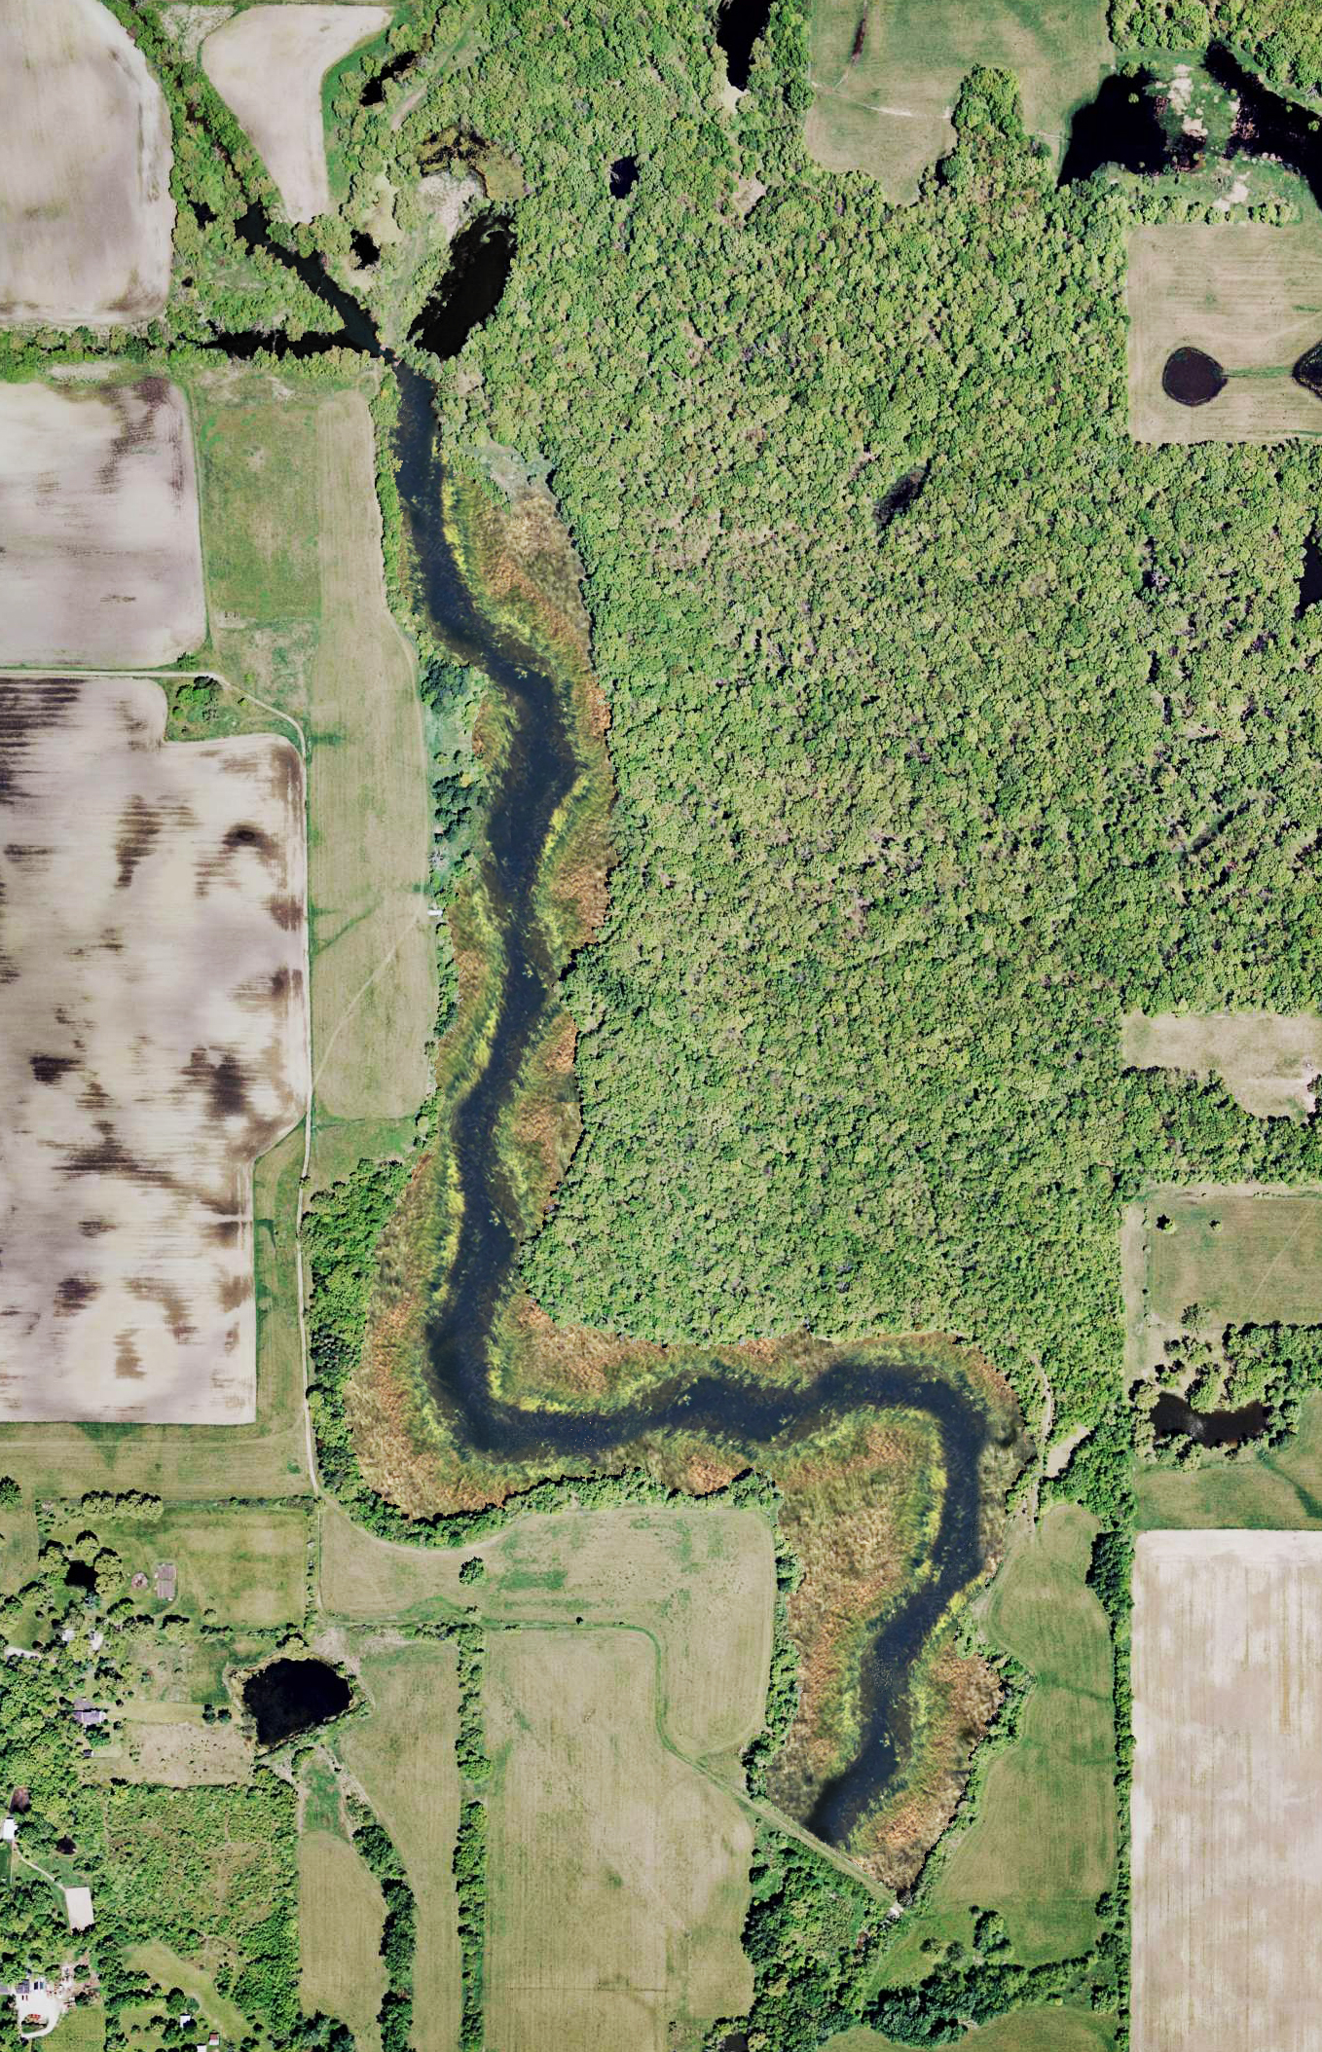
Phase II
Drain remaining 14 acres
Create pool & riffles stream channel
Address eroded slopes and dam face
Diversify floodplain
Remove concrete spillway & coffer dam
Remove north low-head dam

Slide 18
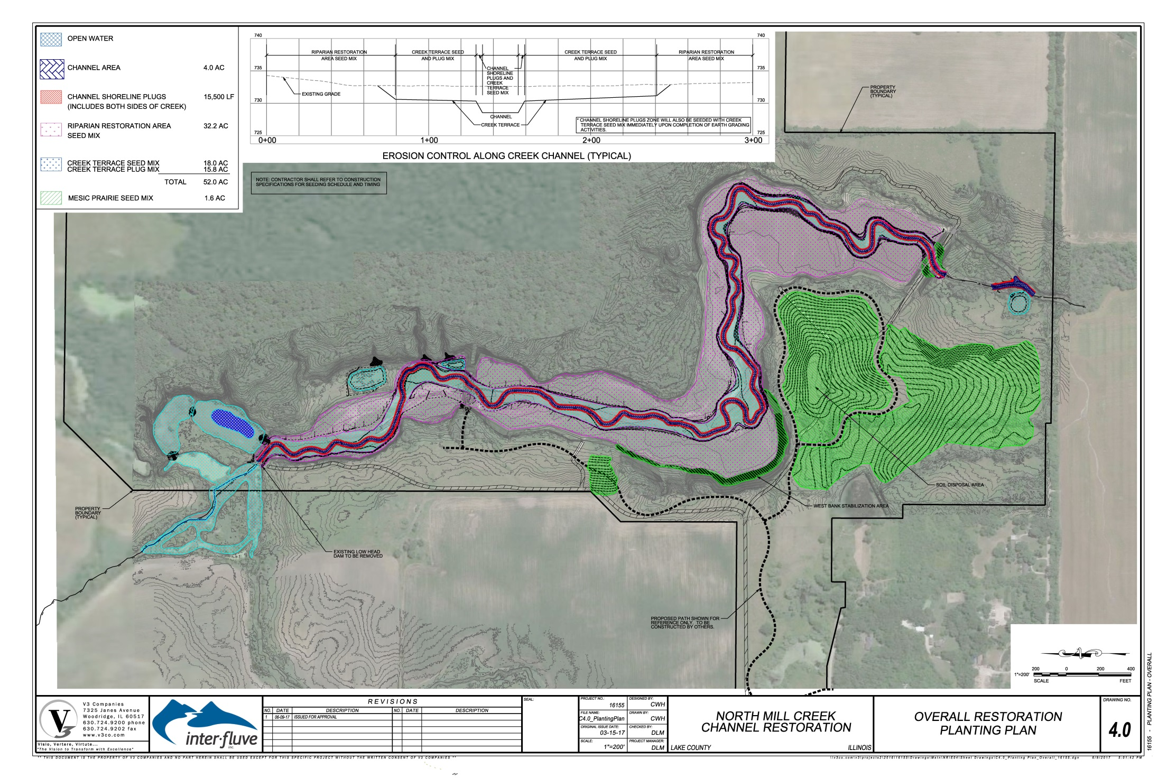

Slide 19
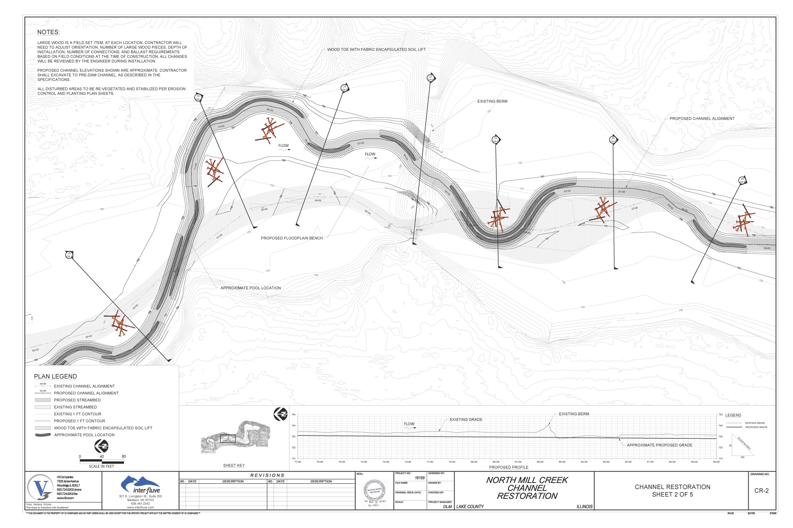

Slide 20
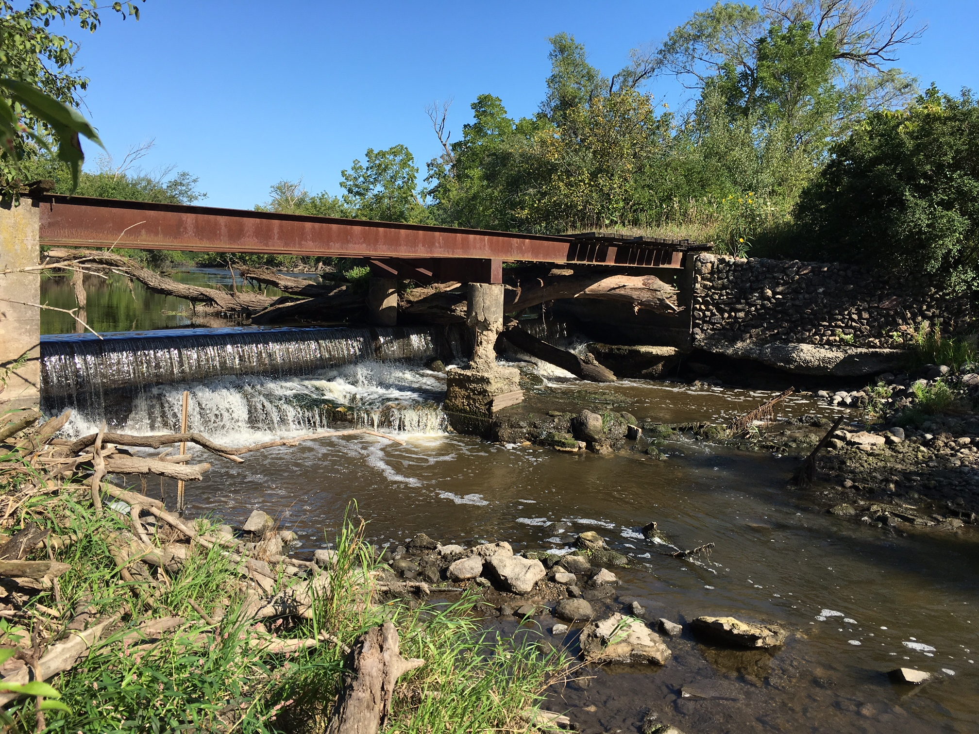
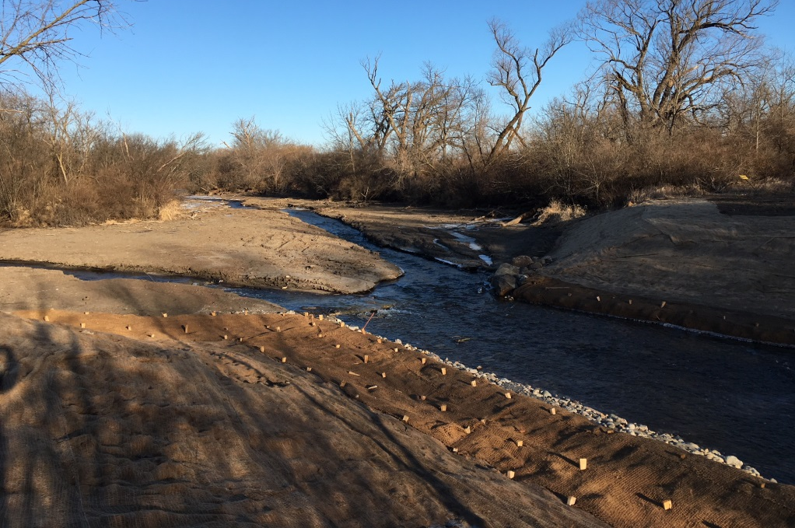

Slide 21
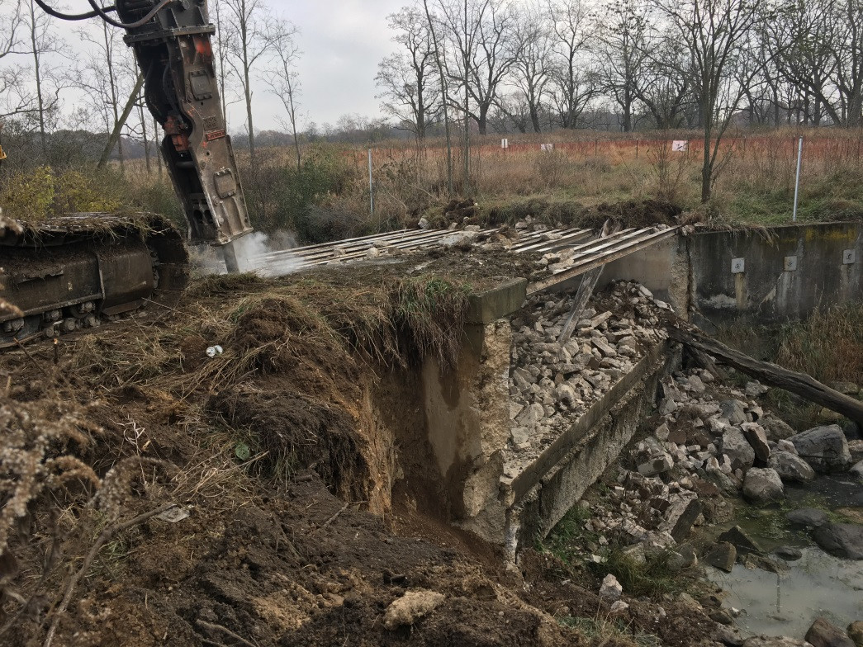
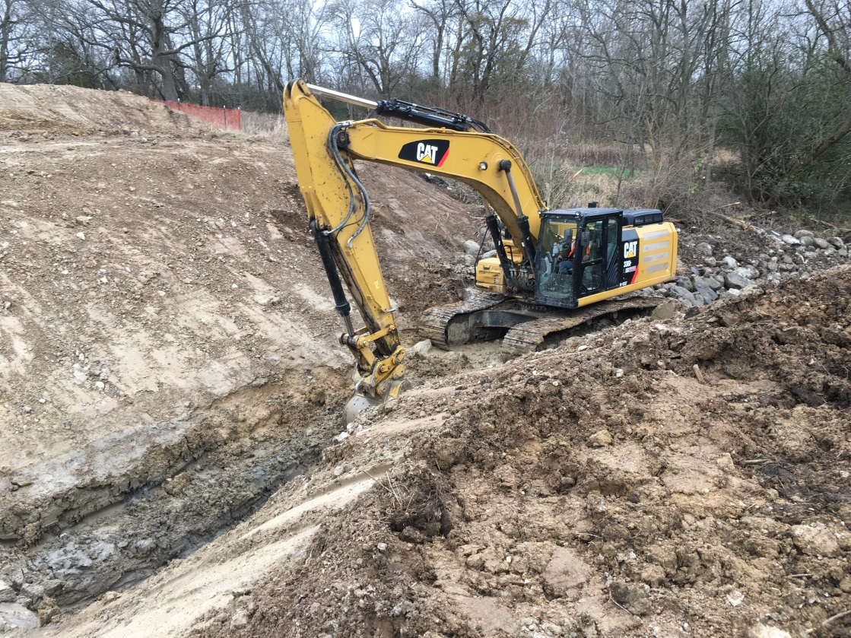
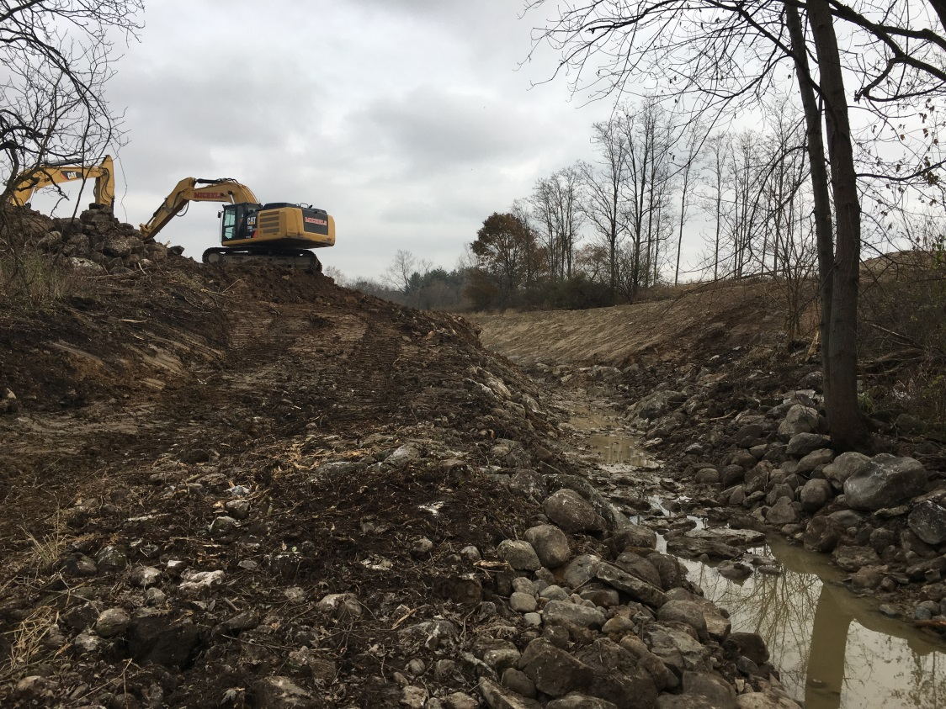
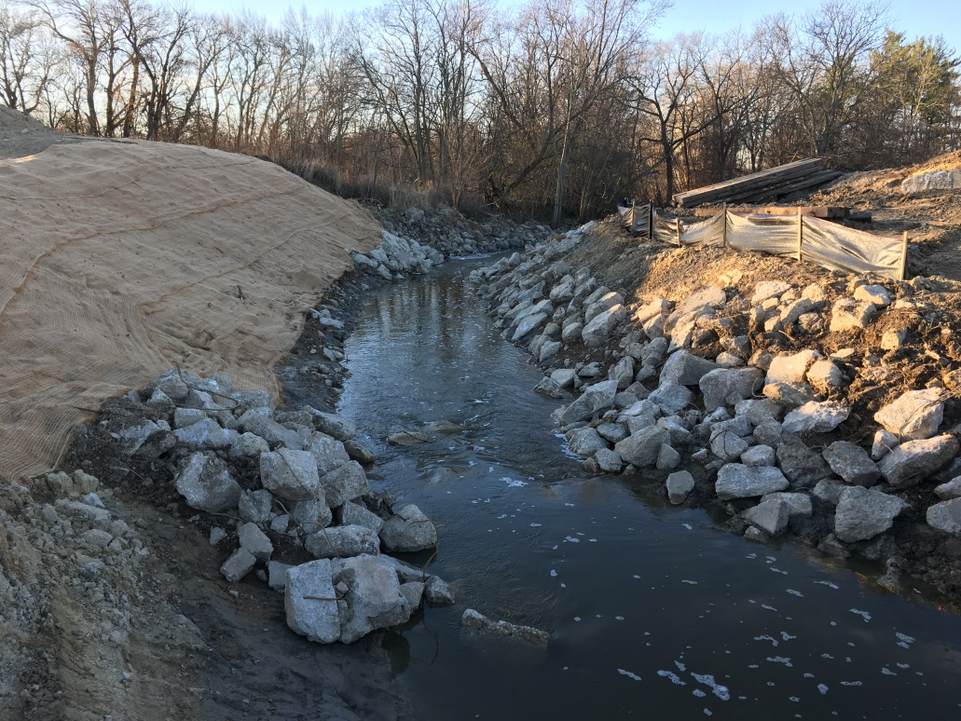

Slide 22
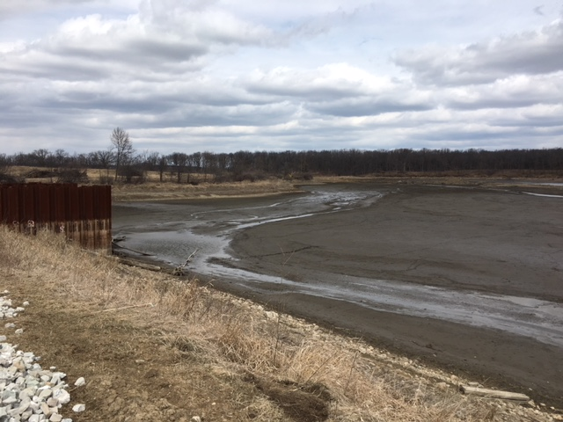
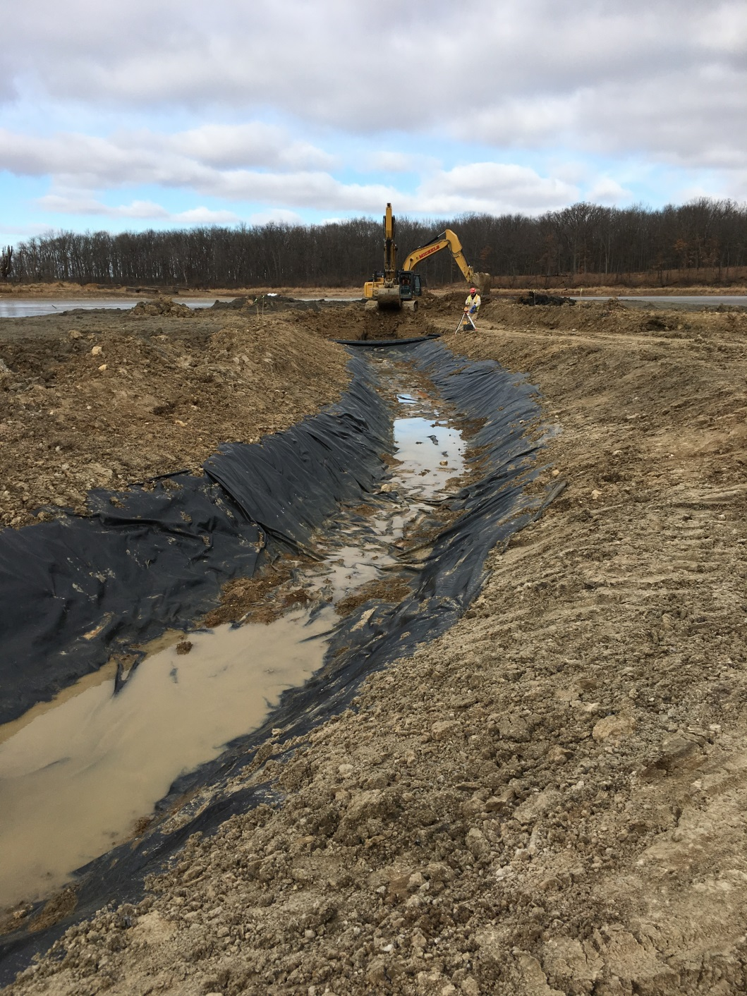
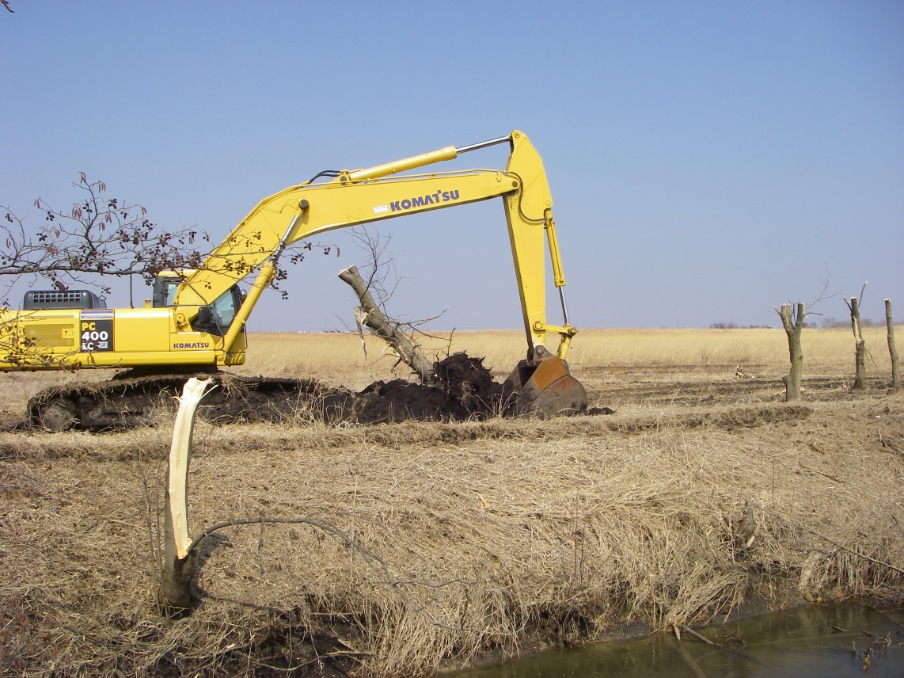

Slide 23
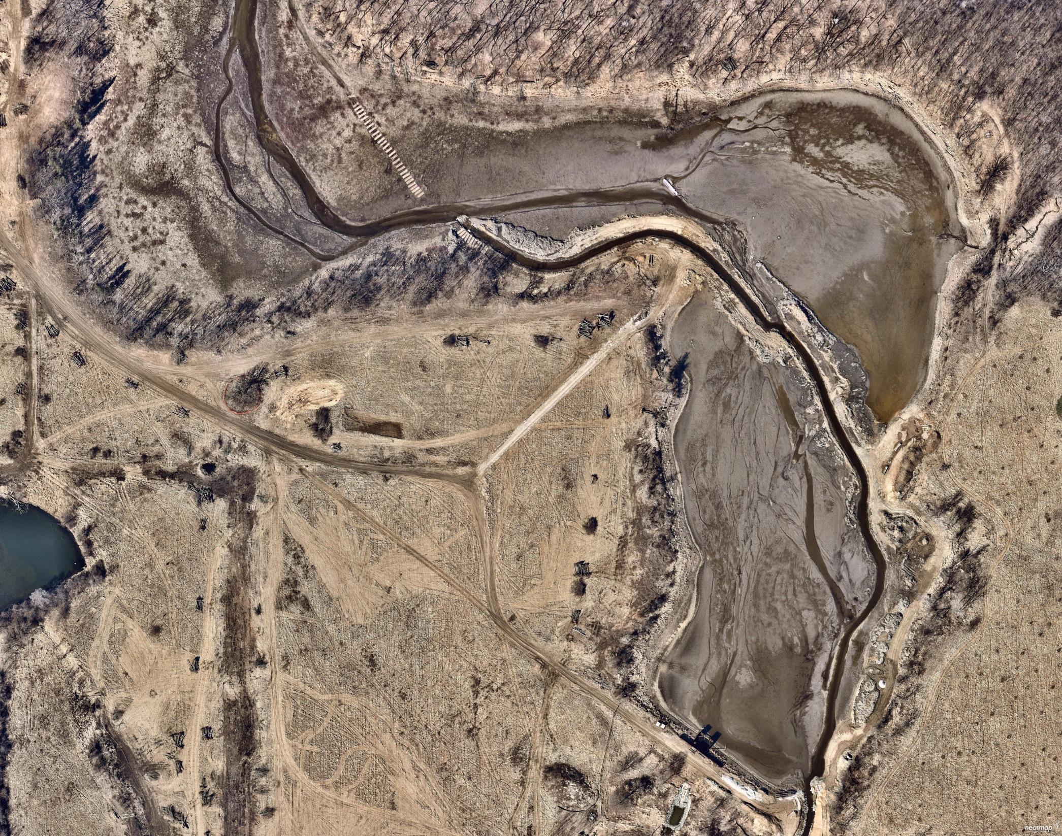

Slide 24
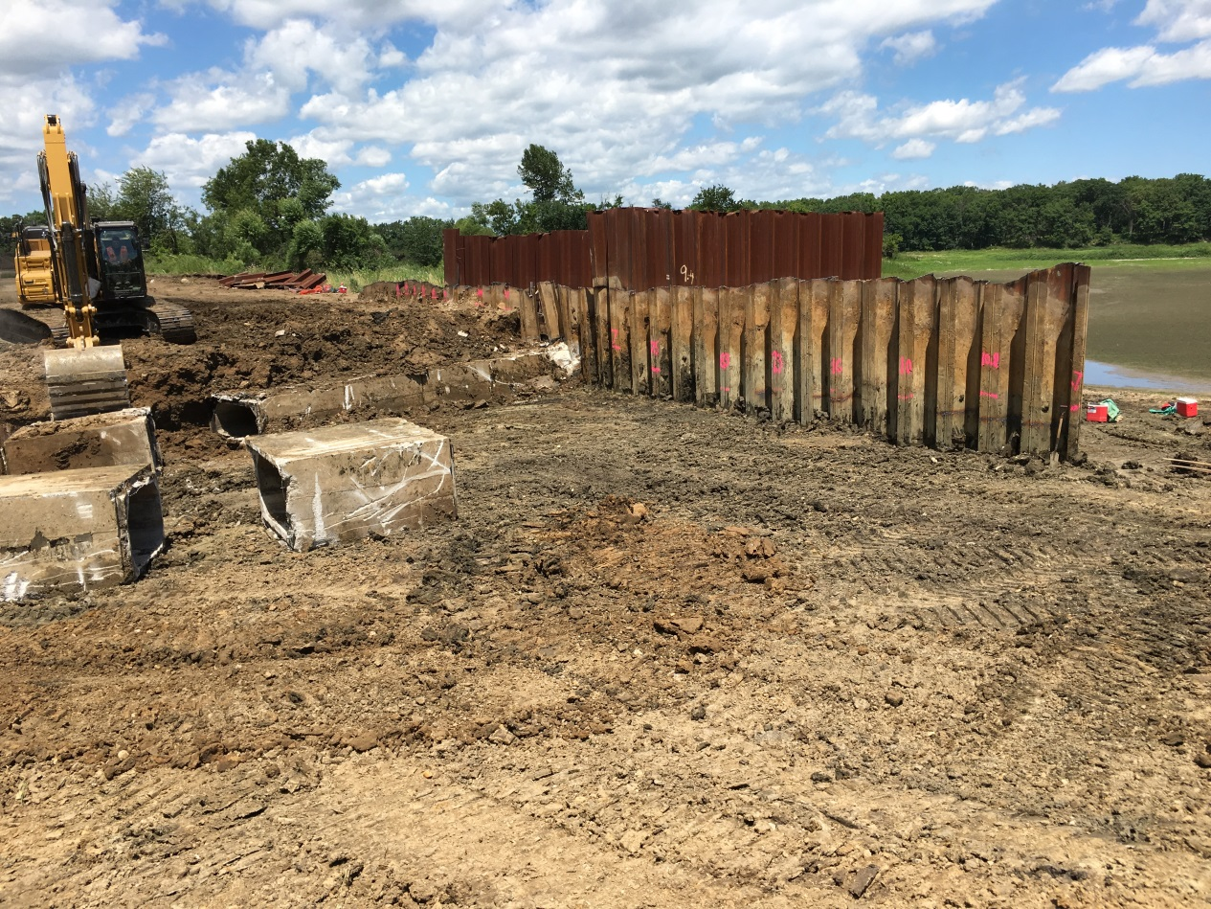

Slide 26
North Mill Creek Channel Restoration
Phase I
Total Cost $1M
Funding Assistance
$472K
319 Grant from U.S. Environmental Protection Agency & Illinois Environmental Protection Agency
Phase II
Total Cost $4M
Funding Assistance
$1M
319 Grant from U.S. Environmental Protection Agency & Illinois Environmental Protection Agency
Ethel’s Woods Ecosystem Services $8M/year
(flood control, water purification and groundwater recharge)

