Slide 1
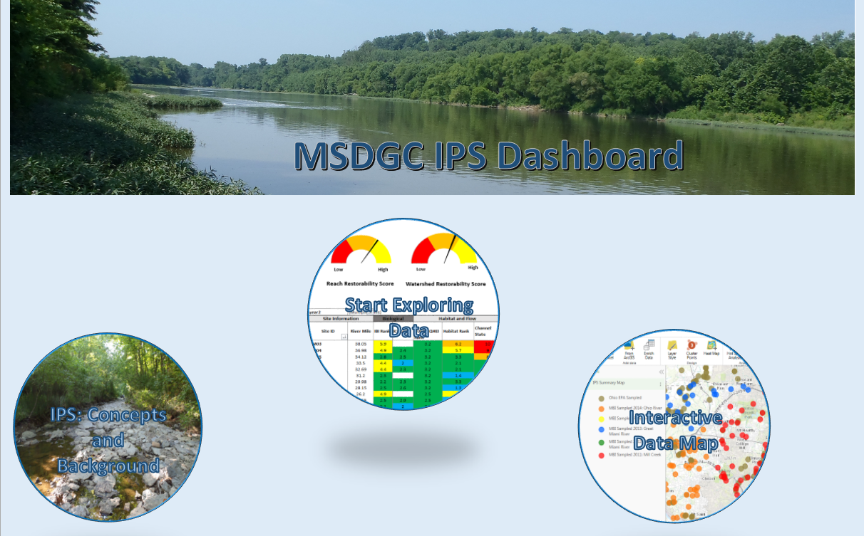

MSDGC Integrated Prioritization System (IPS)

Slide 2
Setting Priorities and Decision-Making: A Stronger Scientific Basis
MSDGC requested MBI to develop a tool for assessing biological & water quality conditions affected by multiple variables and stressors
Identify the most limiting stressors in the receiving streams
Develop a database that can be queried at the site, reach, and sub-watershed levels
Identify the “highest return” projects – both restoration and protection options.
Address required regulatory actions (e.g., CSO controls) while cost-effectively improving conditions for aquatic life and attainment of Water Quality Standards.
MSDGC’s service area:
11 sub-watersheds
3 major main stem rivers

Slide 3
History of Integrated Prioritization Systems
Ohio EPA
  Original IPS Concept Supports the Water Resource Restoration Sponsor Program (WRRSP)
    Used to prioritize and qualify WRRSP funded projects.
    Based on identified aquatic life use impairments related to habitat.
DuPage River Salt Creek Working Group IPS (DuPage Co., IL)
  Based on rotating basin surveys and includes consideration of:
    Waterbody ecological potential;
    “Restorability” of impairments revealed by monitoring and assessment;
    Effectiveness of “doable” restoration options;
    Being updated in 2016 based on lessons learned.

Slide 4
Statistically Demonstrated
Stressor Indicators
Parameter mIBI fIBI
  Riparian Score 5 Regression
  Riffle Score 4 3
  Channel Score Regression 10
  Substrate Score 9 Regression
  Pool Score 7 7
  Chloride 141 mg/l 112 mg/l
  TKN Regression 1.0 mg/l
  BOD₅ Regression Regression
  NH3N Regression 0.15 mg/l
Habitat
Chemical

Slide 5
The IPS Regulatory Foundation:
The MSDGC IPS is focused on the attainment of Ohio Water Quality Standards
Provides the basis for designated uses for aquatic life and recreation.
Ohio WQS have tiered uses for aquatic life & recreation.
Biocriteria are the arbiter of aquatic life use attainment.
Bacterial indicators are the arbiter of recreation uses.
Aquatic life is the focus of the IPS.
CWA Section 101(a)(2) “. . . it is the national goal that wherever attainable, an interim goal of water quality which provides for the protection and propagation of fish, shellfish, and wildlife and provides for recreation in and on the water . . . “

Slide 6
General Steps in a Stressor Identification Process for Aquatic Life
IPS Process
examines data at regional scale to refine thresholds & set priorities
Rotating
Watershed M&A
Stressor Identification Process:
Biocriteria Impairment with Stressor Threshold Analyses
Implement Management Actions:
CSO
SSO
Stormwater
Habitat
Other
Likely Causes & Sources of Impairment Identified

Slide 7
What is the IPS?
Allows users to visualize and rank aquatic life use aspects of CWA water quality issues:
  Identifies designated aquatic life uses (goals) for streams and rivers.
  Identifies aquatic life impaired reaches including severity and extent.
  Identifies causes of impairment.
  A standardized approach to viewing data linked to attainment of aquatic life uses.
  Sites, reaches, and watersheds ranked by Restorability (for impaired waters) and Susceptibility & Threat (for attaining waters).

Slide 8
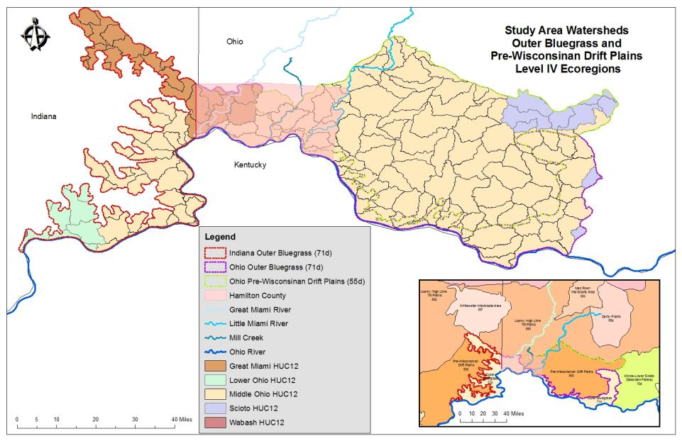
IPS study areas are necessarily regional in scope and focus on common sub-regions at a HUC12 scale
MSDGC
Ohio EPA

Slide 9
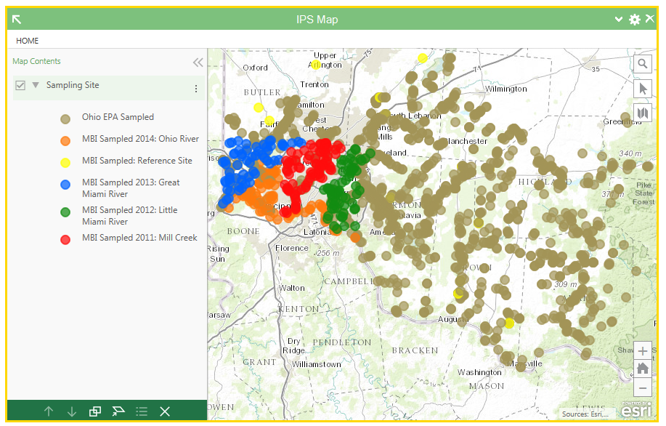
Data Used in the IPS
Regional data used to develop Restorability and Susceptibility/threat ratings at the site, reach, and Huc12 watershed scales.

Slide 10
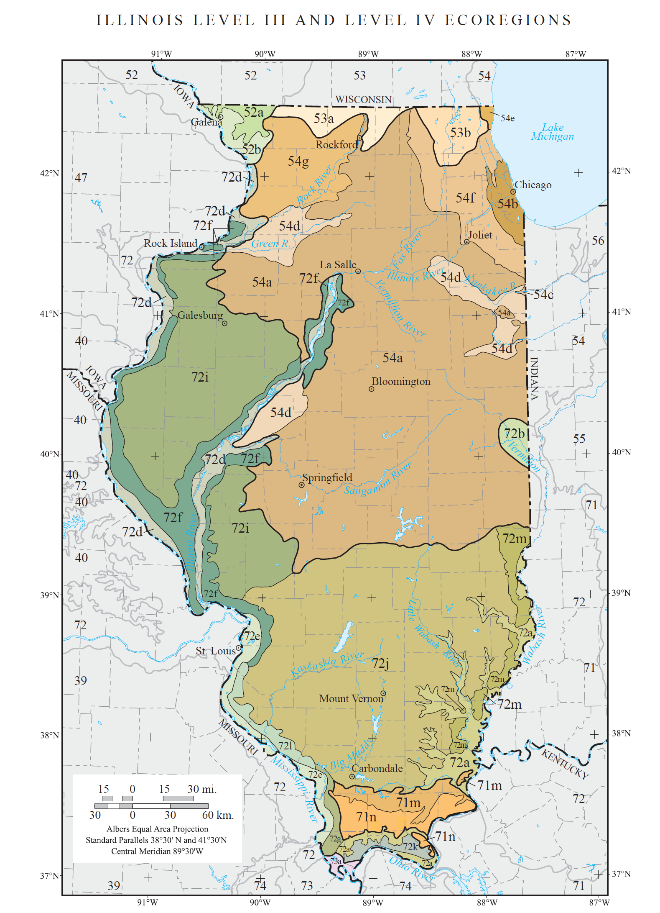
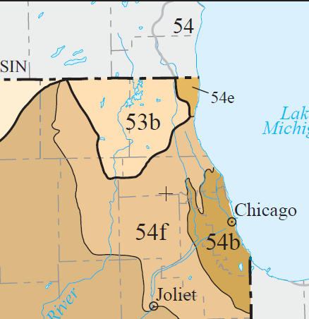
NE Illinois IPS Data
DRSCWG IPS re-development includes DRSCWG, DRWW, and IEPA regional databases which will expand the stressor and response gradients in 2017-18 across NE Illinois.
DRWW
IEPA
DRSCWG
IEPA
LDPWG

Slide 11
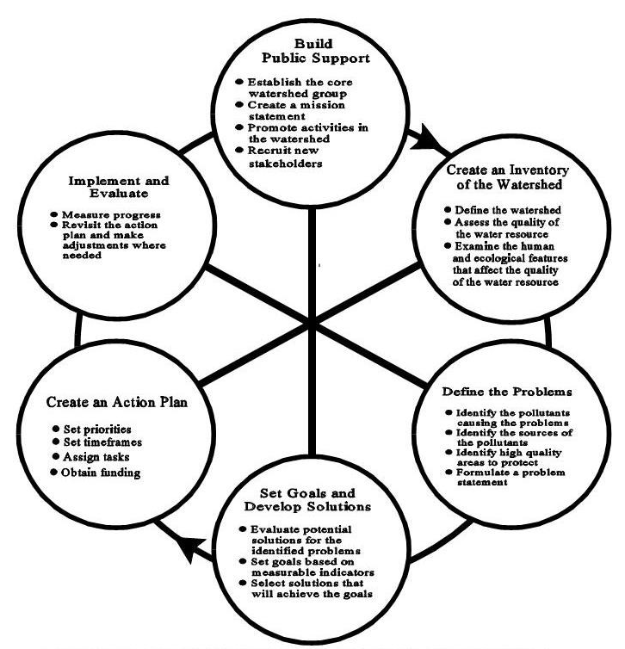
IPS & Annual Watershed Assessments
Addresses all of the DATA functions in a Watershed Action Plan
  Inventory: Aquatic life use attainment status
  Identify & quantify pollutants, sources, high quality waters, ecological features
  Prioritize abatement projects
  Measure Progress
  Inform Public

Slide 12
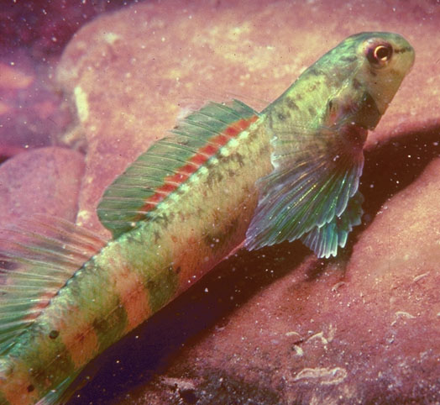
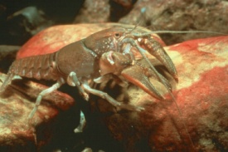
IPS: A Data Driven Foundation
Ambient monitoring data that includes:
  Biological data
    To evaluate biocriteria compliance
  Water and sediment chemistry data
    To evaluate water quality criteria
    Compare to biocriteria based benchmarks
    Compare to reference site benchmarks
  Habitat data
    Key limiting factor to biota
  Land use and flow data
    Effects of land use on the natural flow regime is a key issue

Slide 13
Stressor and Response Variables are Normalized to the Same Scale
Stressor Rank Guide
Narrative Description | Aquatic Life Use Equivalent | Numeric Range
Excellent | Exceptional Warmwater Habitat (EWH) | 0-2
Good | Warmwater Habitat (WWH) | 2-4
Fair | Modified Warmwater Habitat (MWH) | 4-6
Poor | Limited Resource Water (LRW) | 6-8
Very Poor | Never Acceptable | 8-10

Slide 14
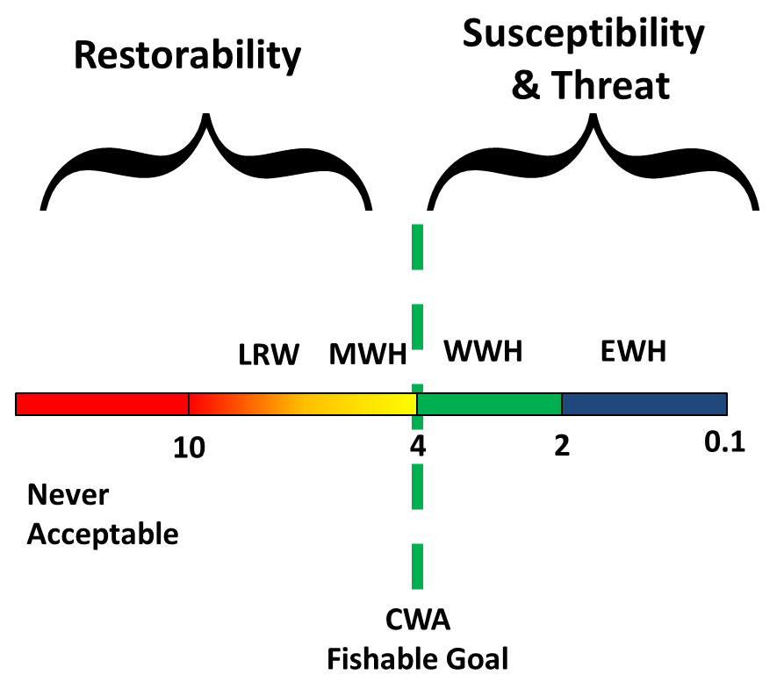
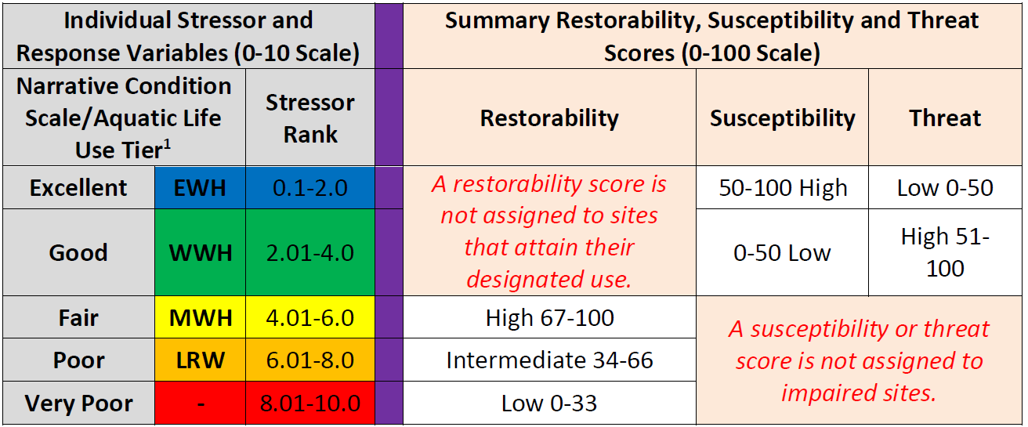
Principal IPS Outputs

Slide 15
Derivation of Stressor Benchmarks
Multiple options for stressor benchmarks:
  Water quality criteria where they exist (ammonia, dissolved oxygen).
  Regionally derived biological stressor benchmarks.
  Regional reference conditions.
Regionally derived benchmarks provide thresholds for parameters without WQ criteria and more relevant and accurate effect thresholds for parameters with statewide criteria.

Slide 16
http://www.msdgc.org/initiatives/water_quality/index.html

Slide 17
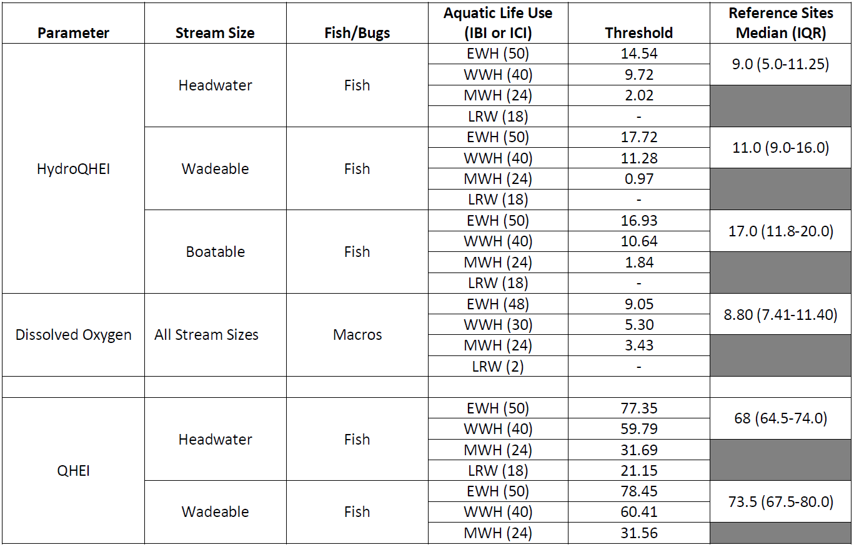
Stressor Categories | Common Indicators (Italic – Used in the IPS)
Habitat Diversity | QHEI, QHEI Channel
Bedded Sediment | QHEI Substrate Metric, QHEI Embeddedness and Silt Scores
Stream Flow Regime | Base Flow Index (LF), HydroQHEI (LF), Impervious Surface (LF/HF), Mean Sept Flows (LF)
Oxygen Demand | Minimum DO, BOD
Acid/Alkaline Conditions | pH
Dissolved Substances | Total Chloride, Conductivity, TDS
Suspended Substances | TSS
Nutrients | TP, Nitrate, TKN
Conventional Toxics | Ammonia
Metals | Copper, Zinc, Lead, Manganese
Flood Plain/Land Use Quality | QHEI Riparian, Buffer Land Use, Catchment Land Use (Heavy Urban)
IPS Variables & Endpoints

Slide 18
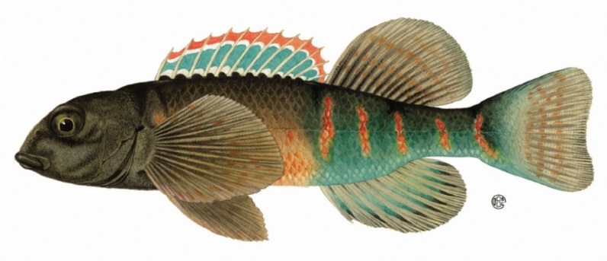
QHEI (Habitat)
Stream Size | Aq. Life Use | IBI Biocrit-eria | Ref Values Median (IQR) | Threshold Values
Headwater | EWH | 50 | 68 (64.5-74.0) | 77.35
 | WWH | 40 |  | 59.79
 | MWH | 24 |  | 31.69
 | V. Poor | 18 |  | 21.15
Wadeable | EWH | 50 | 73.5 (67.5-80.0) | 78.45
 | WWH | 40 |  | 60.41
 | MWH | 24 |  | 31.56
 | V. Poor | 18 |  | 20.74
Boatable | EWH | 48 | 83.5 (77.25-84.75) | 76.65
 | WWH | 38 |  | 60.06
 | MWH | 24 |  | 36.83
 | V. Poor | 18 |  | 26.88
QHEI Stressor
Rank:
10
4
2
0

Slide 19
Restorability Algorithm
Each of the restorability factors are scaled from 0-10:
A lower score indicates full attainment and/or a high potential for restoration;
A higher score indicates an accumulation of precluding stressors some of which make restorability more difficult or cost-prohibitive.
IPS tool designed to evaluate at site, reach, or watershed scale.

Slide 20
Susceptibility & Threat
Susceptibility refers to the sensitivity of attaining aquatic assemblages with more diverse and sensitive assemblages (e.g., reflected by high IBI & ICI scores) being more susceptible.
Threatened are waters that attain their aquatic life use, but which have elevated stressor levels.
The more stressor categories that are elevated and the higher the level of stress, the greater the threat.

Slide 21
Restorability or Susceptibility/Threat Scores at Each Site, Reach, & Huc 12
Individual Stressor and Response Variables (0-10 Scale) |  |  |  | Summary Restorability, Susceptibility and Threat Scores (0-100 Scale)
Narrative Condition Scale/Aquatic Life Use Tier¹ |  | Stressor Rank |  | Restorability | Susceptibility | Threat
Excellent | EWH | 0.1-2.0 |  | A restorability score is not assigned to sites that attain their designated use. | 50-100 High | Low 0-50
Good | WWH | 2.01-4.0 |  |  | 0-50 Low | High 51-100
Fair | MWH | 4.01-6.0 |  | High 67-100 | A susceptibility or threat score is not assigned to impaired sites.
Poor | LRW | 6.01-8.0 |  | Intermediate 34-66
Very Poor | - | 8.01-10.0 |  | Low 0-33
Since Illinois lacks a TALU structure in their WQS we will need to develop and apply an equivalent structure within the NE Illinois IPS . . .

Slide 22
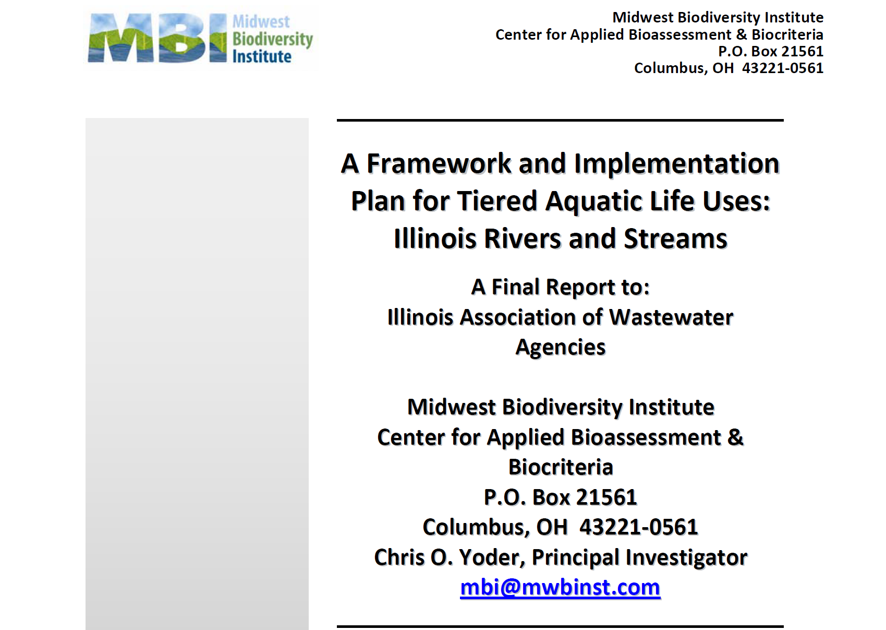
. . . And we could use the IAWA sponsored effort to add tiered aquatic life uses and biocriteria to the Illinois WQS (2012).

Slide 23
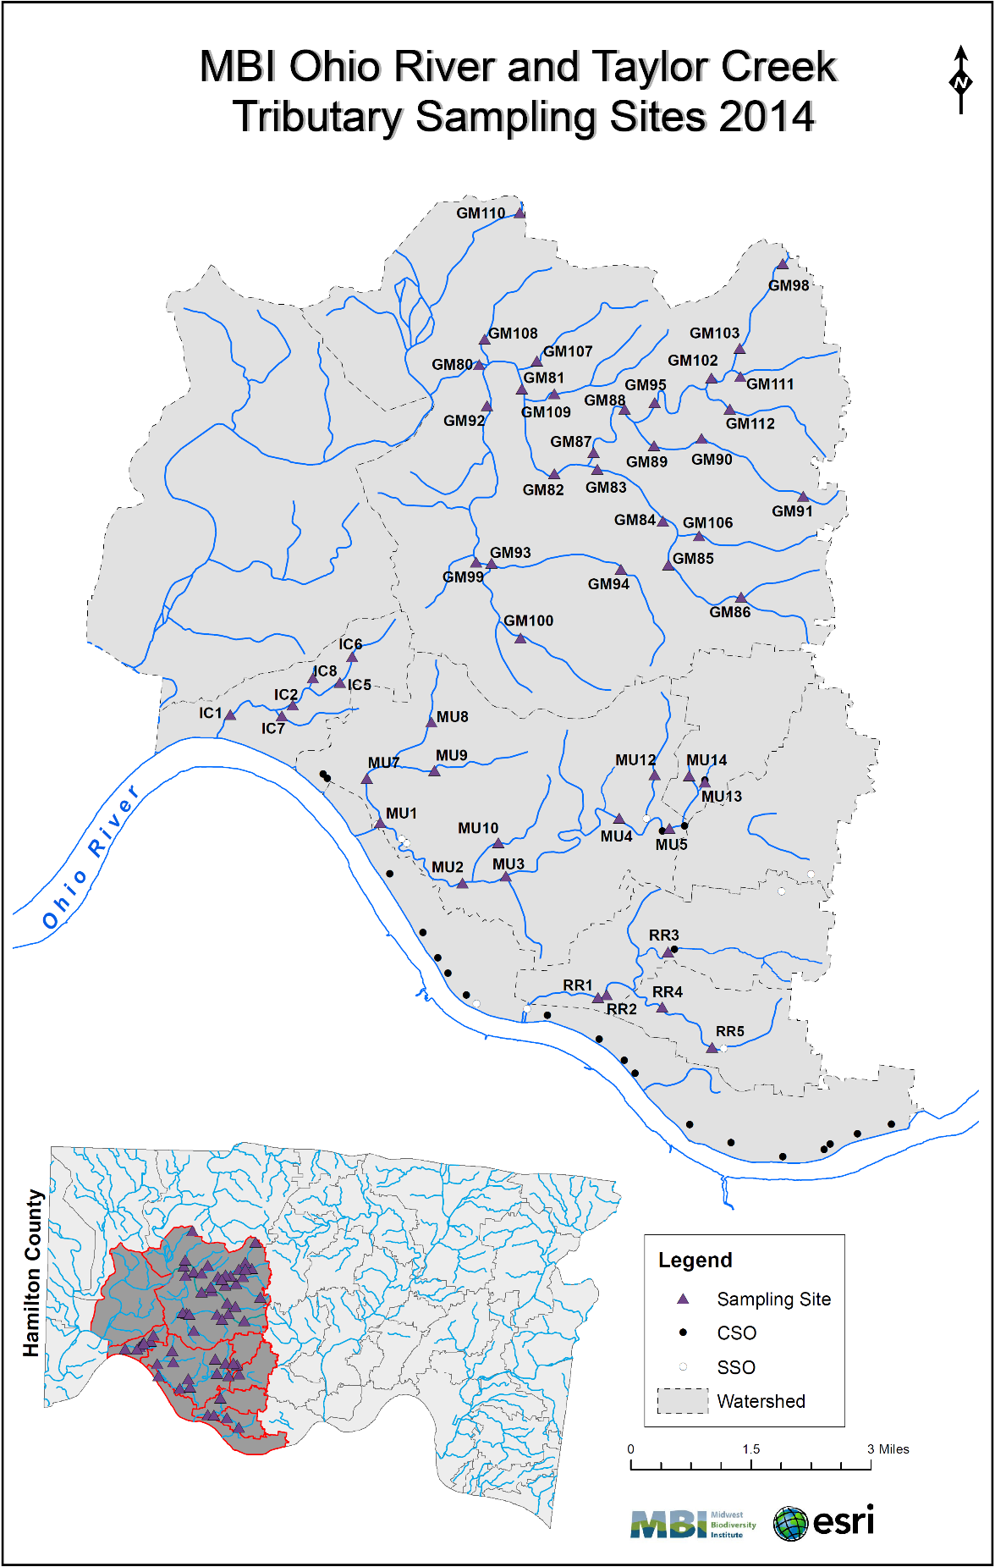
Ohio R. Tributaries & Taylor Creek Survey Design
Pollution survey design – uses geometric allocation of sampling sites
Additional sites positioned in proximity to suspected sources of stress & contamination
Each site assigned a consistent site code (e.g., MU 01, MU 02)
51 total sites
Each sampled for biological & water quality parameters
Employed 3 crews over the June-October index period
Followed Ohio EPA methods to ensure data consistency and usefulness of results
The same approach was used to design the Upper Des Plaines bioassesment in 2016 such that the same outputs derived for MSDGC should be available to DRWW.

Slide 24
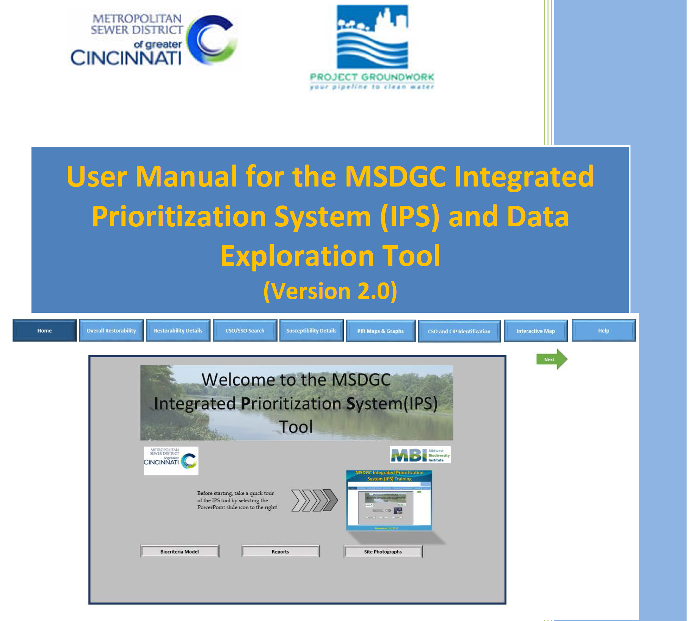
IPS Dashboard

