Slide 1
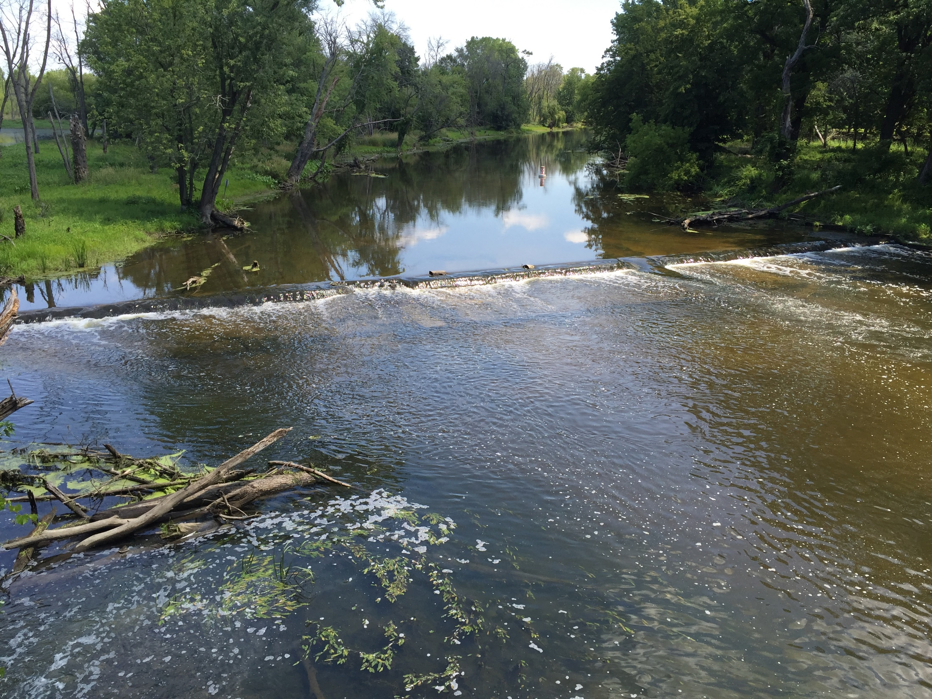
Biological and Water Quality Assessment of the Upper Des Plaines Watershed
Des Plaines River Watershed Workgroup
August 17, 2017
Chris O. Yoder
Midwest Biodiversity Institute
Columbus, OH

Slide 2
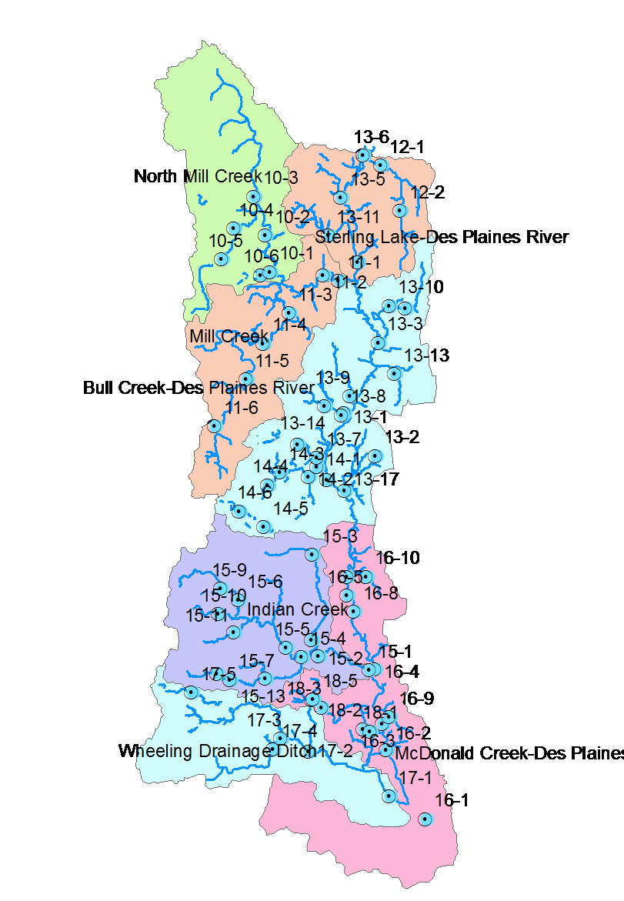
Upper Des Plaines Watershed Bioassessment
Pollution survey design – geometric allocation of sampling sites with additional sites positioned in proximity to suspected sources of stress & contamination.
Each site assigned a consistent site code (e.g., 13-6).
70 sites sampled in mainstem & tributary subwatersheds in 2016.
Each sampled for biological, habitat, & water quality parameters.
Employed 3 crews over a July-October seasonal index period.
Followed IEPA methods to ensure data consistency & relevance of results.
Three year rotation will initiate in 2017.
This design yielded 70 sites which was 3.5X the sites previously assessed by IEPA – so why would this be important?

Slide 3
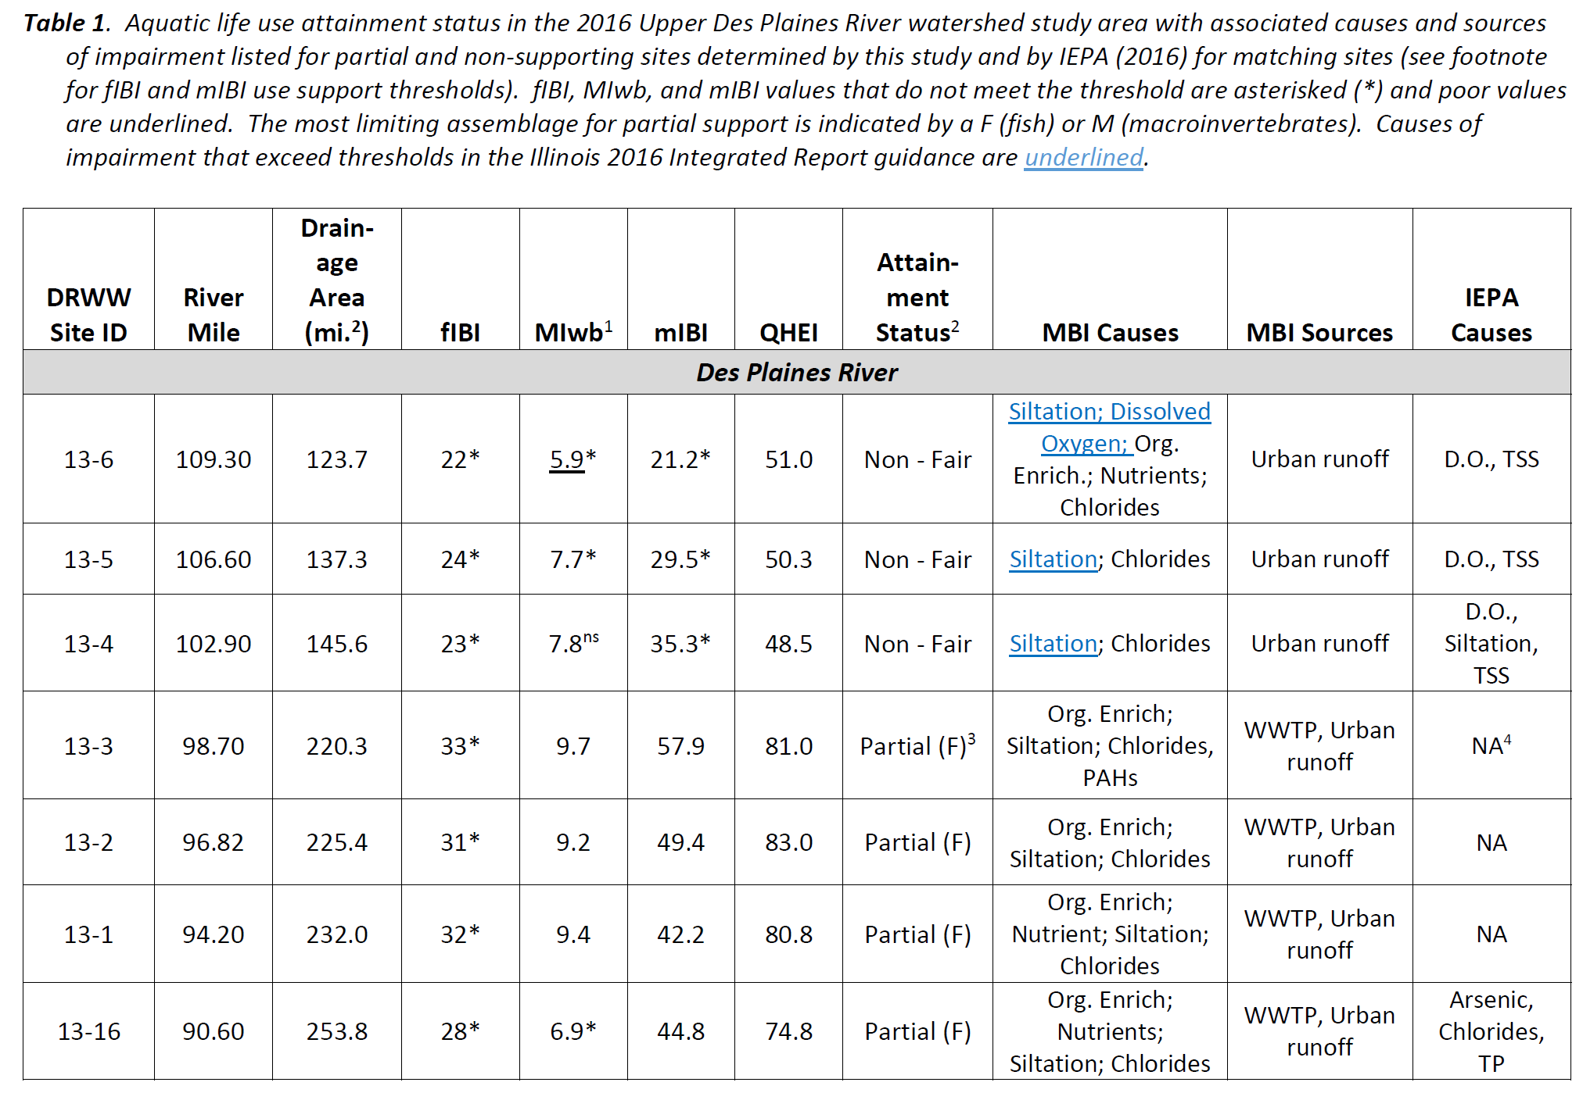
Because the allocation of sampling sites positioned in closer proximity to sources of stress & contamination was needed to identify and rank all relevant pollution impacts and gradients – the result was a different set of causes than that identified by IEPA.

Slide 4
Evaluating Chemical Results: WQC & Threshold Effects
Parameter | Water Quality Criteria |  |  | Effect Thresholds |  |  |  | Non-effect Benchmarks
 | IL Chronic | IL Acute |  | Ohio EPA | SW Ohio | NOAA SQRT | Other | Regional Reference | IL Non-Standard
Demand Group
BOD₅ | NA | NA | -- |  | 2.48 mg/L [HW Streams] 2.96 mg/L [WD Streams] 2.60 mg/L [BT Rivers] | -- | -- | 2.00 mg/L [HW Streams] | --
Dissolved Oxygen (D.O.) | 5.5./6.0 mg/L [7-day rolling avg.] | 3.5/5.0 mg/L [minimum] | 7.2 mg/L [HW Streams] |  | 5.32 mg/L [All Streams] | -- | -- | 6.6 mg/L [HW Streams] | --
Suspended Solids (TSS) | NA | NA | 16.0 mg/L [HW Streams] |  | 65.7 mg/L [HW Streams] 70.8 mg/L [WD Streams] 74.3 mg/L [BT Rivers] | -- | -- | 28.0 mg/L [HW Streams] | --
Nutrients Group
Ammonia-N (NH₃-N) | 1.24 mg/L [pH 8.0/25°C] | 8.40 mg/L [pH 8.0/25°C] |  | 0.05 mg/L [HW Streams] | 0.31 mg/L [HW Streams] | -- | 0.15 mg/L [DRSCW IPS] | 0.025 mg/L [HW Streams] | --
Total Kjeldahl Nitrogen (TKN) | NA | NA |  | 0.50 mg/L [HW Streams] | 0.51 mg/L [HW Streams] 0.58 mg/L [WD Streams] 1.05 mg/L [BT Rivers] | -- | 1.00 mg/L [DRSCW IPS¹¹] | 0.70 mg/L | --
This was all we had to work with for the 2016 Upper Des Plaines bioassessment – the IPS will provide more regionally relevant stressor thresholds.

Slide 5
Illinois EPA Fish Index of Biotic Integrity
The end goal are biological assemblages that meet the State’s aquatic life use “biocriteria”

Slide 6
Illinois EPA IBI Narrative Evaluations
IL General Use Attainment Threshold

Slide 7
Notes:
Sediment results for 2009

Slide 9
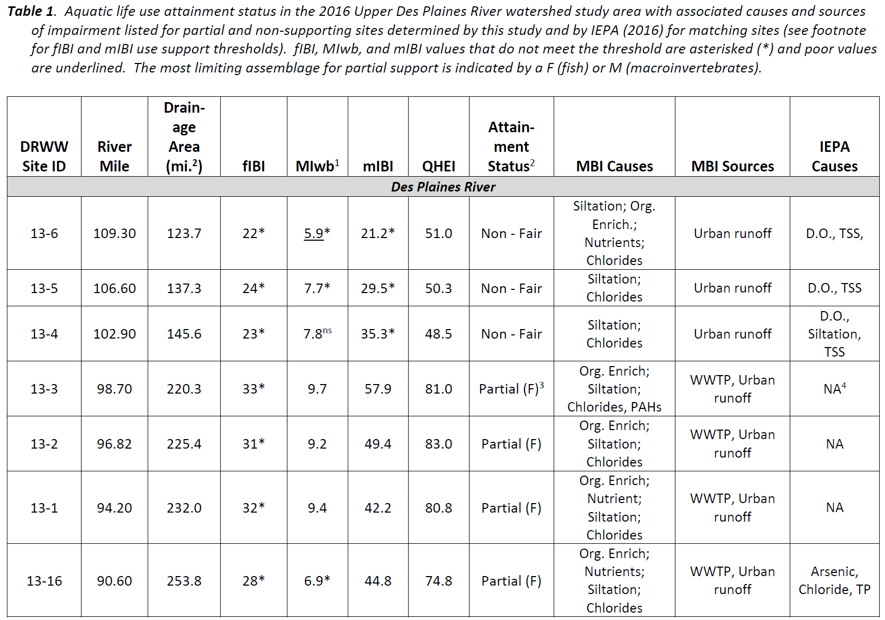
Finding Biological impairments is a first step in impaired waters listings.
A “lines-of-evidence” approach is used to assign causes & sources.

Slide 10
Nutrient Criteria Options
Traditional numeric criterion approach:
  Fixed concentration-based numbers for N and P.
  Focused on relationship with aquatic life and/or nuisance algal growths.
  . . . or based on regional reference conditions.
Combined criteria approach – focused on the effects of nutrient enrichment.
Multiple effect indicators - biocriteria, diel D.O. swing (some use pH swing), and benthic or sestonic chlorophyll a.
Decision trees for attainment and non-attainment of biocriteria, exceedances of maximum D.O. swing, and levels of chlorophyll a

Slide 11
Proposed Stream Nutrient Assessment Procedure (SNAP): An Effects Based Approach
STEP 1 | STEP 2 | STEP 3 | STEP 4
Biological Criteria | DO Swing ² | Benthic Chlorophyll ³ | Preliminary Assessment: Trophic Condition Status of Evaluated Segment or Waterbody
All indices attaining or in non-significant departure¹ | Normal or low swings (≤6.5 mg/l) | Low to moderate (≤320 mg/m²) | Attaining use / Not threatened
 |  | High (>320 mg/m²) | Attaining use, but may be threatened | See Flow Chart A
 | Wide swings (>6.5 mg/l) | Low (≤182 mg/m²)
 |  | Moderate to high (>182 mg/m²)
Non-attaining (one or more indices below non-significant departure) | Normal or low swings (≤6.5 mg/l) | Low to moderate (≤320 mg/m²) | Impaired, but cause(s) other than nutrients | See Flow Chart B
 |  | High (>320 mg/m²) | Impaired; likely nutrients over-enrichment | See Flow Chart C
 | Wide swings (>6.5 mg/l) | Low (≤182 mg/m²)
 |  | Moderate to high (>182 mg/m²) | Impaired; Nutrients over-enrichment

