Slide 1
DRWW General membership meeting

Slide 2
DRWW BUSINESS
2018 Financial Report
Approval of Executive Board Member Alternates
Executive Board Updates
Committee Updates

Slide 5
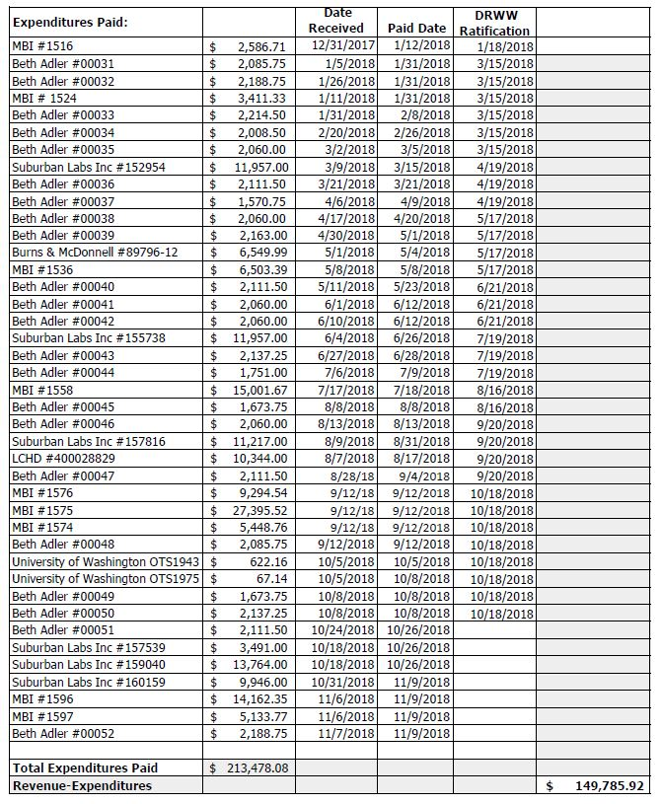

Slide 6
Approval of executive board member alternates
New Bylaw Language allowing Executive Board Members to designate an alternate to attend meetings with voting rights.
Alternates are required to be an Agency Member employee.
Alternates are required to be approved by a majority vote at a General Membership Meeting.

Slide 7
Approval of executive board member alternates

Slide 8
Monitoring/Water quality Improvements committee
Recap of Activities:
Completed 4th year of data collection.
Current program consists of 71 monitoring sites.
Completed Bioassessment Monitoring of DPR Main Stem during 2018:
Sediment analyses.
Benthic chlorophyll a analyses.
Macroinvertebrate inventory.
Fish inventory.
Habitat evaluation.
Added continuous monitoring with data sondes for chloride assessment and sestonic chlorophyll a analyses to program in 2018.

Slide 9
Next stepS
Develop Nutrient Assessment and Reduction Plan (NARP).
Complete final year of Bioassessment Monitoring on Northern Tributaries during 2019.

Slide 10
Lakes committee
Completed 2018 field sampling.
Next steps:
Analyzing data and completing report.
Communicating results
2018 Deicing Workshop Recap

Slide 11
Ms4 task force – Green infrastructure training
Partnership with Applied Ecological Services (AES)
Engineered to meet MS4 Permit Requirement for Annual Green Infrastructure Training.

Slide 12
Green infrastructure training seminar
67 registered, 57 signed in.
Free to DRWW Members; $25 non-members
Tentative 2019 Training Seminar – November, 2019
Michelle Zimmerman, Algonquin Public Works

Slide 13
photos
Maggie Soliz, Applied Ecological Services
Trish Beckjord, The Conservation Foundation

Slide 14
Thank you
Certificates for one professional development hour will be at the back of the room.

