Slide 1
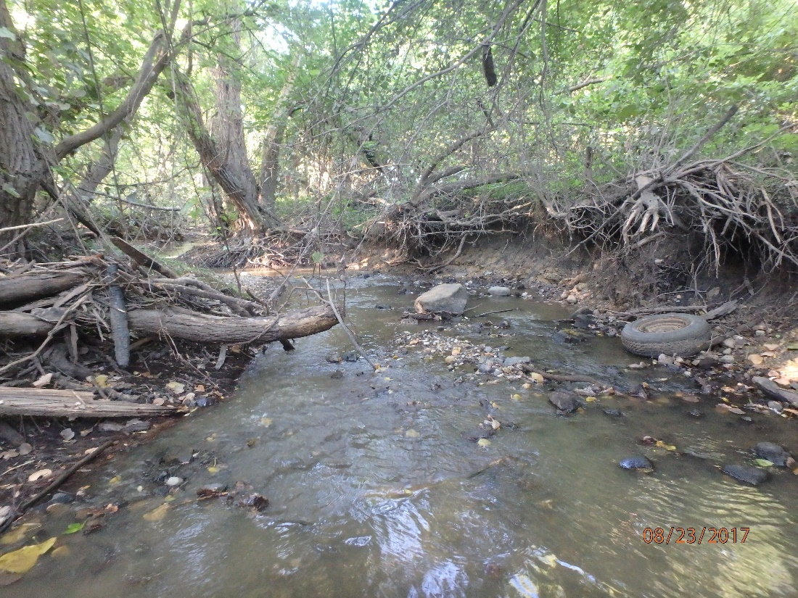
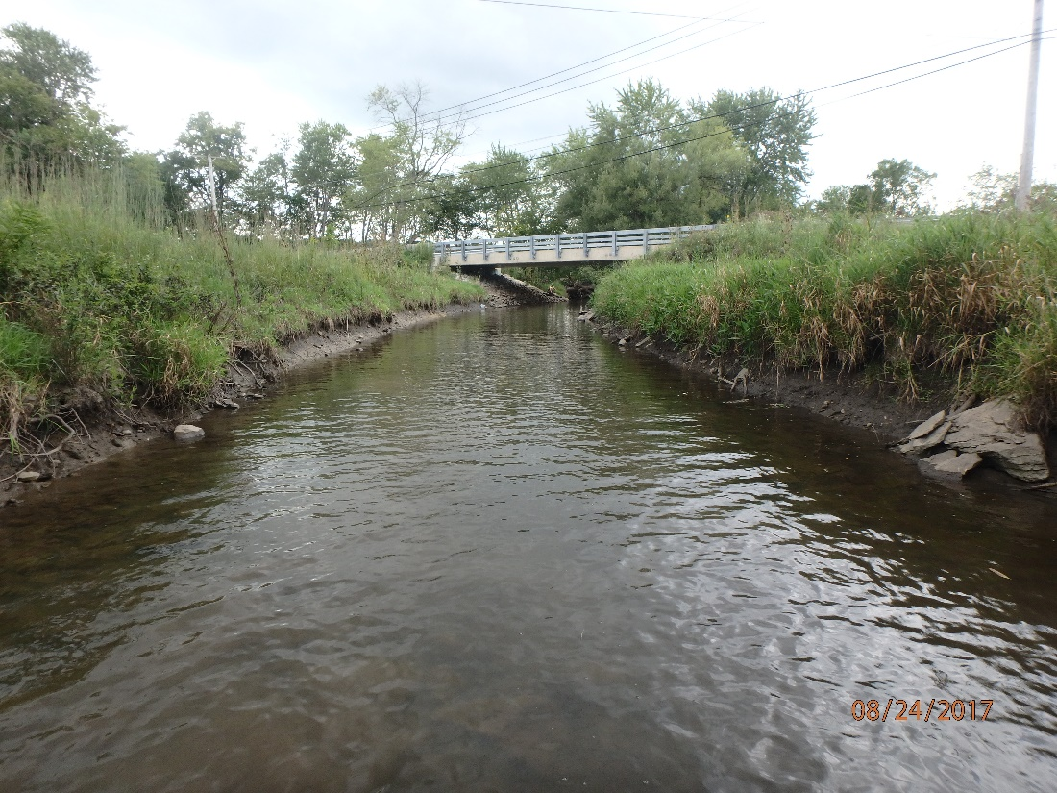
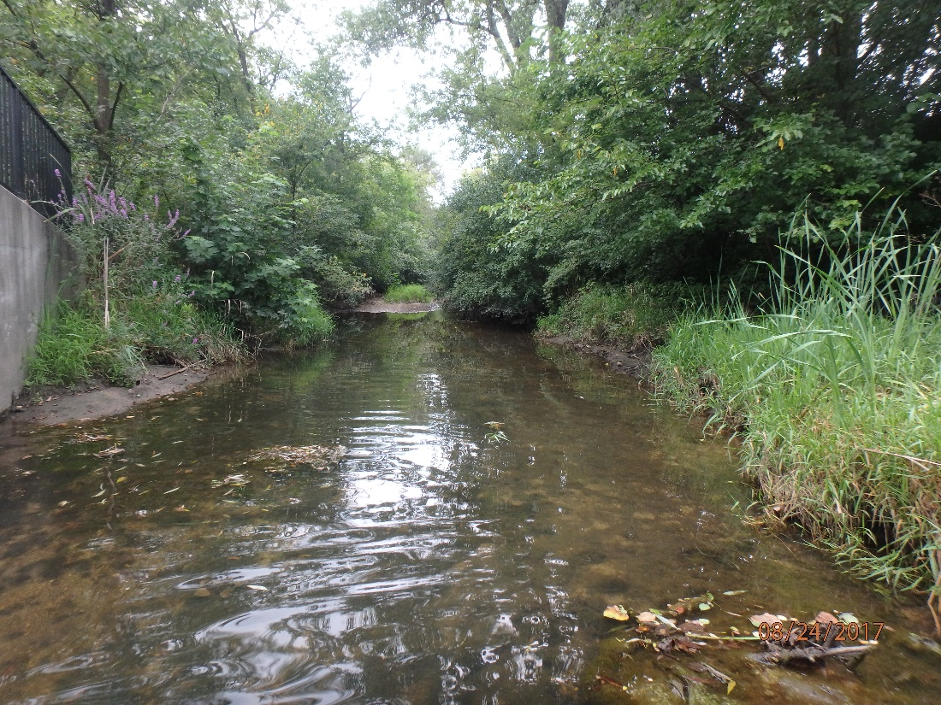
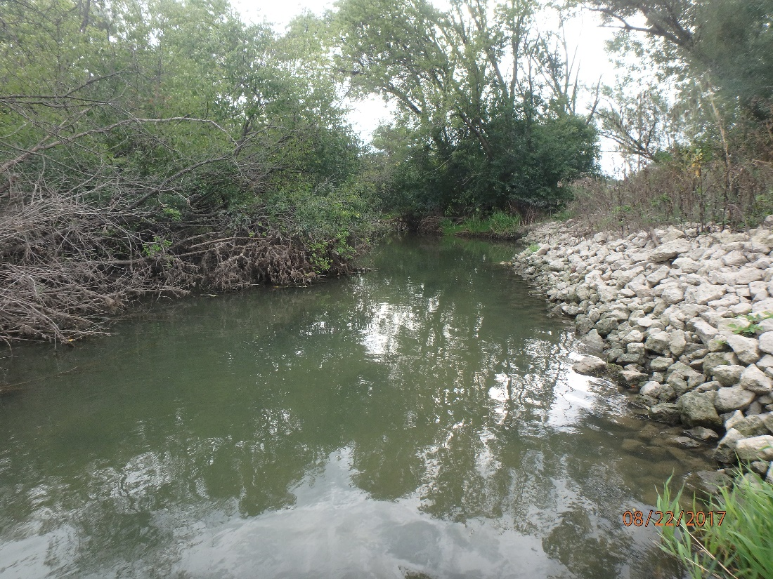
Biological and Water Quality Assessment of the Upper Des Plaines Watershed
Year 1 Rotation:
Indian, Buffalo, and Aptakisic Creeks
Buffalo Creek
Indian Creek
Des Plaines River Watershed Workgroup
November 15, 2018
Chris O. Yoder
Midwest Biodiversity Institute
Columbus, OH
Seavey Drainage Ditch
Aptakisic Creek

Slide 2
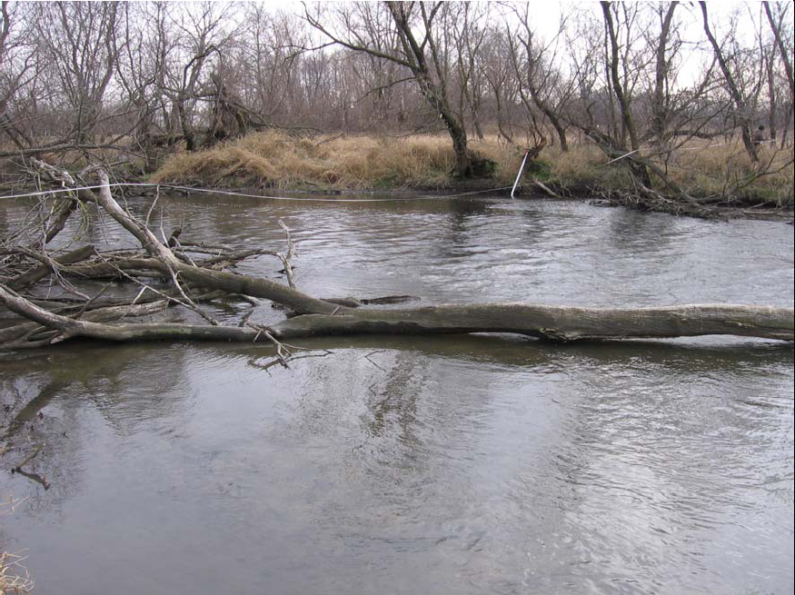
The Development of a Biological Assessment Plan for the DuPage and Salt Creek Watersheds
A similar approach was followed for the Upper Desplaines & for the Lower Des Plaines in 2018
DuPage-Salt Creek Work Group
March 7, 2006
Chris O. Yoder
Center for Applied Bioassessment and Biocriteria
Midwest Biodiversity Institute
Columbus, OH

Slide 3
What is a Bioassessment?
Bioassessment is the essential implementation tool for a TALU based approach
Bioassessment – a systematic assessment of the aquatic resource using biological indicators AND chemical/physical indicators in a supporting role.
Biocriteria – numerical benchmarks for determining attainment of a goal expressed in the definition of an aquatic life designated use in the state WQS.
TALU = Tiered Aquatic Life Uses
A data driven approach to WQ management
Reasonably available tools and criteria exist to assess and evaluate this for all waterbody types.

Slide 4
Aquatic Life Uses
ALUs inherently “drive” the determination of status & management responses, thus they are a critical determinant of overall program effectiveness.
Definition:
A designation (classification) assigned to a waterbody based on the aquatic assemblage that can realistically be sustained given the regional reference condition and the level of protection afforded by the applicable criteria.
potential
This underscores the critical importance and “reach” of aquatic life uses – they influence every aspect of water quality management.

Slide 5
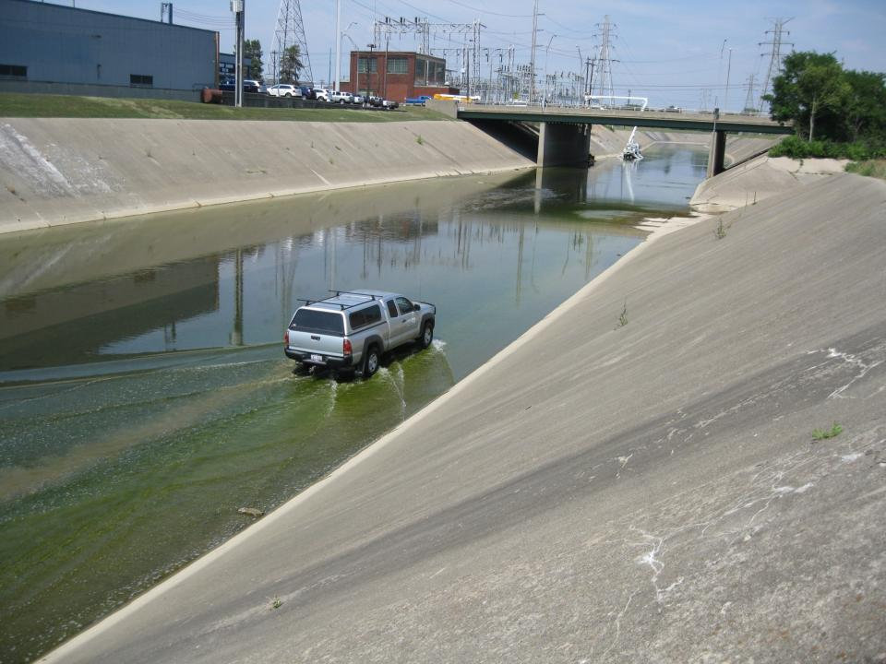
Chemical – excess nutrients from urban runoff and CSOs
Physical – extensively modified stream habitat
Biological – nuisance algal growth
Energy cycling – short nutrient spirals
Treating these independently will not solve the problem.
Mill Creek – Cincinnati, OH

Slide 6
CORE INDICATORS
Core indicators are measured routinely – independent of assessment & management questions
•
Fish Assemblage
•
Macroinvertebrates
•
Periphyton
(Use Community Level Data From At Least Two)
Physical Habitat Indicators
Chemical Quality Indicators
•
Channel morphology
•
Flow
•
pH
•
Temperature
•
Substrate Quality
•
Riparian
•
Conductivity
•
Dissolved O
2
For Specific Designated Uses Add the Following:
AQUATIC LIFE
RECREATIONAL
WATER SUPPLY
Base List
:
Base List
:
Base List
:
•
•
•
Supplemental indicators are added depending on designated uses, study area setting, and monitoring objectives and questions
Ionic strength
Fecal bacteria
Fecal bacteria
•
Nutrients, sediment
•
Ionic strength
•
Ionic strength
Supplemental List
:
Supplemental List
:
•
Nutrients, sediment
•
Metals (water/sediment)
•
Other pathogens
•
•
Supplemental List
:
Organics (water/sediment)
Organics (water/sed.)
•
Metals (water/sediment)
•
Chlorophyll a
•
Chlorophyll a
•
Organics (water/sed.)
•
Other pathogens
HUMAN/WILDLIFE CONSUMPTION
•
Chlorophyll a
Base List
:
•
Metals (in tissues)
•
Organics (in tissues)

Slide 7
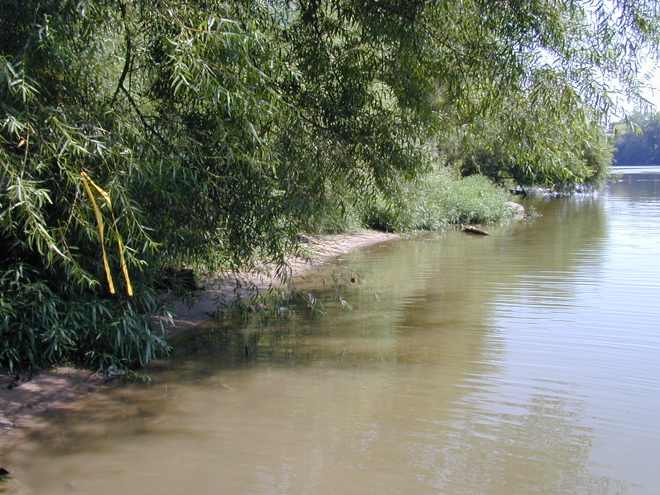
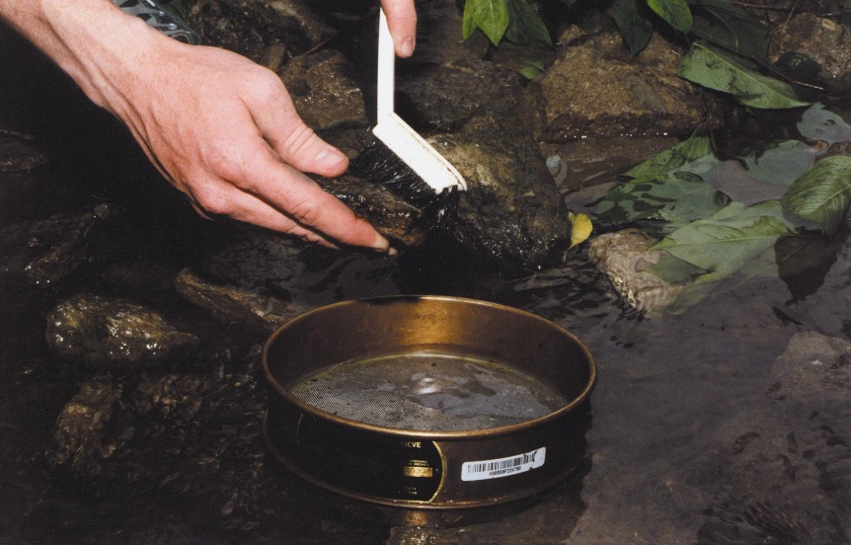
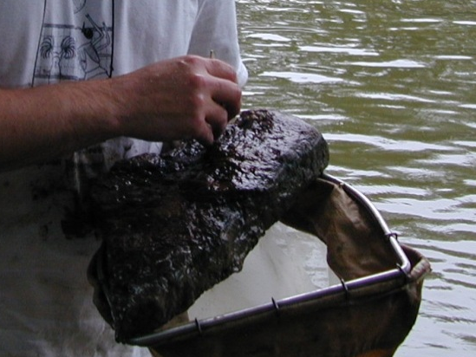
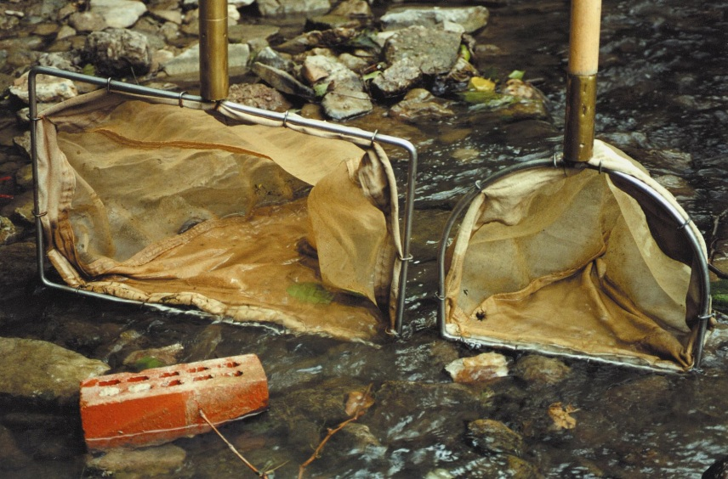
Benthic Macroinvertebrates
Active Sampling Methods Examples
Scrubbing substrates
Picking
Dome
Sampler
Net-based methods
(including kicks,
dips, jabs, sweeps,
& picks)
Grab
samplers
Notes:
Among the active sampling methods commonly used, there is a good mixture of qualitative and quantitative sampling methods. This will largely depend on how the sampling method is employed. First, let’s review some of the more common collection techniques used in many of these methods. When sampling substrates that can be handled (e.g., rocks, woody debris, macrophytes), macroinvertebrates may be removed by scrubbing the substrate or picking the substrate with tweezers. Net-based methods include dips, jabs, and sweeps in one or more habitat types. Net sweeping includes methods in which the habitat is disturbed prior to, or while sweeping the net to collect dislodged macroinvertebrates. The grab sampler and the dome sampler are two types of sampling devices which are normally used for quantitative assessments. Grab samplers are available in a variety of sizes and weights to meet study needs. While they have their specific applications, they cannot be used in all habitat types, and are particularly difficult to use in the collection of samples from hard substrates or in strong currents. The diver-operated dome sampler has been an effective sampling tool for use in coarse substrates in water deeper than 0.50-0.75 m. The sampler contains a battery-operated pump that moves materials dislodged by a diver into a Nitex sample bag (Cuffney 1993).

Slide 8
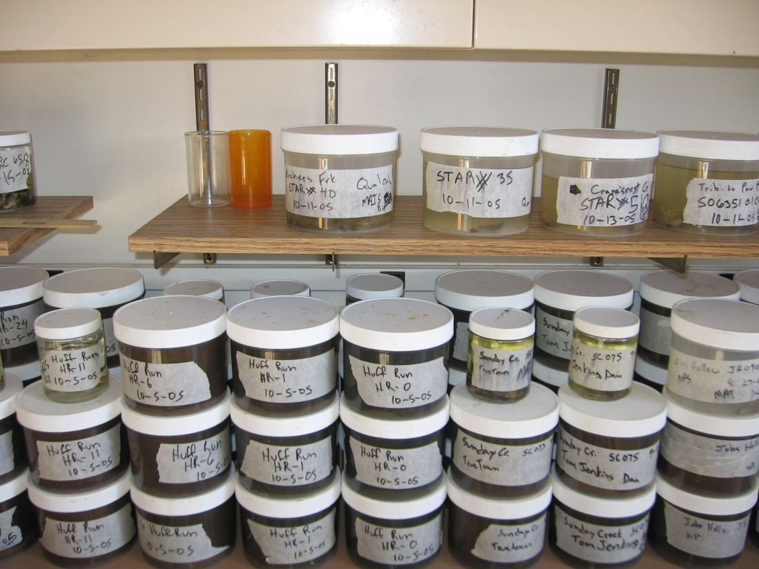
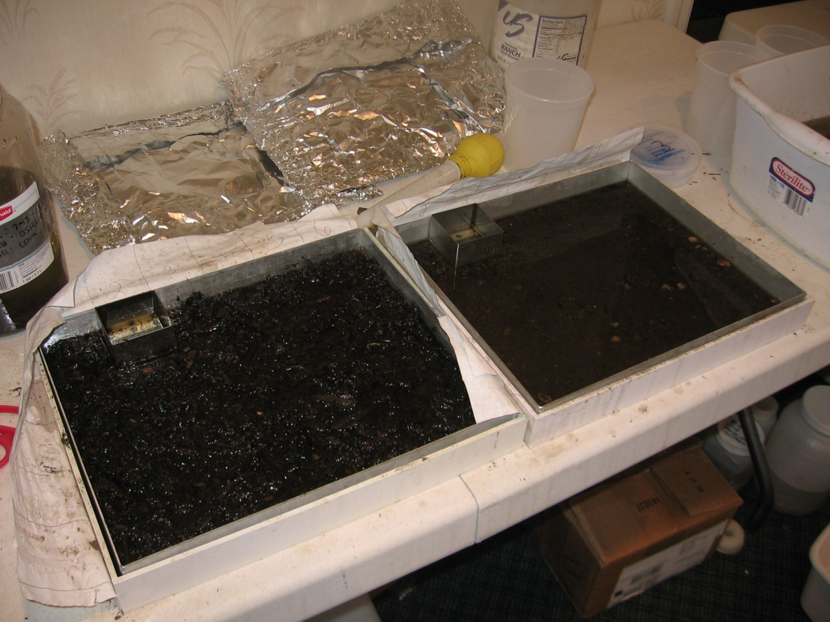
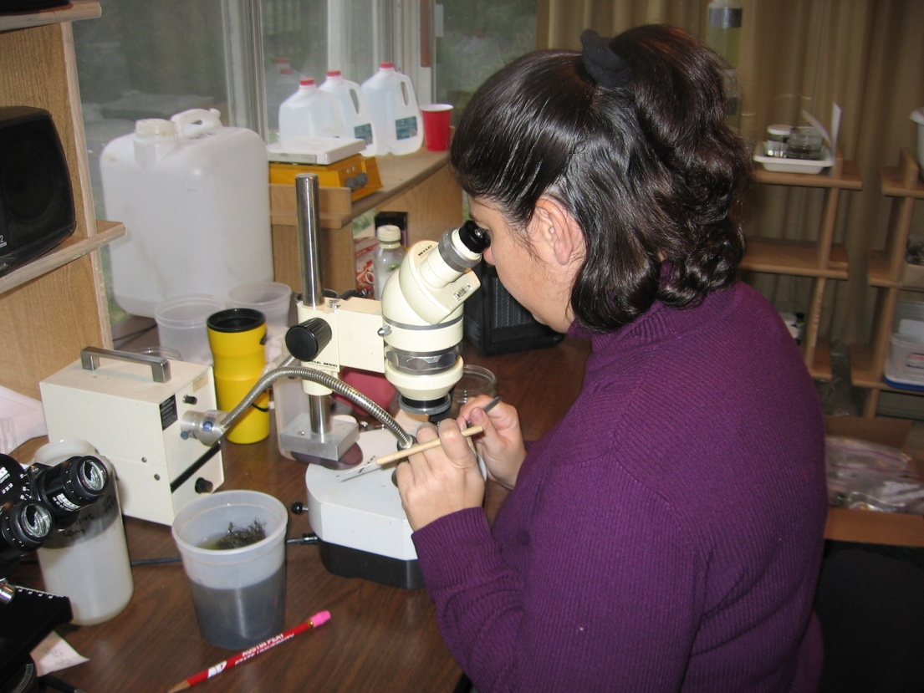
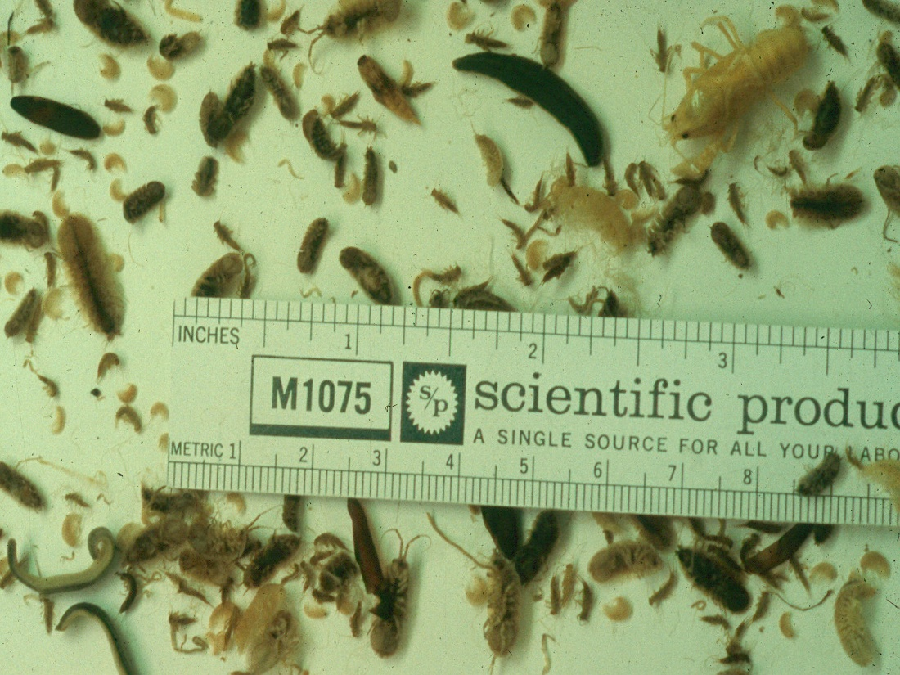
IEPA methods for field collections & lab processing

Slide 9
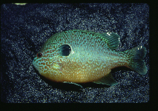
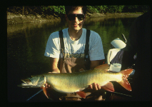
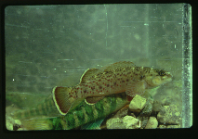
Fish are a widely identifiable component of aquatic systems and are valued for their recreational uses. Most species, however, are more obscure, and comprise the second most endangered group.

Slide 10
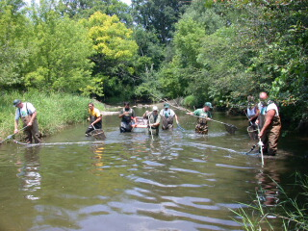
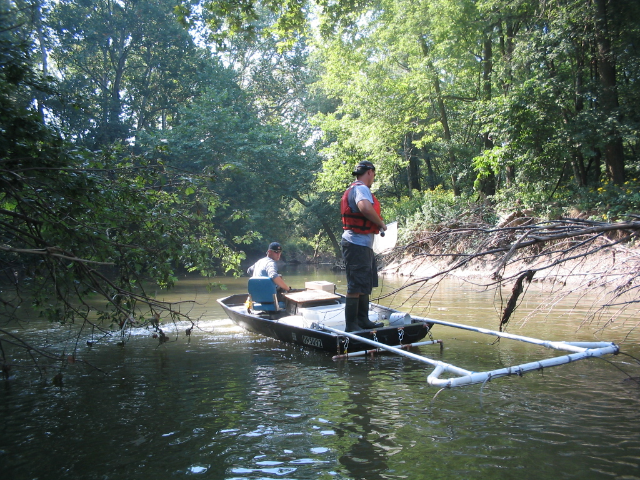
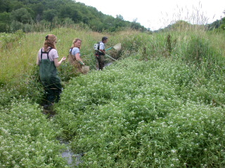
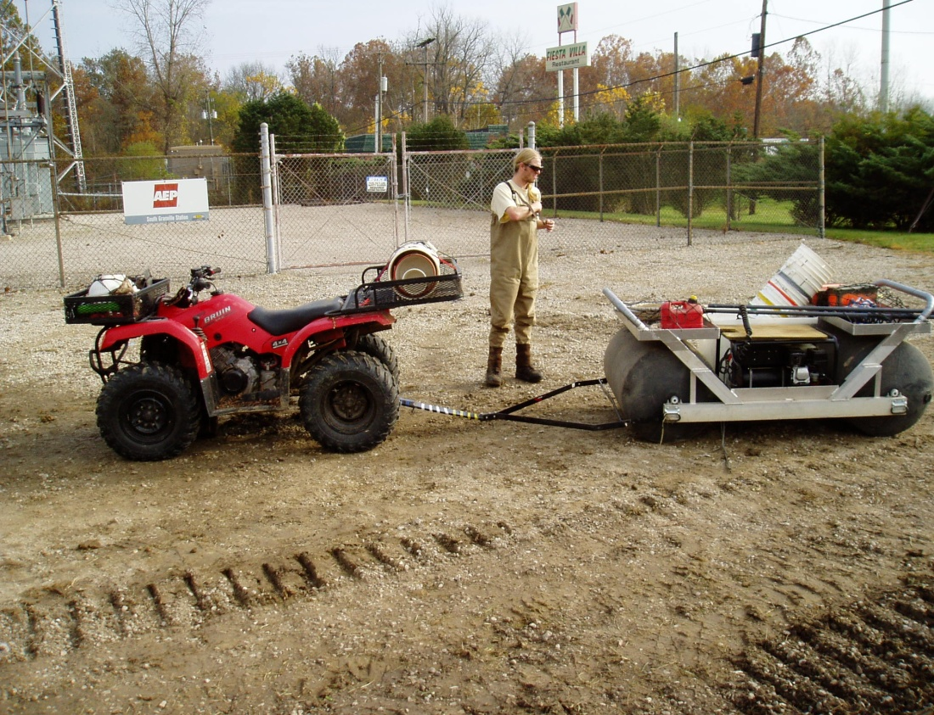
Illinois DNR “electric seine”
MBI pulsed D.C. electrofishing methods

Slide 11
The Qualitative Habitat Evaluation Index (QHEI)
QHEI Includes Six Major Categories of Macrohabitat
Substrate - types, origin, quality, embeddedness
Instream Cover – types and quantity
Channel Quality – sinuosity, development, stability
Riparian – width, quality, bank stability & quality
Pool/Run/Riffle – depth, current types, embedded-ness, morphology
Gradient – local gradient (fall per unit distance)
Source: The Qualitative Habitat Evaluation Index (Rankin 1989)

Slide 12






















Chemical/Physical Field Procedures
Chemical/Physical Field Procedures
Water column grab sampling
Depth integrated sampler
Water column grab sampling
Depth integrated sampler
Automatic composite samplers
Time-of-travel dye injection
Automatic composite samplers
Time-of-travel dye injection

Slide 13
Chemical Effluent & Exposure Information
Permitted Discharges are Sampled for
Permitted Discharges are Sampled for
Whole Effluent Toxicity (WET) Testing
a Variety of Chemicals - This Provides
Whole Effluent Toxicity (WET) Testing
a Variety of Chemicals - This Provides
is Performed Primarily on Effluents
Data to Determine Pollutant Loads
is Performed Primarily on Effluents
Data to Determine Pollutant Loads
Fish Tissue Analysis Reveals
Fish Tissue Analysis Reveals
Bioaccumulative Pollutants and Risks
Bioaccumulative Pollutants and Risks
to Human and Wildlife Health
Biochemical Markers (Biomarkers) are
to Human and Wildlife Health
Biochemical Markers (Biomarkers) are
Useful for Discerning Problem
Useful for Discerning Problem
Pollutants
Pollutants

Slide 14
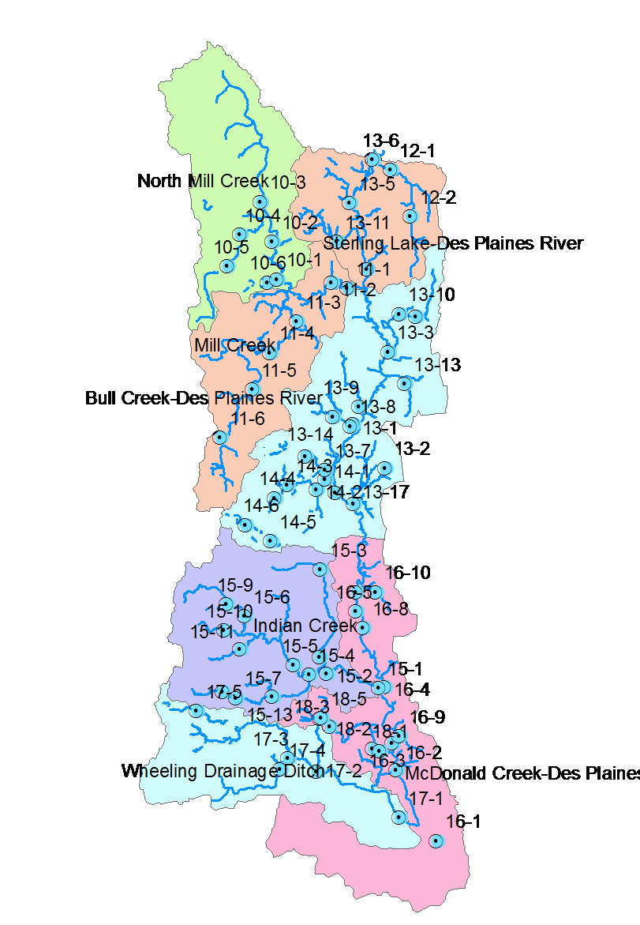
Upper Des Plaines Watershed Bioassessment
Pollution survey design – geometric allocation of sampling sites with additional sites positioned in proximity to suspected sources of stress & contamination.
Each site assigned a consistent site code (e.g., 13-6).
70 sites sampled in mainstem & tributary subwatersheds in 2016.
Each sampled for biological, habitat, & water quality parameters.
Employed 3 crews over a July-October seasonal index period.
Followed IEPA methods to ensure data consistency & relevance of results.
Three year rotation initiated in 2017.
Spatial sampling design is critical for accurately detecting impairments and providing data at the same scale at which restoration is applied.

Slide 15
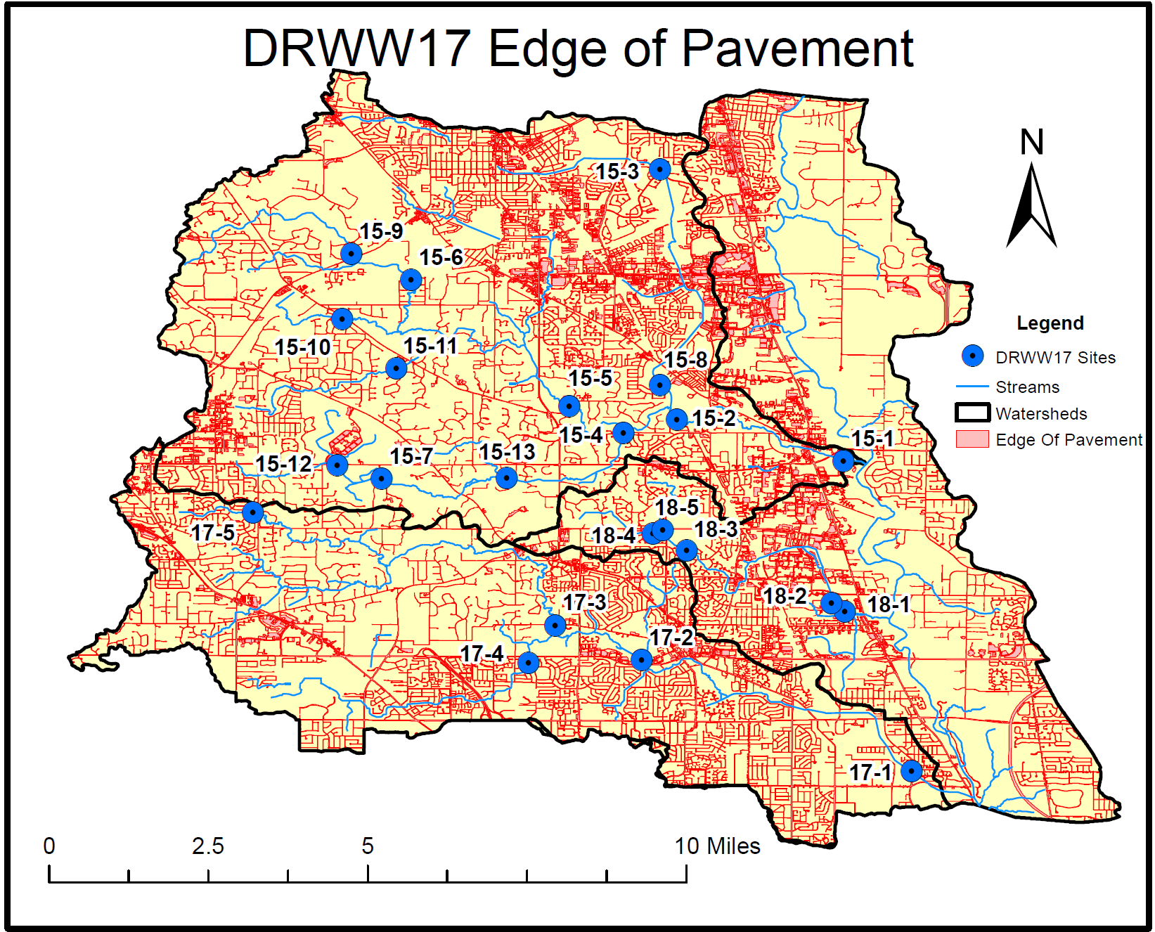
Indian Creek (15)
Aptakisicn Cr. (18)
Buffalo Creek (17)

Slide 16
Completing the Cycle of WQ Management: Managing for Environmental Results
Indicator Levels
1: Management actions
2: Response to management
3: Stressor abatement
4: Ambient conditions
5: Assimilation and uptake
6: Biological response
Administrative Indicators [permits, plans, grants, enforcement]
Stressor Indicators [pollutant loads, land practices]
Exposure Indicators [pollutant conc., habitat, ecosystem process, fate & transport]
Response Indicators [biological assemblage indices, other attributes]
“Ecological Health” The Endpoint of Concern

Slide 17
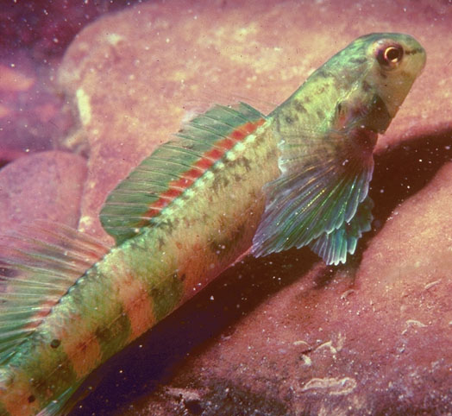
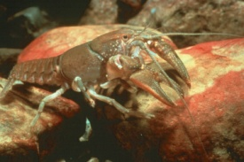
A Data Driven Framework
Ambient M&A and other data that includes:
  Biological Assemblages (at least two)
    Evaluate biocriteria compliance
    Evidence of response to stressor types
  Water and Sediment Chemistry Data
    Compare to biocriteria based thresholds
    Compare to regional reference benchmarks
    Evaluate efficacy of current water quality criteria
  Habitat Data
    Key limiting factor to biota – can eclipse other factors
    Key determinant of use attainability
  Land Use and Flow Data
    Effects of land use on the biota can eclipse other stressors
    Effects of hydrological modifications - proxy indicators

Slide 18
Facility | Receiving Water Body | River Mile | Latitude | Longitude | Average Flow 2016 (MGD) | Design Average Flow (MGD) | Treatment Type¹ | Nutrient Removal²
Lake Co. DPW Mill Creek WWTP | Mill Creek/Des Plaines R. | 1.0/102.0 | 42°25’00”N | 87°55’40”W | 2.1 | 7.8 | AWT | M
North Shore SD Waukegan WWTP | Des Plaines R. | 98.1 | 42°22’15”N | 87°54’53”W | 22.0 | 44.0 | AWT | P
North Shore SD Gurnee WWTP | Des Plaines R. | 95.5 | 42°21’25”N | 87°55’36”W | 23.6 | 47.2 | AWT | N
Libertyville WWTP (IL0029530) | Des Plaines R. | 84.8 | 42°15’15”N | 88°56’10”W | 4.0 | 8.0 | AWT | M
Mundelein WWTP (IL0022501) | Des Plaines R. | 84.6 | 42°15’11”N | 87°50’34”W | 5.0 | 15.0 | Secondary | M
Lake Co. DPW New Town Century WWTP (IL0071366) | Des Plaines R. | 82.3 | 42°13’30”N | 87°56’15”W | 6.0 | 18.0 | AWT | M
Lake Co. DPW Des Plaines WWTP (IL0022055) | Aptaksic Cr./ Des Plaines R. | 0.8/76.4 | 42°09’47”N | 87°55’40”W | 16.0 | 51.8 | AWT | M
Lindenhurst SD WWTP (IL0020796) | Hastings Cr. | 2.8 | 42°26’01”N | 88°01’56”W | 2.0 | 5.7 | AWT | M

Slide 19
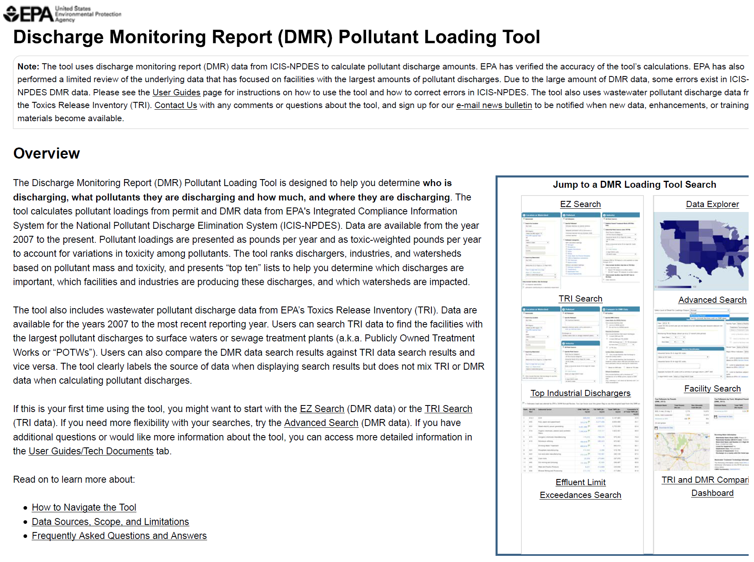
https://cfpub.epa.gov/dmr/

Slide 20
Notes:
Sampling locations for 2009

Slide 21
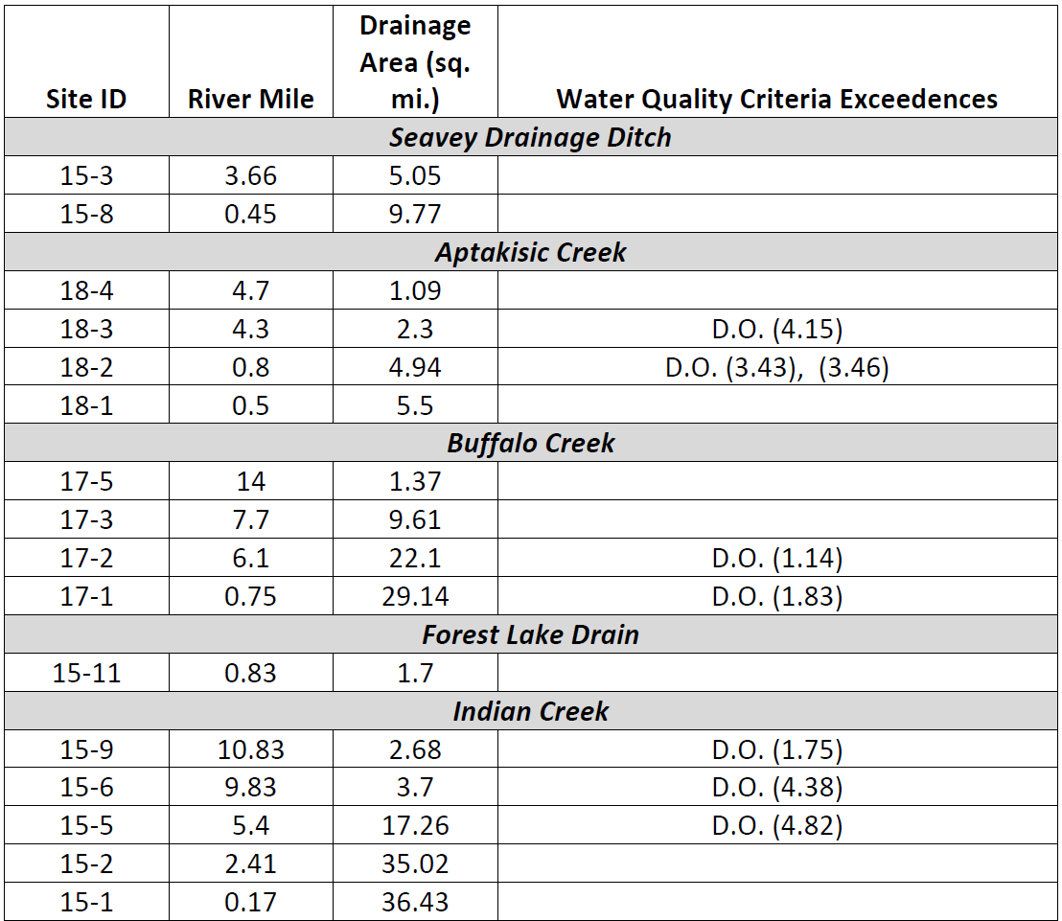

Slide 22
Evaluating Chemical Results: WQC & Threshold Effects
Parameter | Water Quality Criteria |  |  | Effect Thresholds |  |  |  | Non-effect Benchmarks
 | IL Chronic | IL Acute |  | Ohio EPA | SW Ohio | NOAA SQRT | Other | Regional Reference | IL Non-Standard
Demand Group
BOD₅ | NA | NA | -- |  | 2.48 mg/L [HW Streams] 2.96 mg/L [WD Streams] 2.60 mg/L [BT Rivers] | -- | -- | 2.00 mg/L [HW Streams] | --
Dissolved Oxygen (D.O.) | 5.5./6.0 mg/L [7-day rolling avg.] | 3.5/5.0 mg/L [minimum] | 7.2 mg/L [HW Streams] |  | 5.32 mg/L [All Streams] | -- | -- | 6.6 mg/L [HW Streams] | --
Suspended Solids (TSS) | NA | NA | 16.0 mg/L [HW Streams] |  | 65.7 mg/L [HW Streams] 70.8 mg/L [WD Streams] 74.3 mg/L [BT Rivers] | -- | -- | 28.0 mg/L [HW Streams] | --
Nutrients Group
Ammonia-N (NH₃-N) | 1.24 mg/L [pH 8.0/25°C] | 8.40 mg/L [pH 8.0/25°C] |  | 0.05 mg/L [HW Streams] | 0.31 mg/L [HW Streams] | -- | 0.15 mg/L [DRSCW IPS] | 0.025 mg/L [HW Streams] | --
Total Kjeldahl Nitrogen (TKN) | NA | NA |  | 0.50 mg/L [HW Streams] | 0.51 mg/L [HW Streams] 0.58 mg/L [WD Streams] 1.05 mg/L [BT Rivers] | -- | 1.00 mg/L [DRSCW IPS¹¹] | 0.70 mg/L | --
Most will be updated via the currently ongoing IPS development

Slide 23
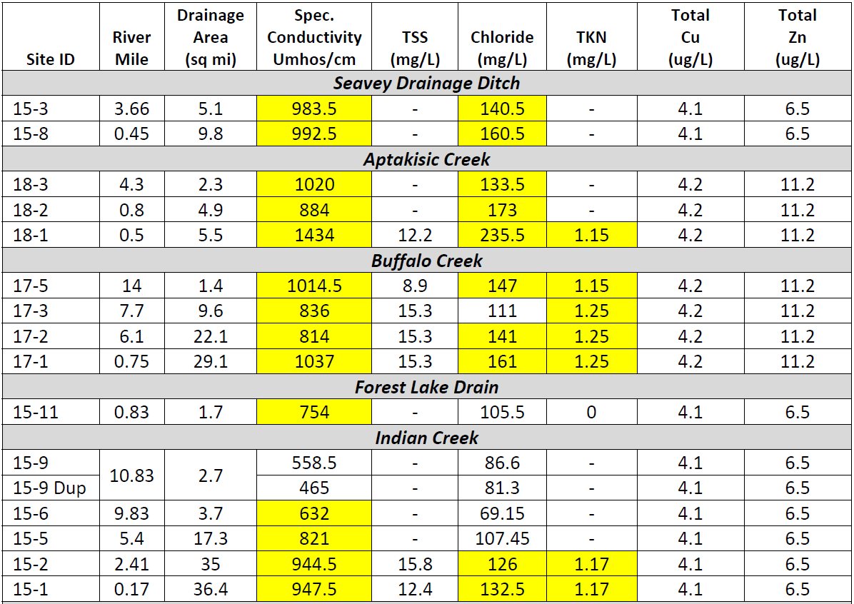

Slide 28
Notes:
pH swings for a single station from the month of June (Arlington Drive on the mainstem) Note the swing from 7.8 to 9.2 on the 18th. Clear sign of nutrient over-enrichment.

Slide 30
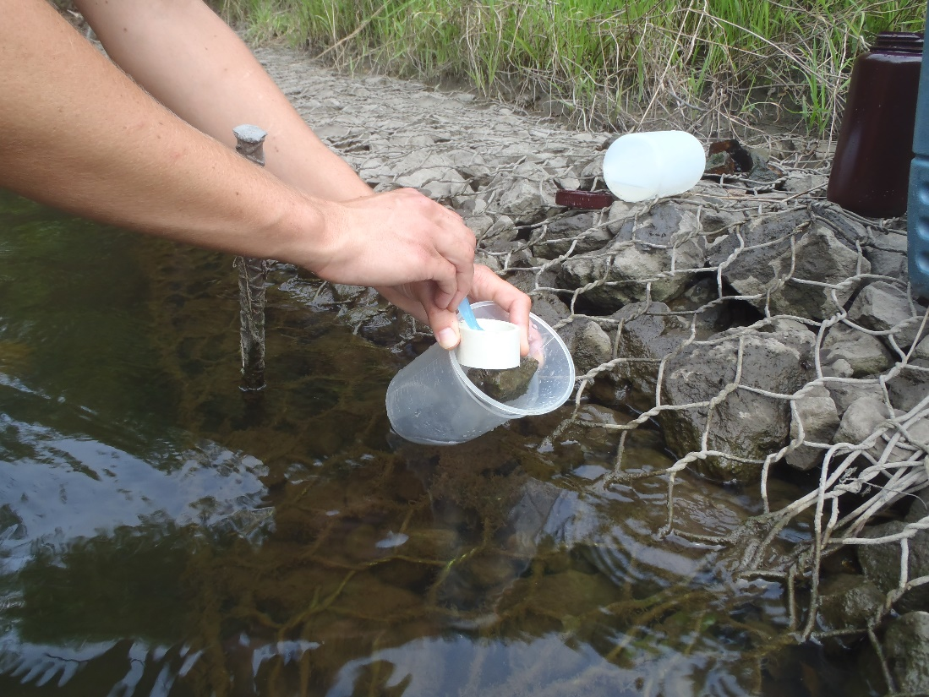
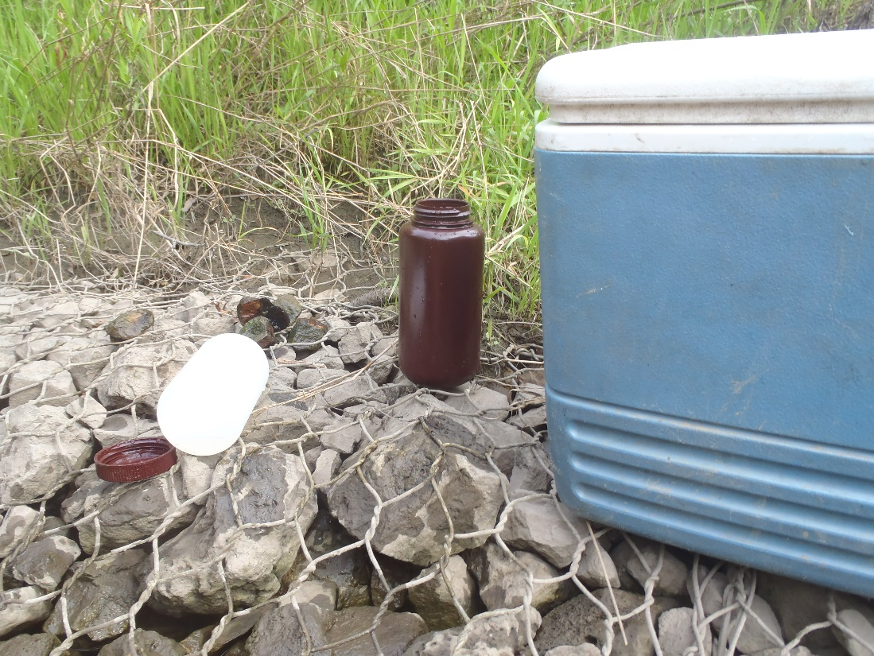
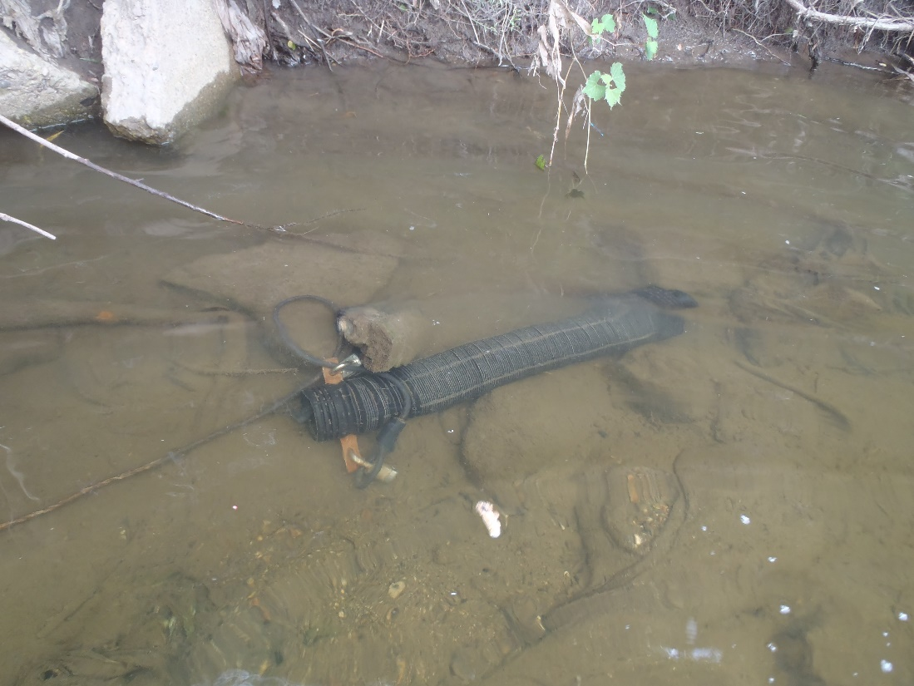
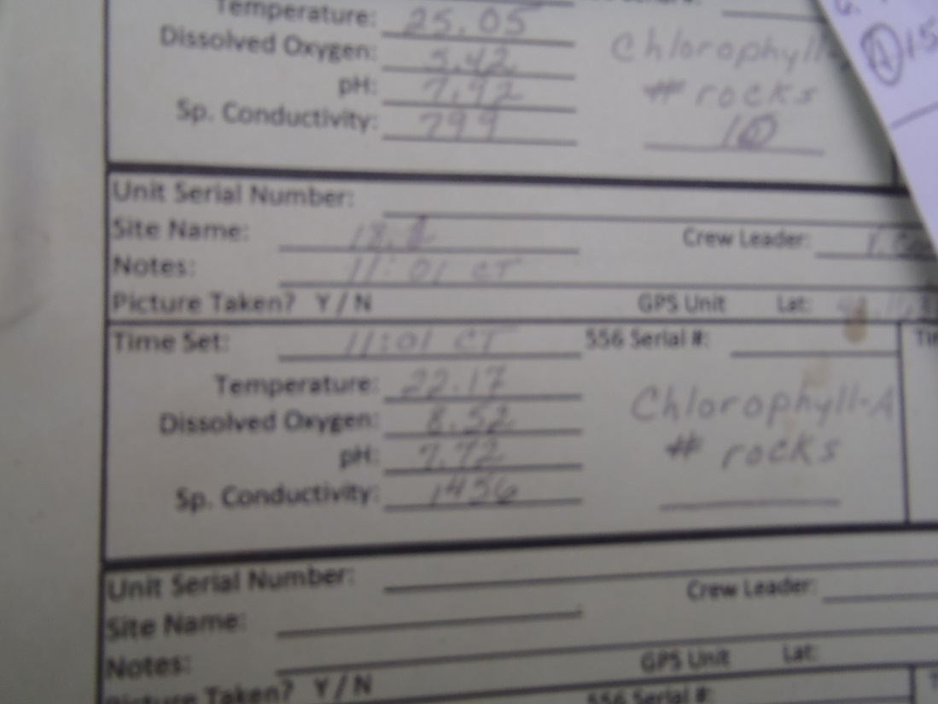
Benthic Chlorophyll a
Stream Nutrient Assessment Procedure (SNAP) – a “combined” criterion for nutrient effects
Continuous D.O. – daily “flux”

Slide 31
Habitat alteration is consistently a leading cause of biological impairment

Slide 32
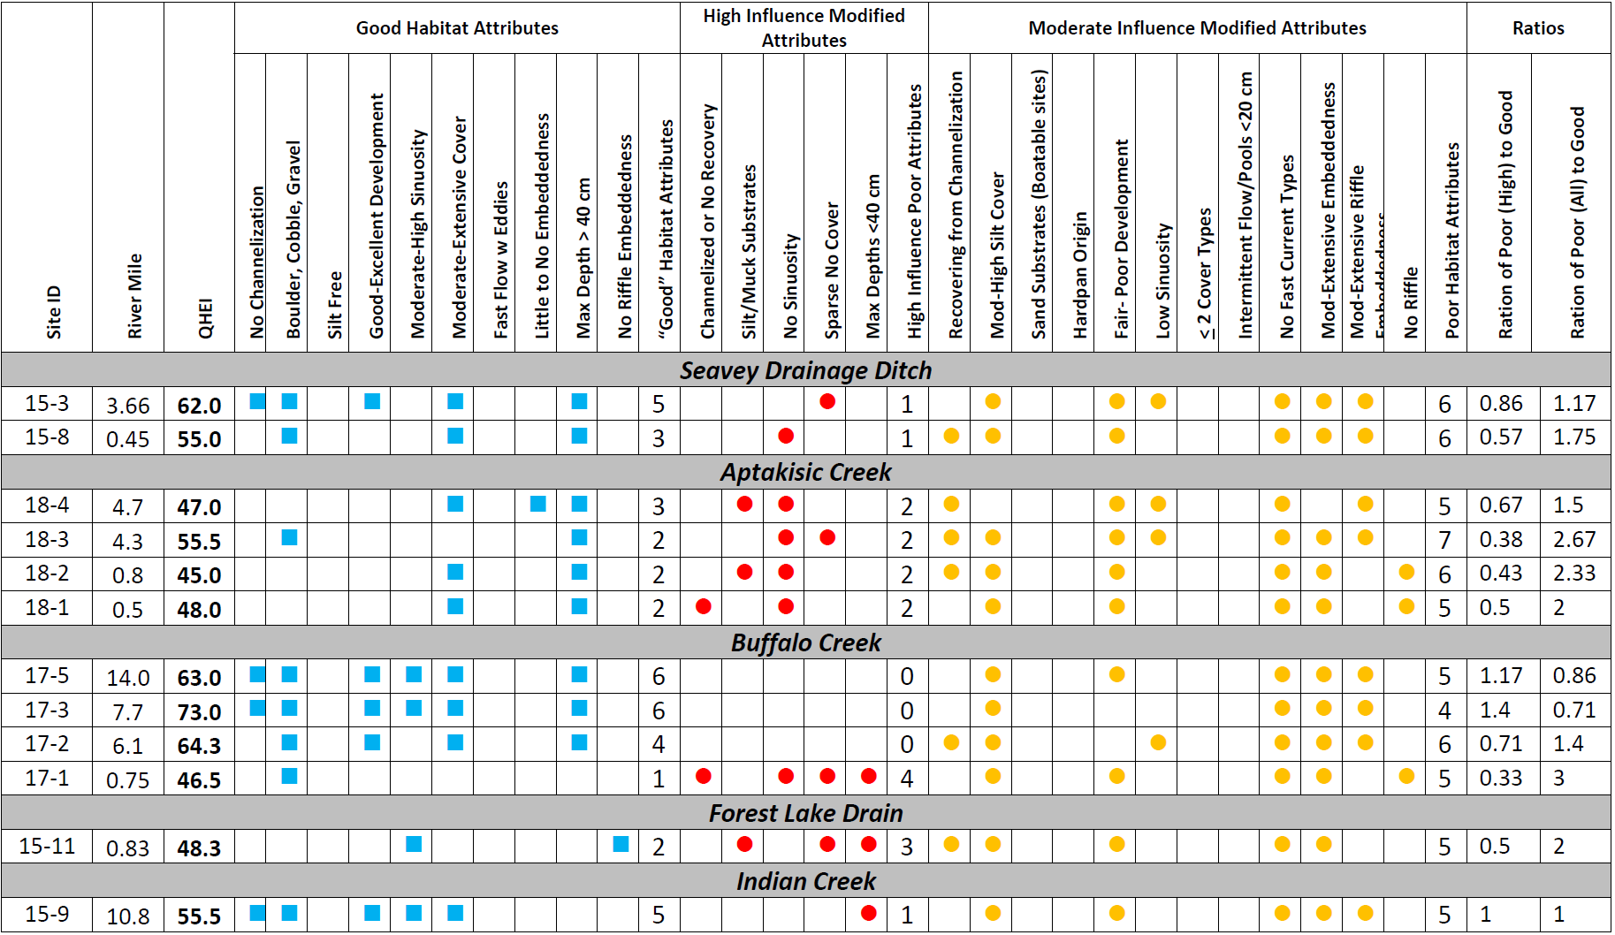

Slide 33
Illinois EPA Fish Index of Biotic Integrity
The end goal are biological assemblages that meet the State’s aquatic life use “biocriteria”

Slide 34
Illinois EPA IBI Narrative Evaluations
IL General Use Attainment Threshold

Slide 35
Notes:
Sediment results for 2009

Slide 39
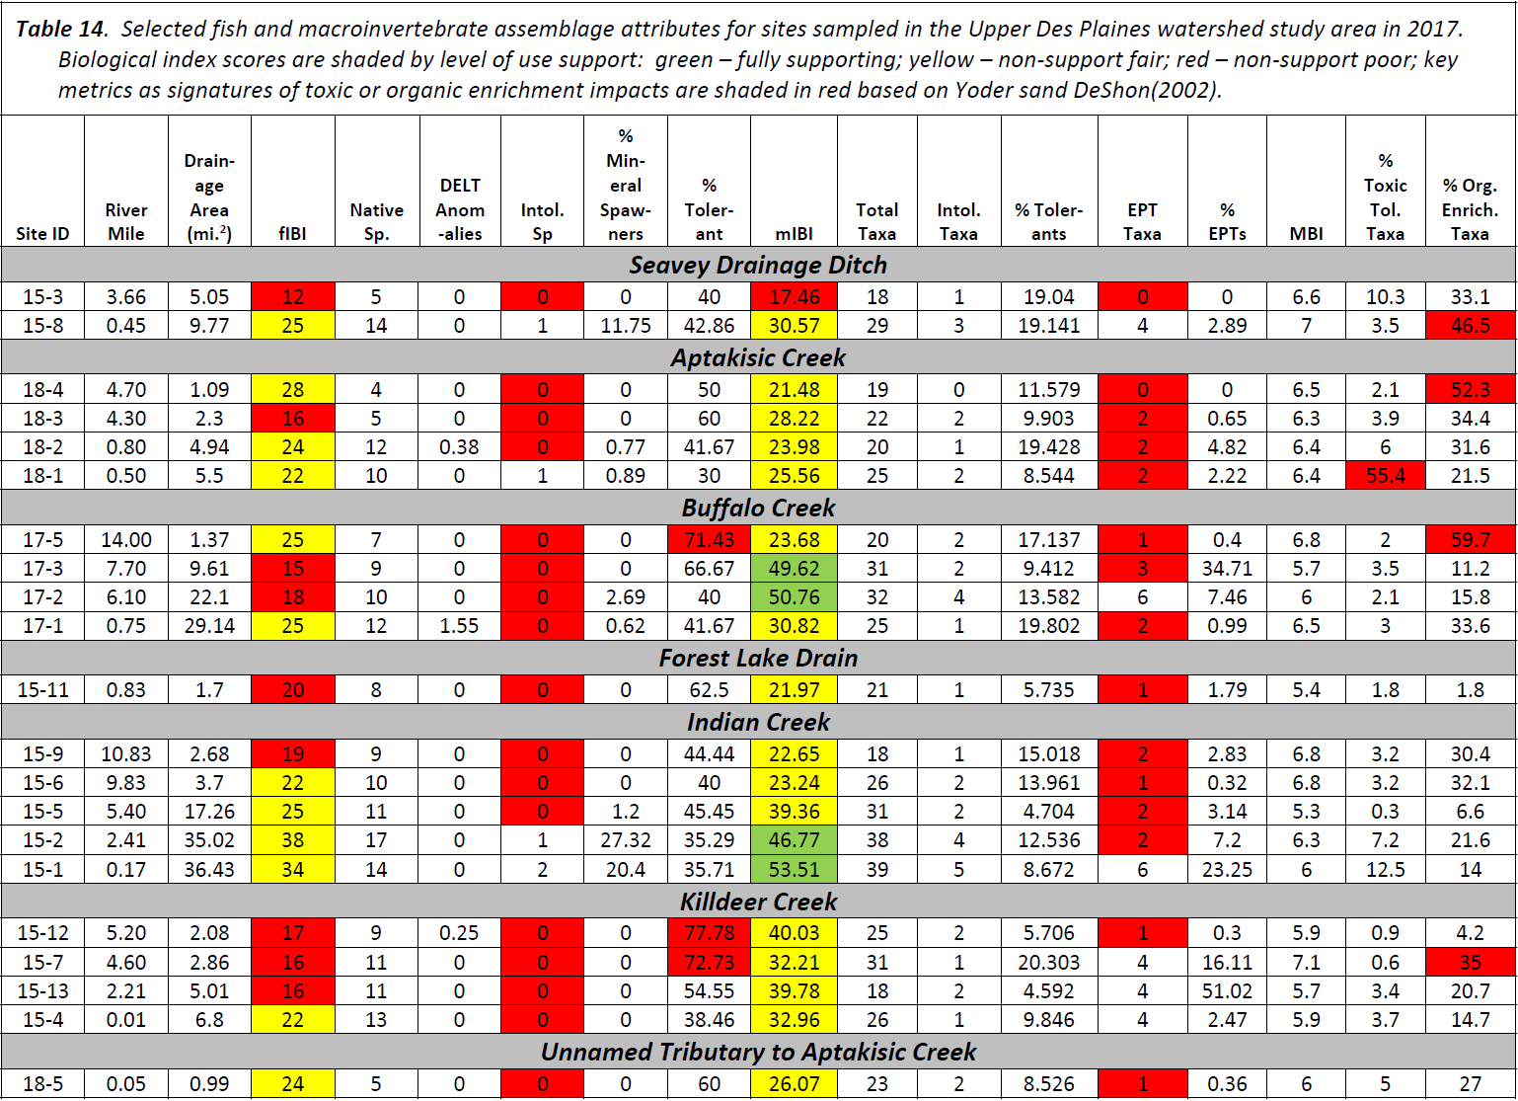
Finding Biological impairments is a first step in impaired waters listings.
A “lines-of-evidence” approach is used to assign causes & sources.

