Slide 1
History of Integrated Prioritization Systems
Ohio EPA
  Original IPS Concept Supports the Water Resource Restoration Sponsor Program (WRRSP)
    Used to prioritize and qualify WRRSP funded projects.
    Based on identified aquatic life use impairments related to habitat.
DuPage River Salt Creek Working Group IPS (DuPage Co., IL)
  Based on rotating basin surveys and includes consideration of:
    Waterbody ecological potential;
    “Restorability” of impairments revealed by monitoring and assessment;
    Effectiveness of “doable” restoration options;
    Being updated in 2016 based on lessons learned.

Slide 2
The IPS: A Stronger Scientific Basis for Setting Priorities and Decision-Making
Integrated Prioritization Systems
Identify the most limiting stressors in receiving streams based on comprehensive monitoring and assessment (M&A).
Develop a database and tools that can be queried (and applied) at the site, reach, and sub-watershed levels (HUC12).
Identify the “highest return” projects – both restoration and protection options.
Address required regulatory actions to attain WQS (e.g., NPDES, TMDLs, nutrients) while cost-effectively improving other aquatic life impairments (e.g., habitat).
DuPage Salt Creek Watershed Workgroup (DRSCW), Upper Des Plaines Watershed (DRWW), and Metropolitan Sewer District of Greater Cincinnati (MSDGC) thus far.

Slide 3
General Steps in IPS Development
IPS development
examines data at regional scale to refine thresholds for deriving restorability & susceptibility factors
Rotating
Watershed M&A
Feedback
Stressor Identification Process:
Biocriteria Impairment with Stressor Threshold Analyses
Implement Management Actions:
CSO
SSO
Stormwater
Habitat
Other
Results are made available via a “Dashboard” (ArcGIS, Power BI, etc.) with all supporting information in subsequent tabs.
Proximate Causes & Sources of Impairment Identified

Slide 4
Statistically Demonstrated
Stressor Indicators: DRSCW 2010
Parameter mIBI fIBI
  Riparian Score 5 Regression
  Riffle Score 4 3
  Channel Score Regression 10
  Substrate Score 9 Regression
  Pool Score 7 7
  Chloride 141 mg/l 112 mg/l
  TKN Regression 1.0 mg/l
  BOD₅ Regression Regression
  NH3N Regression 0.15 mg/l
Habitat
Chemical

Slide 5
What is the IPS?
Allows users to visualize and rank aquatic life use aspects of CWA water quality issues:
  Identifies designated aquatic life uses (goals) for streams and rivers.
  Identifies aquatic life impaired reaches including severity and extent.
  Identifies causes of impairment.
  A standardized approach to viewing data linked to attainment of aquatic life uses.
  Sites, reaches, and watersheds ranked by Restorability (for impaired waters) and Susceptibility & Threat (for attaining waters).

Slide 6
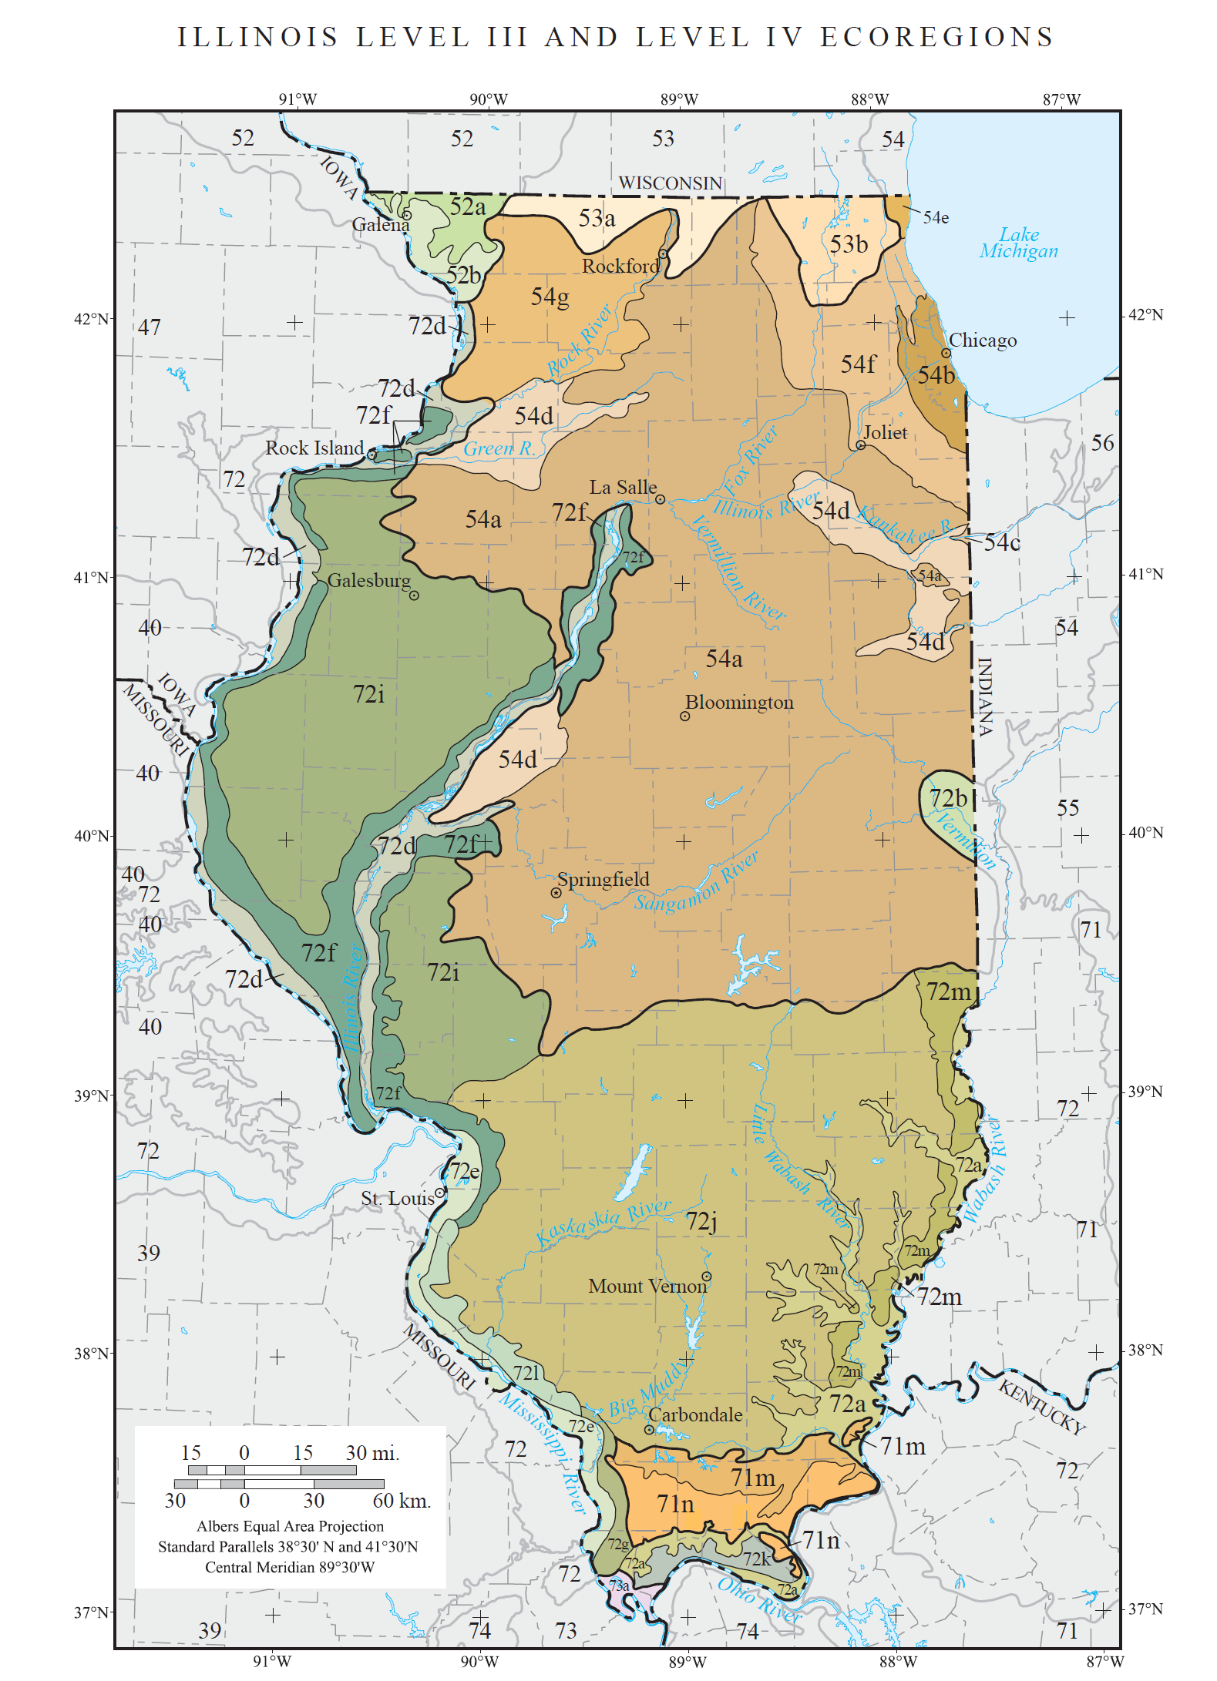
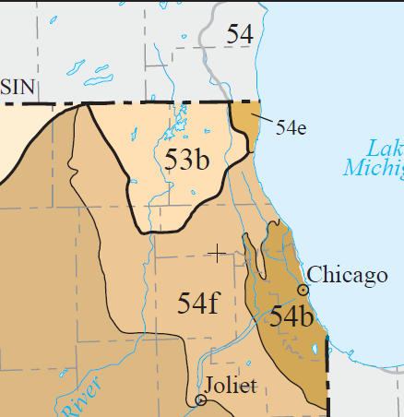
NE IL M&A and IPS Update
Monitoring initiated in 2006 (DRSCW) – first Integrated Prioritization System (IPS) in 2010 after 3 years data collection.
DRWW
M&A is ongoing – DRSCW added a 4th watershed in 2012; three new watershed groups added in 2016-17.
IEPA
NBWW
DRSCW
LDPW
POTWs required to become dues paying members by NPDES permit condition.
IEPA
IPS update and expansion across all four groups in NE Illinois in 2018.

Slide 7
DRSCW-DRWW M&A Relationship to IL EPA M&A
~5-6+ times the number of IL EPA sites per watershed – over extrapolation from single sites.
Little to no coverage of <5 mi.² by IL EPA – many unassessed streams.
Overlap in stressors mostly at categorical level – differences in specific stressors.
Minimal direct use of IL EPA data except for reference data adjacent to areas for IPS development.
IL EPA M&A support for TMDLs limited to delineation of impaired segments.
No IL biologically based stressor thresholds are available – a major IPS developmental task.

Slide 8
The derivation of regionally relevant biological effect-based thresholds is an important first step.
http://www.msdgc.org/initiatives/water_quality/index.html

Slide 9
Derivation of Stressor Benchmarks
Multiple options for stressor benchmarks:
  Water quality criteria where they exist (ammonia, dissolved oxygen).
  Regionally derived biological stressor benchmarks.
  Regional reference conditions (not effect based).
Regionally derived benchmarks provide thresholds for parameters without WQ criteria and more relevant and accurate effect thresholds for parameters with statewide or otherwise outdated criteria.

Slide 10
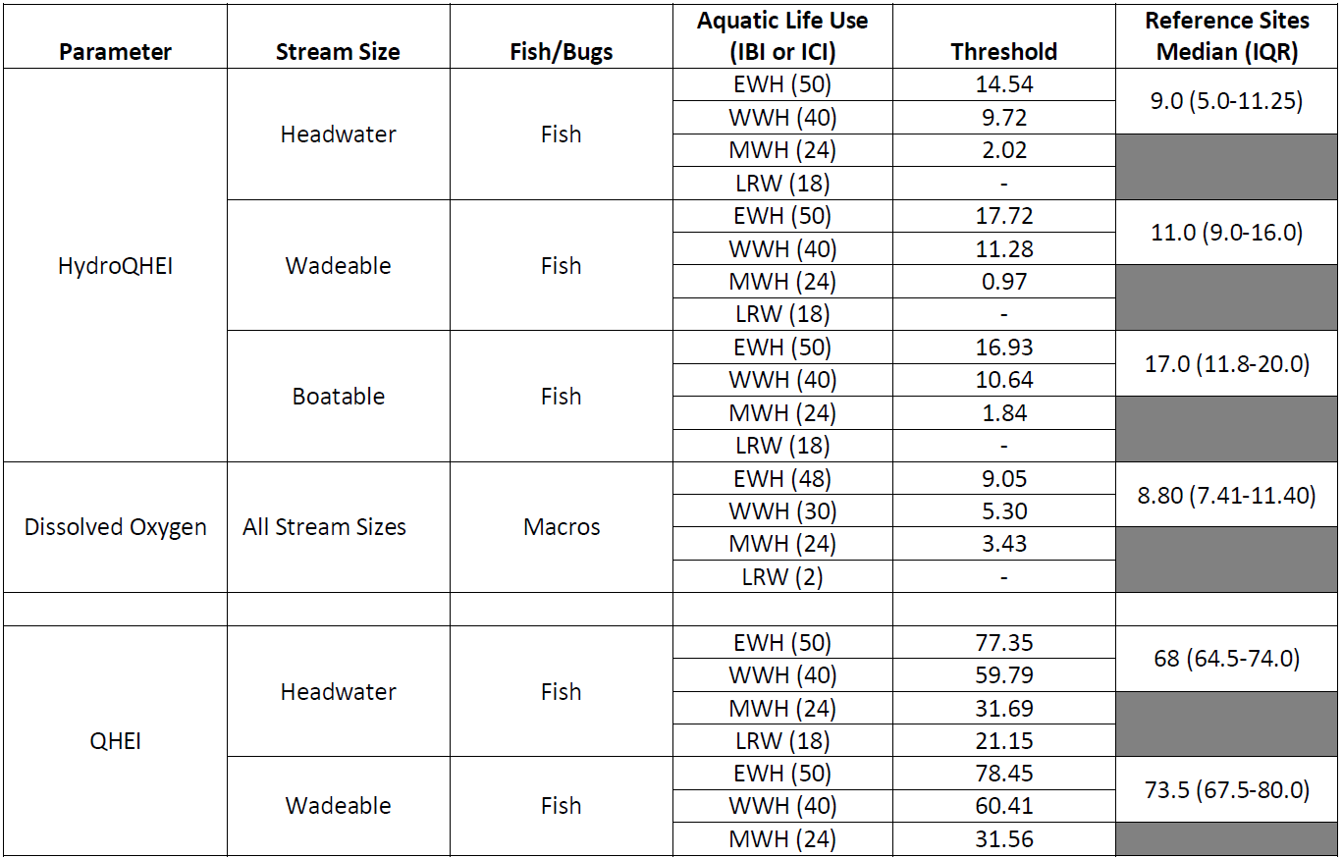
Stressor Categories | Common Indicators (Italic – Used in the IPS)
Habitat Diversity | QHEI, QHEI Channel
Bedded Sediment | QHEI Substrate Metric, QHEI Embeddedness and Silt Scores
Stream Flow Regime | Base Flow Index (LF), HydroQHEI (LF), Impervious Surface (LF/HF), Mean Sept Flows (LF)
Oxygen Demand | Minimum DO, BOD
Acid/Alkaline Conditions | pH
Dissolved Substances | Total Chloride, Conductivity, TDS
Suspended Substances | TSS
Nutrients | TP, Nitrate, TKN
Conventional Toxics | Ammonia
Metals | Copper, Zinc, Lead, Manganese
Flood Plain/Land Use Quality | QHEI Riparian, Buffer Land Use, Catchment Land Use (Heavy Urban)
MSDGC IPS Variables & Endpoints

Slide 11
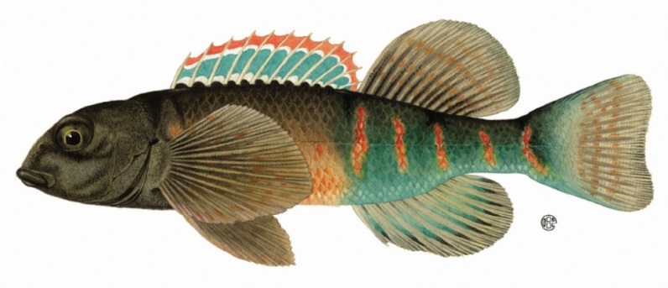
QHEI (Habitat)
Stream Size | Aq. Life Use | IBI Biocrit-eria | Ref Values Median (IQR) | Threshold Values
Headwater | EWH | 50 | 68 (64.5-74.0) | 77.35
 | WWH | 40 |  | 59.79
 | MWH | 24 |  | 31.69
 | V. Poor | 18 |  | 21.15
Wadeable | EWH | 50 | 73.5 (67.5-80.0) | 78.45
 | WWH | 40 |  | 60.41
 | MWH | 24 |  | 31.56
 | V. Poor | 18 |  | 20.74
Boatable | EWH | 48 | 83.5 (77.25-84.75) | 76.65
 | WWH | 38 |  | 60.06
 | MWH | 24 |  | 36.83
 | V. Poor | 18 |  | 26.88
QHEI Stressor
Rank:
10
4
2
0

Slide 12
Stressor and Response Variables are then Normalized to the Same Scale
Stressor Rank Guide
Narrative Description | Aquatic Life Use Equivalent | Numeric Range
Excellent | Exceptional Warmwater Habitat (EWH) | 0-2
Good | Warmwater Habitat (WWH) | 2-4
Fair | Modified Warmwater Habitat (MWH) | 4-6
Poor | Limited Resource Water (LRW) | 6-8
Very Poor | Never Acceptable | 8-10

Slide 13
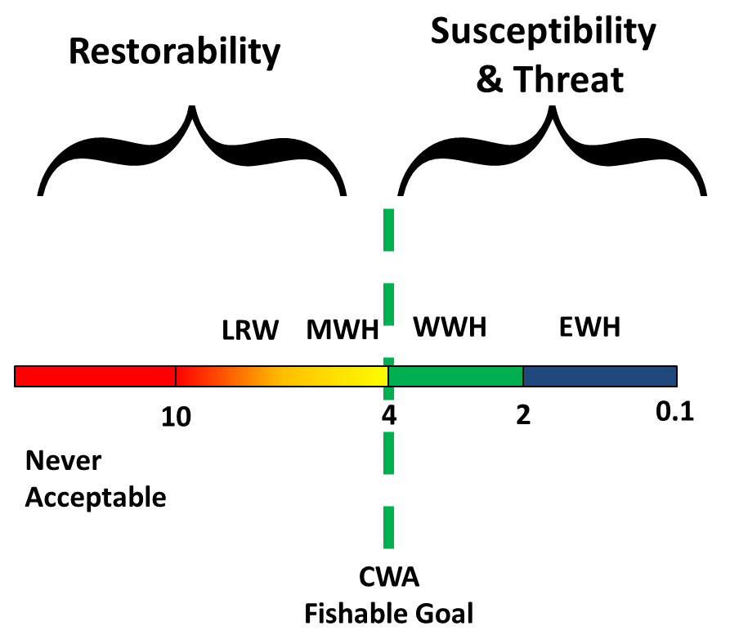
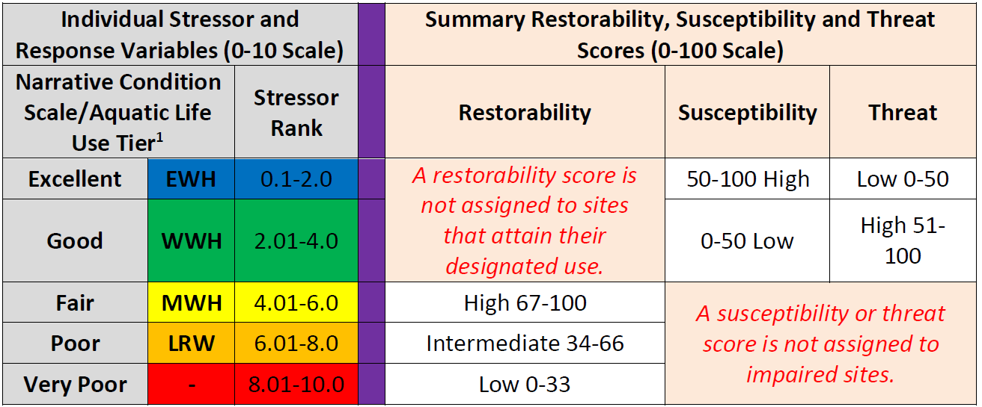
Principal IPS Outputs

Slide 14
Restorability or Susceptibility/Threat Scores at Each Site, Reach, & Huc 12
Individual Stressor and Response Variables (0-10 Scale) |  |  |  | Summary Restorability, Susceptibility and Threat Scores (0-100 Scale)
Narrative Condition Scale/Aquatic Life Use Tier¹ |  | Stressor Rank |  | Restorability | Susceptibility | Threat
Excellent | EWH | 0.1-2.0 |  | A restorability score is not assigned to sites that attain their designated use. | 50-100 High | Low 0-50
Good | WWH | 2.01-4.0 |  |  | 0-50 Low | High 51-100
Fair | MWH | 4.01-6.0 |  | High 67-100 | A susceptibility or threat score is not assigned to impaired sites.
Poor | LRW | 6.01-8.0 |  | Intermediate 34-66
Very Poor | - | 8.01-10.0 |  | Low 0-33
Since Illinois lacks a TALU structure in their WQS we will need to develop and apply an equivalent structure within the NE Illinois IPS . . .

Slide 15
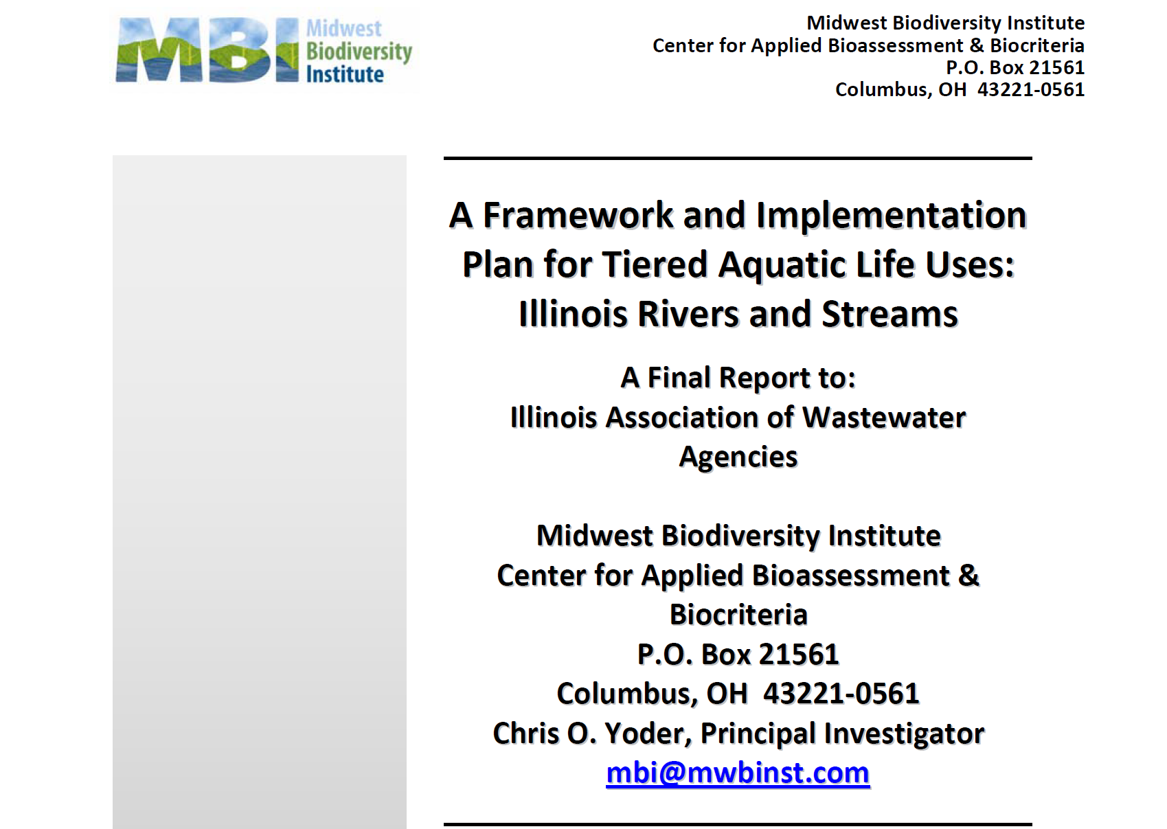
. . . we could use the IAWA sponsored effort to add tiered aquatic life uses to the Illinois WQS (2012) as a template.

Slide 16
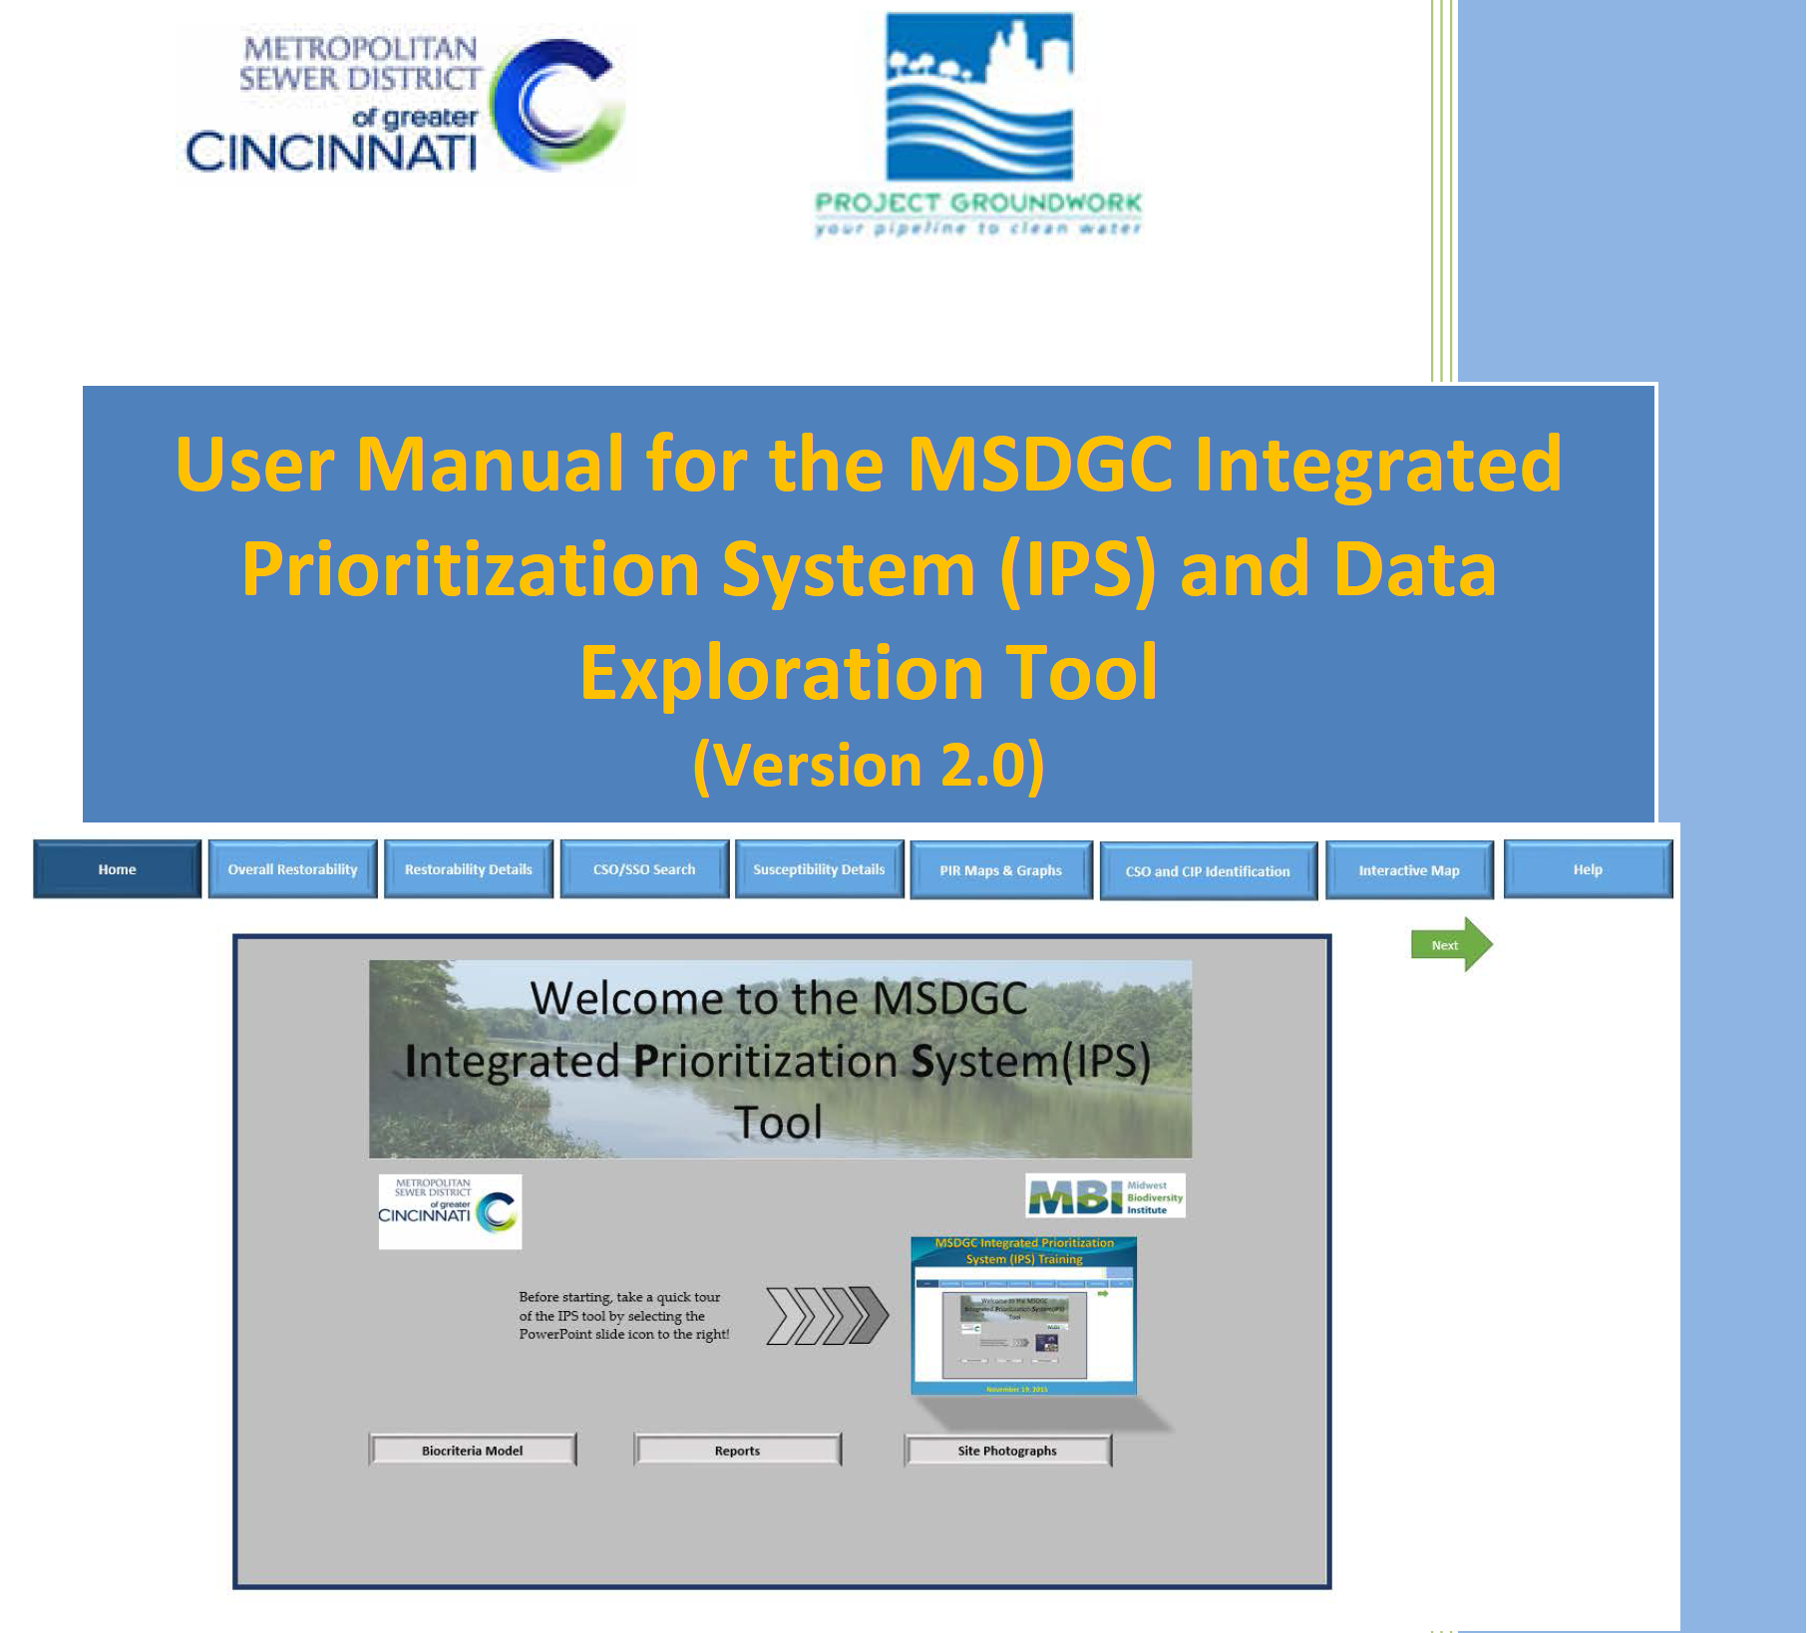
IPS Dashboard
A watershed-based GIS platform for Lake County already exists – adding IPS results and information seems feasible.

